Slide 1
About Care Opinion
#COconf21
Sarah Ashurst
Associate Director of Subscriber Services

Slide 2
Careopinion.org.uk
Care Opinion is a place where people can share their experiences of health or care services
At Care Opinion we make it safe and simple to share stories of care online and for people to see other stories too. The public, services and regulators can see how stories are leading to change.
We think that by sharing honest experiences of care, we learn to see the world differently. Working together, we can all help make care better. As a social enterprise, this is very important to us.
https://vimeo.com/215724873

Slide 3
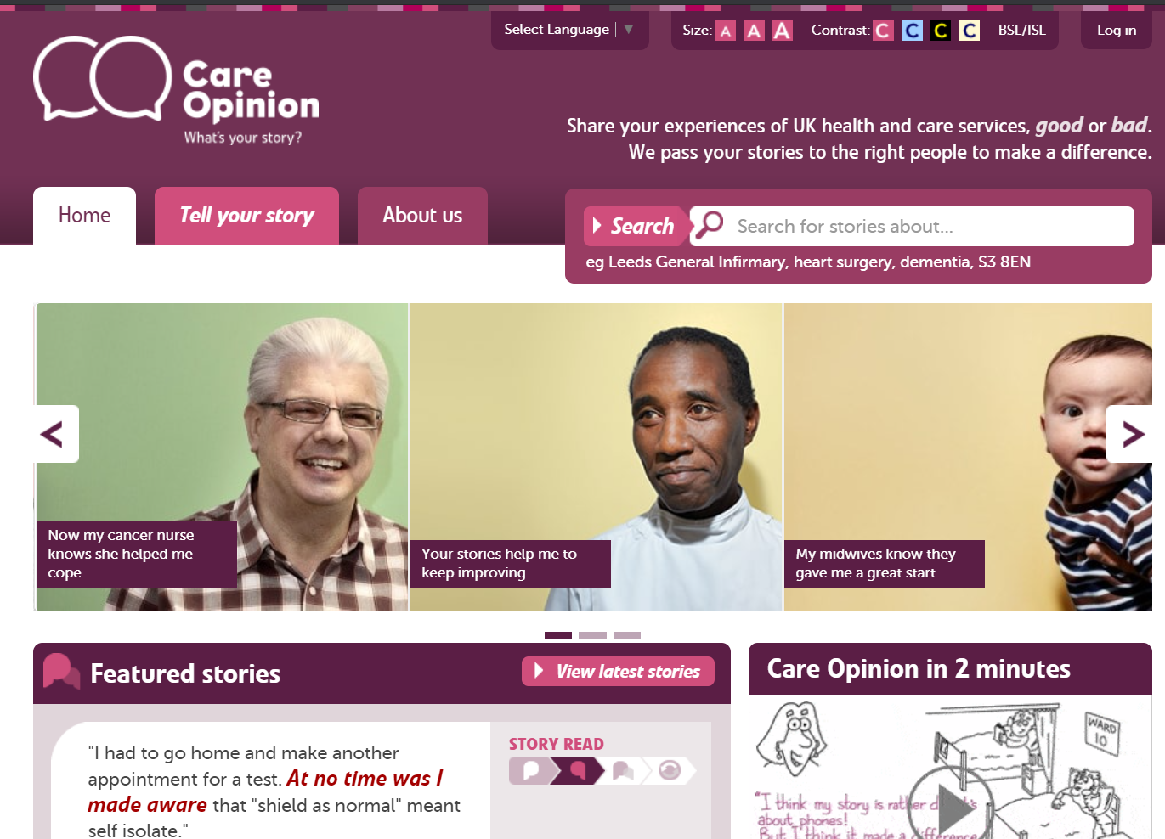

Slide 4
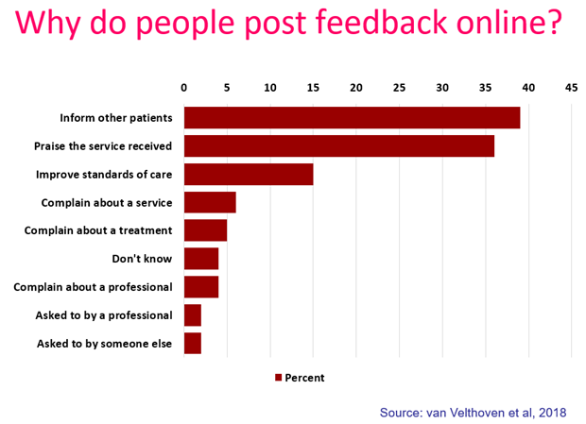
“To give people a chance to read what I went through and maybe give them some hope.”
“It was a difficult time for me to go through and Care Opinion allowed me to control the speed
and words rather than be rushed through Q&As or tick box scenario where things don't quite fit.”
“To highlight the problem without making a formal complaint and to thank the staff for excellent care”
“People need to know how valuable this care is”

Slide 5
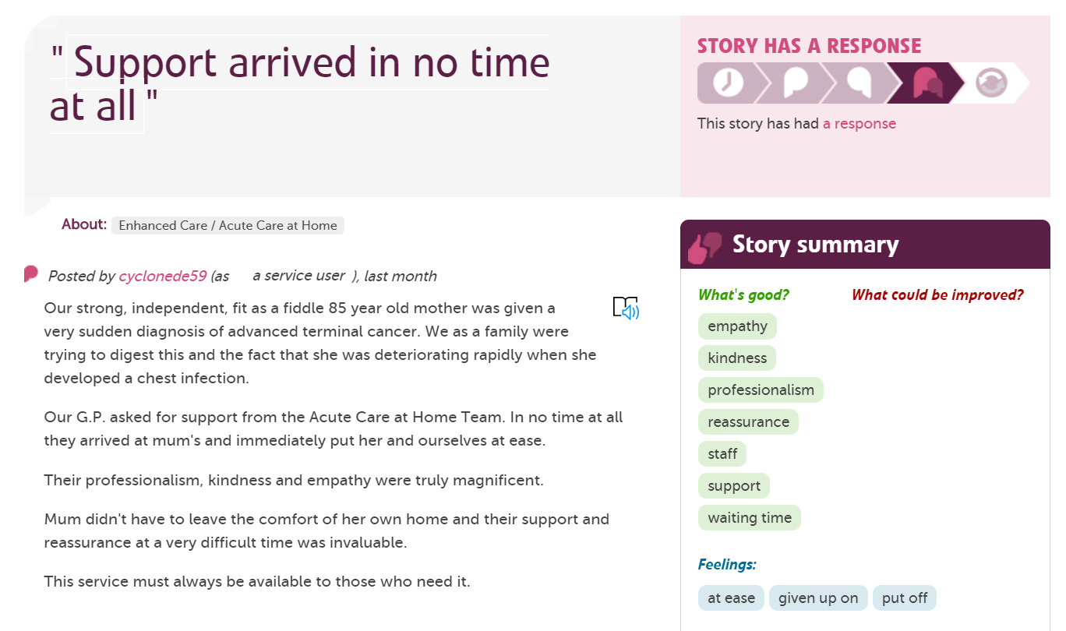
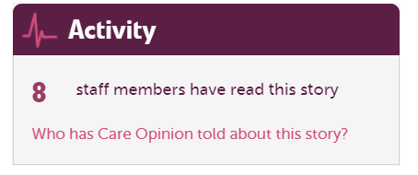
Tags are added by the author to show key themes
Stories by the same person are linked by a username
See which organisations are reading feedback

Slide 6
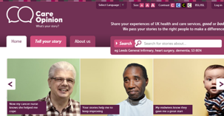
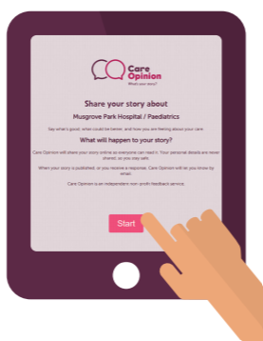
Ways to share a story with Care Opinion
Online careopinion.org.uk or careopinion.ie
Freephone 0800 122 3135 (UK only)
Freepost leaflets
Via a Kiosk link
From a an invitation link
With support from Volunteers
Using picture tiles
All stories are subject to moderation and are uploaded to the website

Slide 7
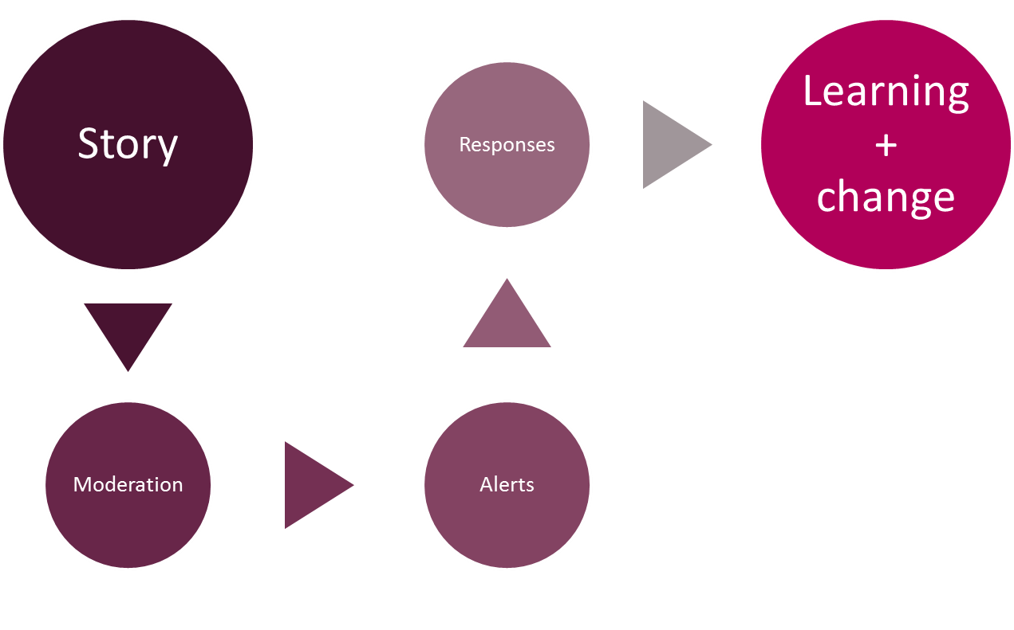
Stories – it’s about the conversation

Slide 8
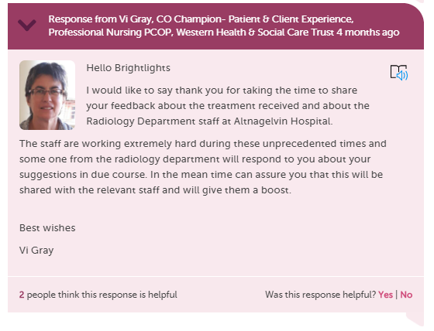
When responding as a member of staff to a story you can…
Respond more than once
Have multiple people respond
Show you are making a change
Include a profile picture
Add links and images
Invite the author to reply to you

Slide 9
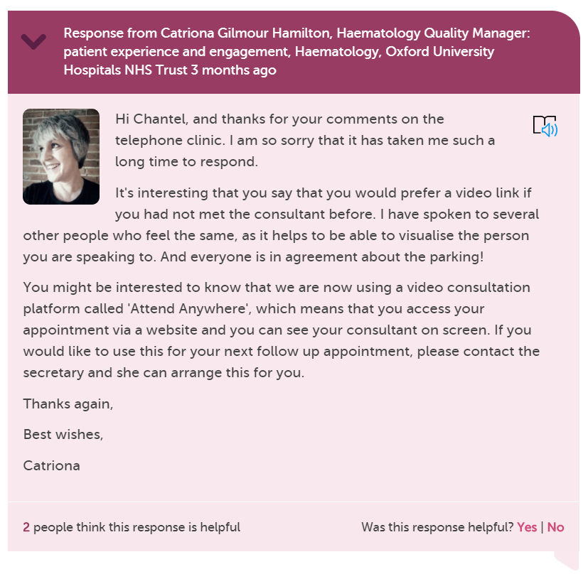

Slide 10
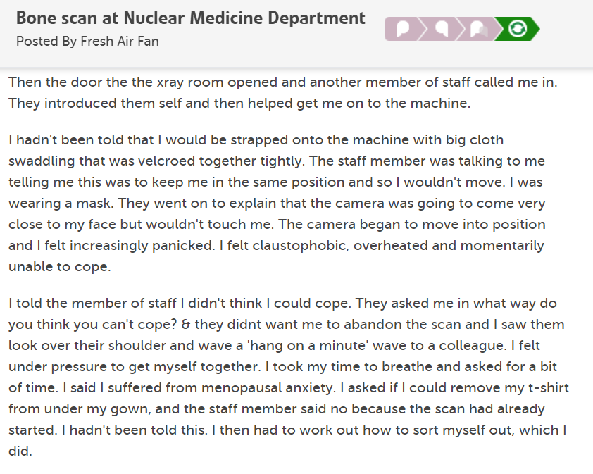
Notes:
https://www.careopinion.org.uk/792233

Slide 11
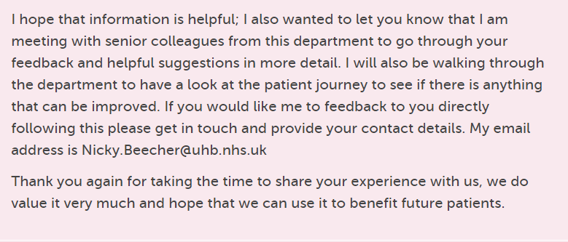
Initial responses from people in the department about what should have happened and offering follow up, ending with….
Notes:
https://www.careopinion.org.uk/792233

Slide 12
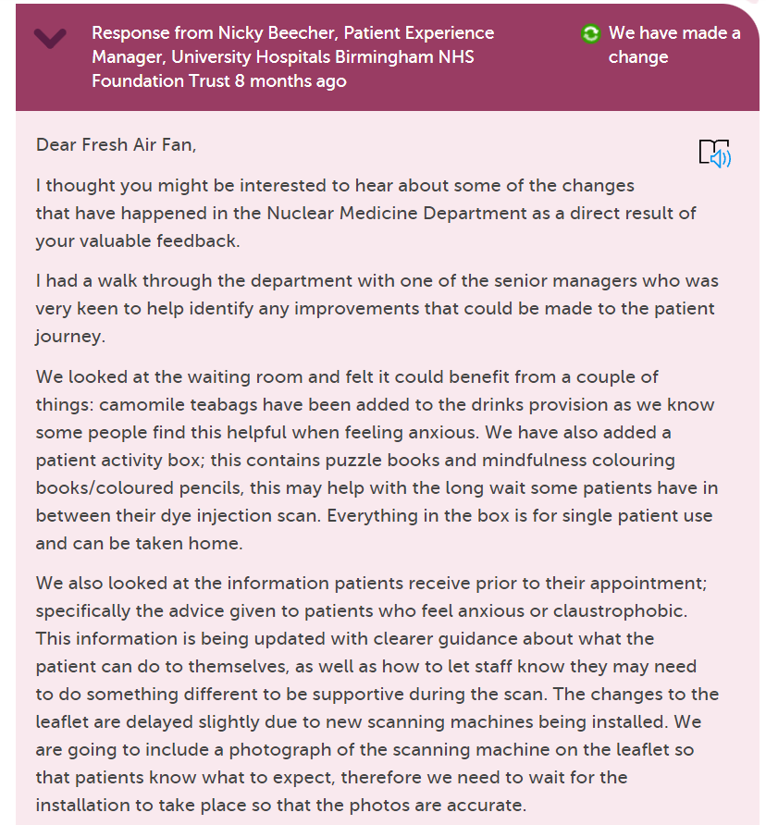
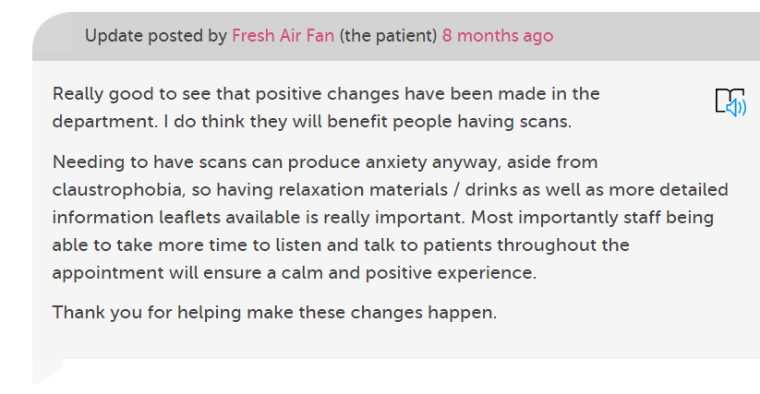
Several changes made from a walk through

Slide 13
Accessibility

Slide 15
BSL and ISL videos explaining the website and how to share a story
Notes:
https://www.careopinion.org.uk/info/signed-videos

Slide 16
Reading stories
Use this symbol on every site page, story and response to;
have the story read out to you
change fonts/text size/text and background colours
Change language (google translate)
see symbols to explain words
See grammar help

Slide 17
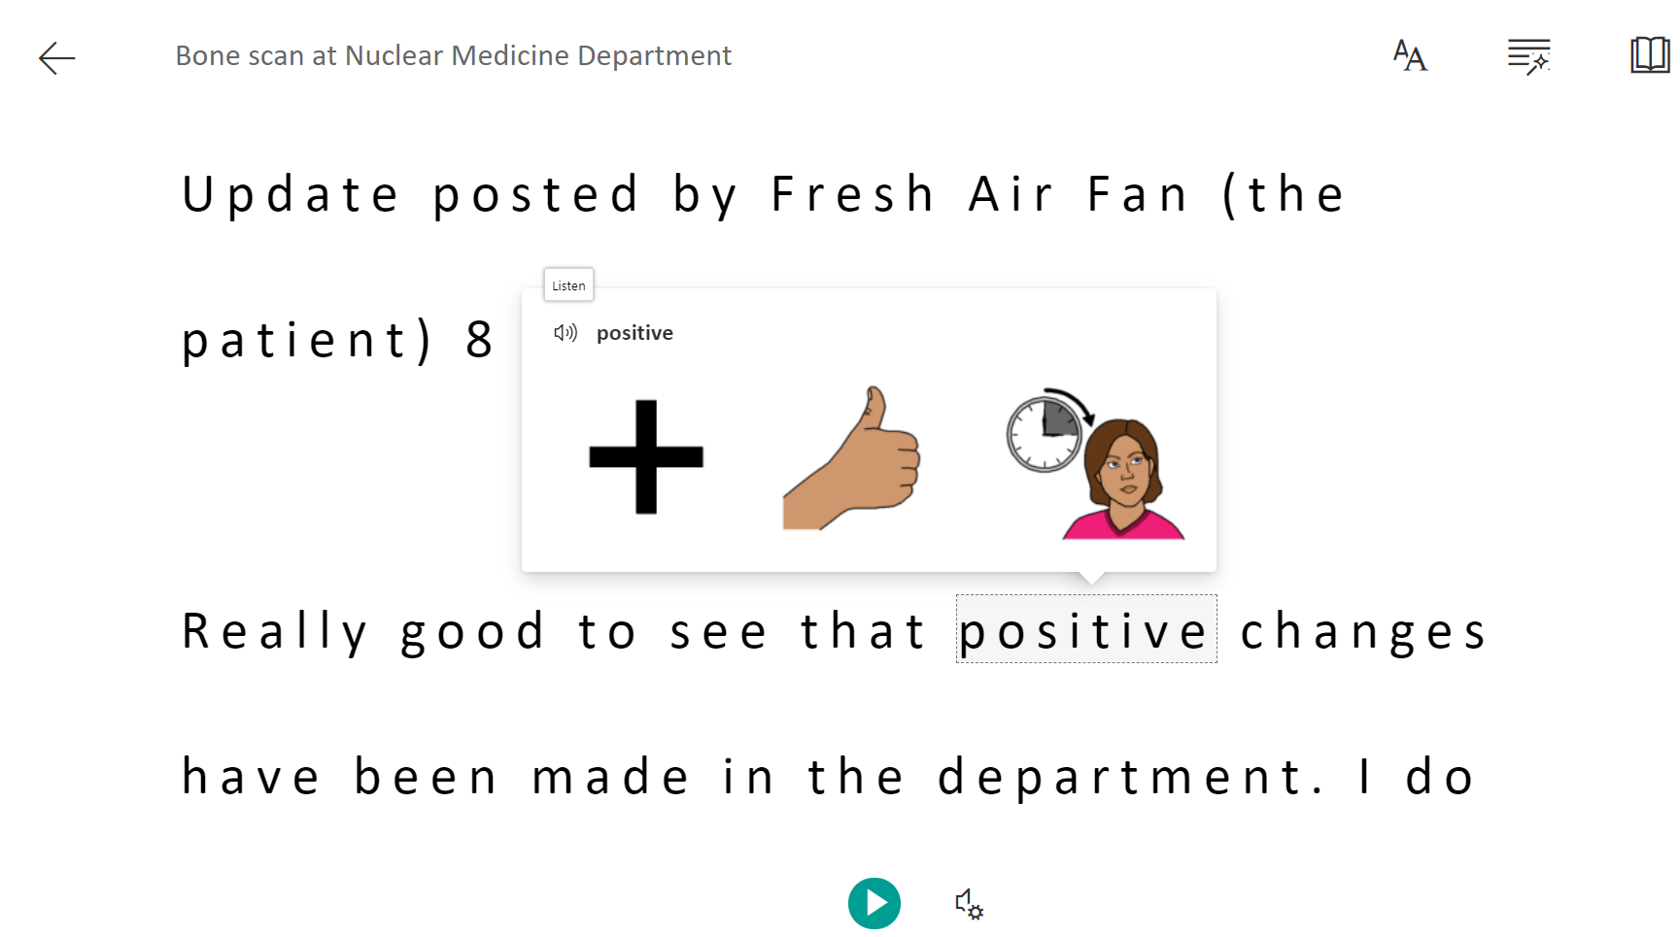
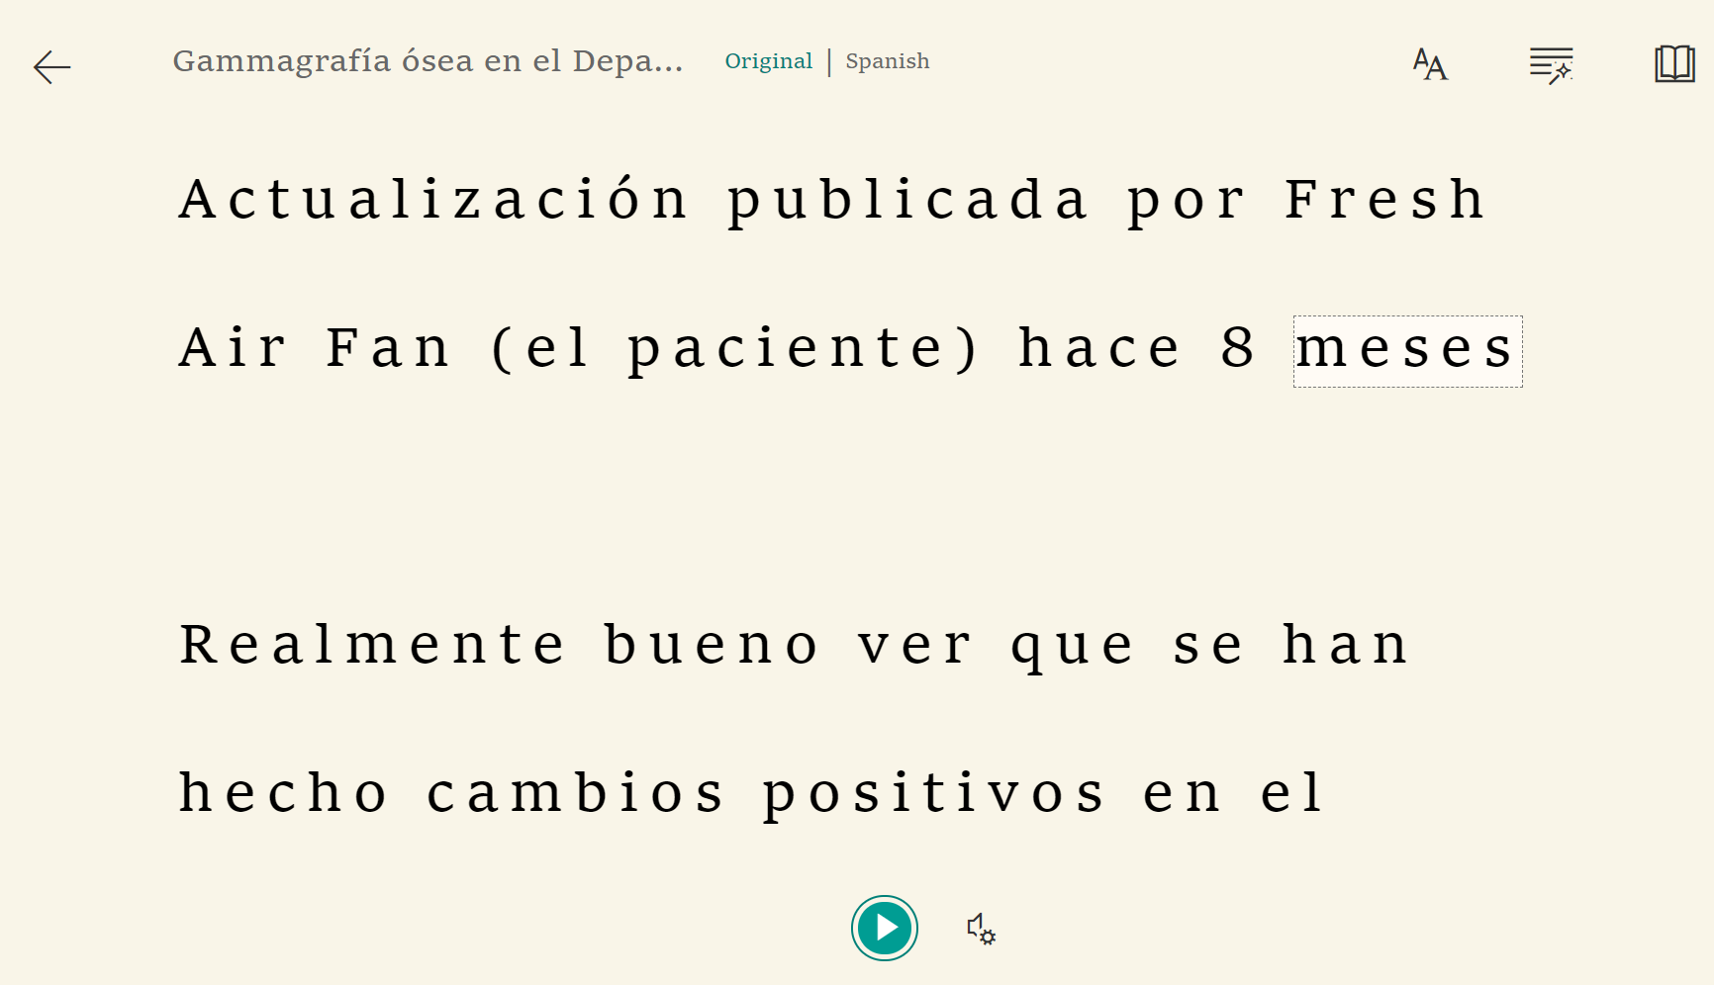
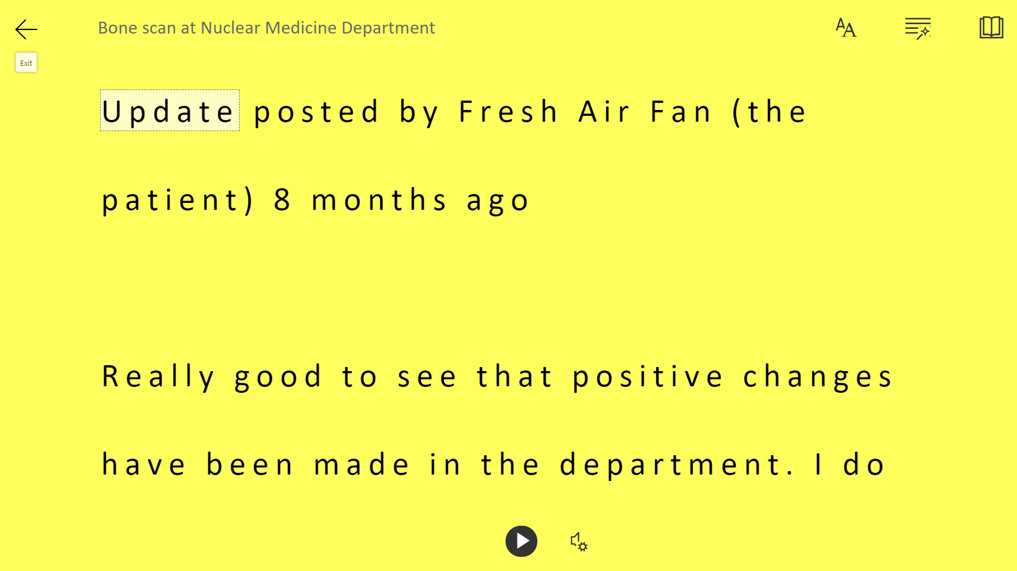

Slide 18
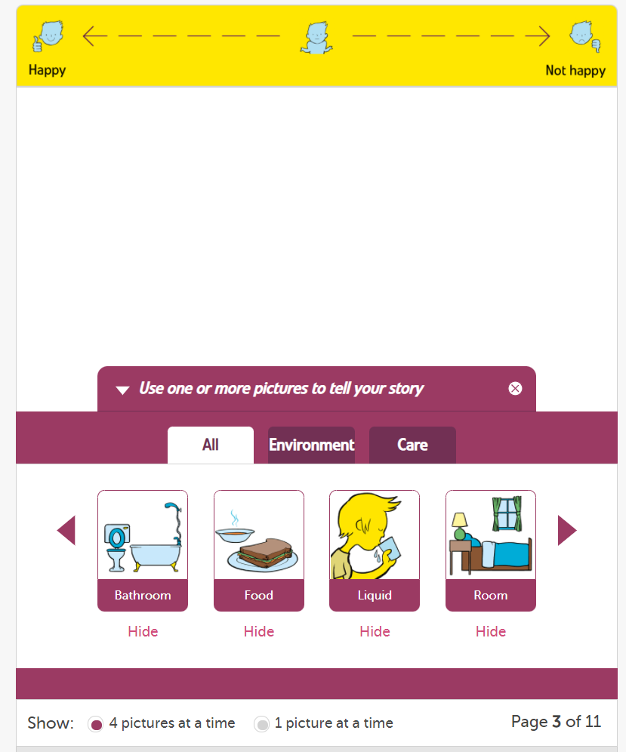
Share your story with pictures and text

Slide 19
Site features for staff

Slide 20
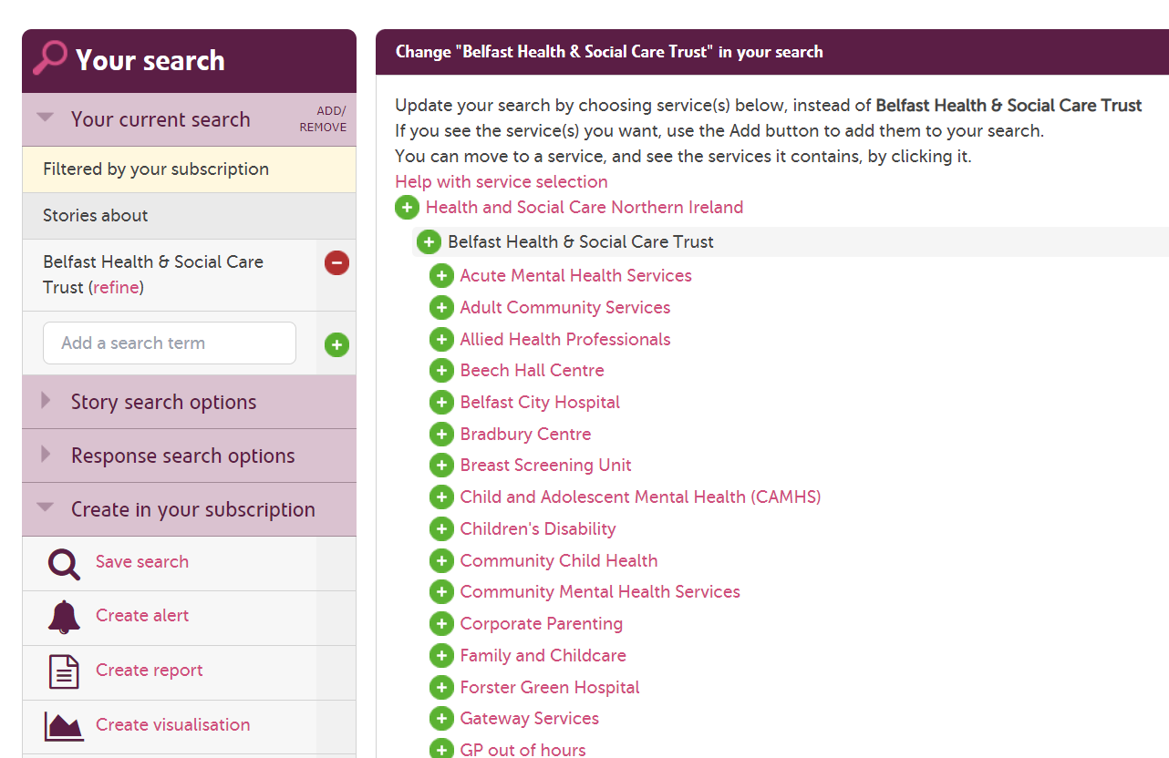
Filtering stories for alerts and reports

Slide 21
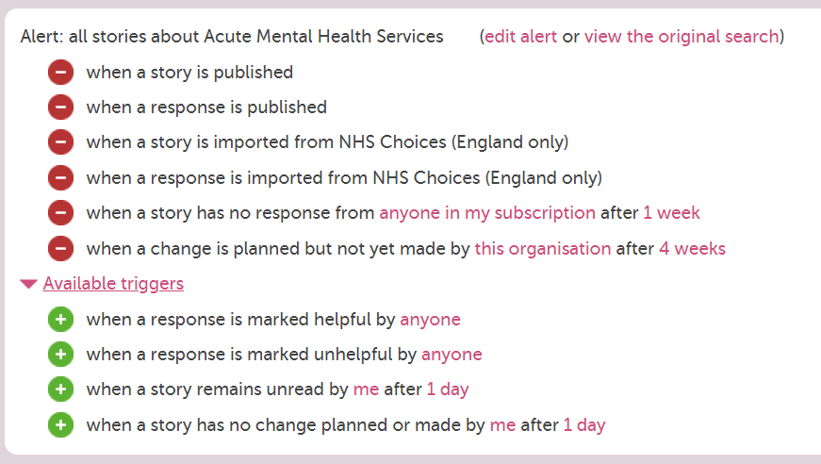
Smart alerting

Slide 22
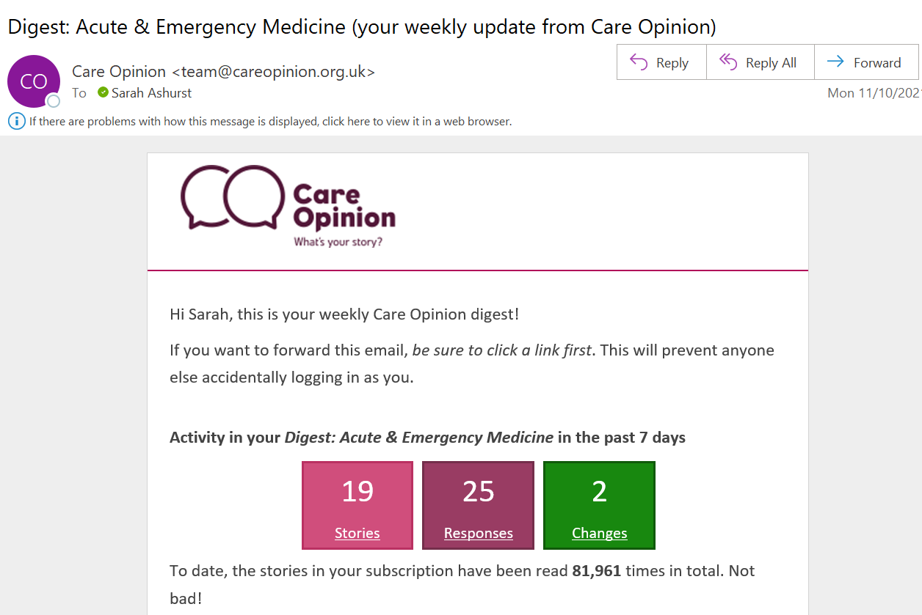
Weekly digests

Slide 23
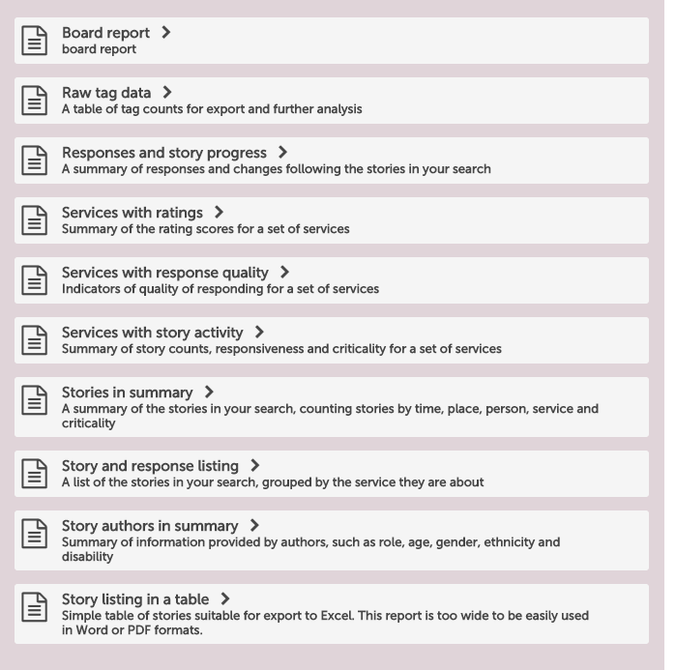
Reporting

Slide 24
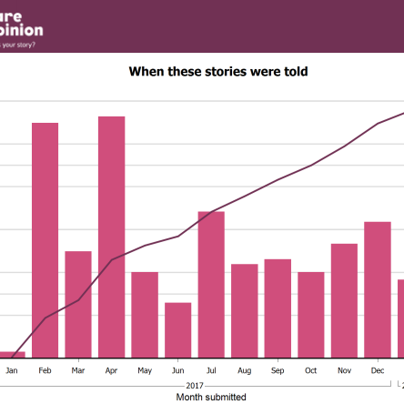
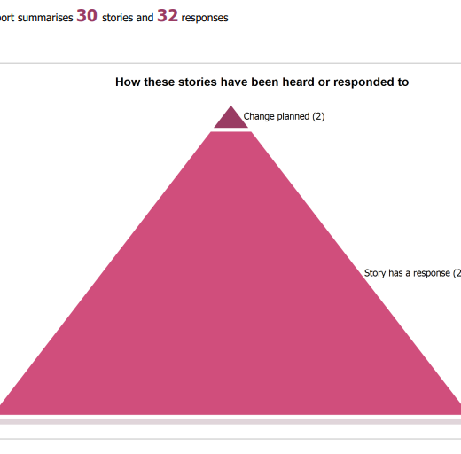
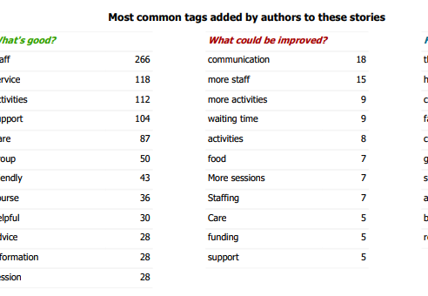
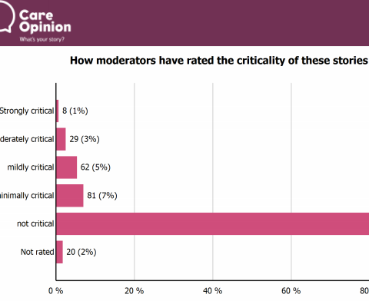
Beyond responding, to individual stories, you can create reports on stories and replies.
Using online feedback in QI projects, workshops and staff training means authors only share their story once but it can have a huge reach and impact.
Don’t forget to tell them.
Notes:
Screenshot from stories in summary report

Slide 25
Introducing invitation links

Slide 26
New feature: Invitation Links
The simplest way to invite people to share their experiences on Care Opinion is just to provide a link to the site.
Another way is to make an "invitation link“ and provide that instead.
What does an invitation link do?
An invitation link allows you to:
customise various aspects of our story-telling workflow
easily access widget codes, kiosk links or QR codes to share with people using services
keep track of which stories came via which invitation links

Slide 27
What does an invitation link look like…
A link to share feedback using the tell your story work flow: https://www.careopinion.org.uk/49/Paediatrics-Major-Trauma-Team (This can be a QR code)
A kiosk link to share feedback : https://www.careopinion.org.uk/49/Paediatrics-Major-Trauma-Team/kiosk (This can be a QR code)
A widget code:
<iframe src="https://www.careopinion.org.uk/49/Paediatrics-Major-Trauma-Team/widget" width="400" height="600" allowTransparency="true" frameborder="0"></iframe>
(This embeds the story telling process on your website)

Slide 28
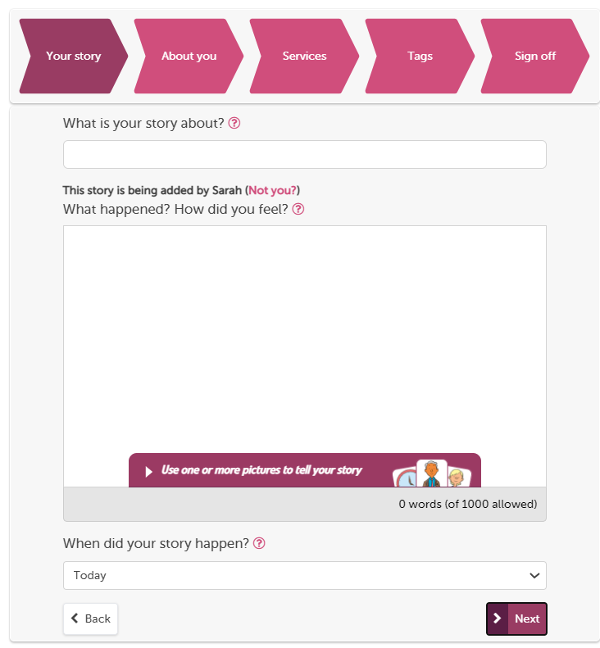
The “tell your story” workflow is our full process on the website
You can use pictures
Give what was good/could be improved tags
Provide optional demographic information, FFT and ratings.
Tag story to multiple providers
Formatted to work on mobile devices

Slide 29
The “kiosk workflow” turns mobiles and tablets into a handheld kiosk
Linked to one service
Author cannot add what was good and what could be improved tags
No option to add demographic information and ratings
Author is not logged in. Safe to pass to another user.
Tablet can be locked to this page
Still needs to be on the internet
FFT rating can be added in

Slide 30
What are the pros of using an invitation link
With an invitation link you can customise the “tell your story” workflow, or direct people to the "kiosk workflow".
Your invitation link can:
make sure a specific health/care service is pre-selected
add specific tags to new stories
after a story is told, invite the author to visit your own survey or consultation too
For English services you can add the FFT question to the kiosk work flow
Track stories relating to a specific topic by using subscriber tagging

Slide 31
What are the pros of using an invitation link
With an invitation link you can customise the “tell your story” workflow, or direct people to the "kiosk workflow".
Your invitation link can:
make sure a specific health/care service is pre-selected
add specific tags to new stories
after a story is told, invite the author to visit your own survey or consultation too
For English services you can add the FFT question to the kiosk work flow
Track stories relating to a specific topic by using subscriber tagging

Slide 32
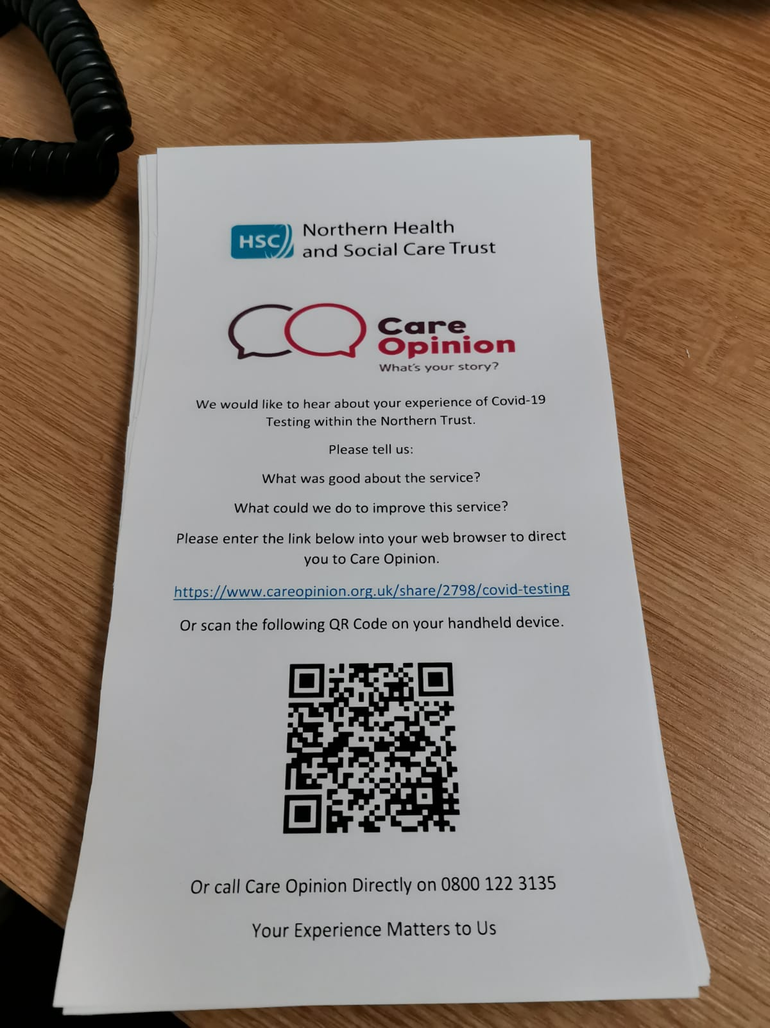
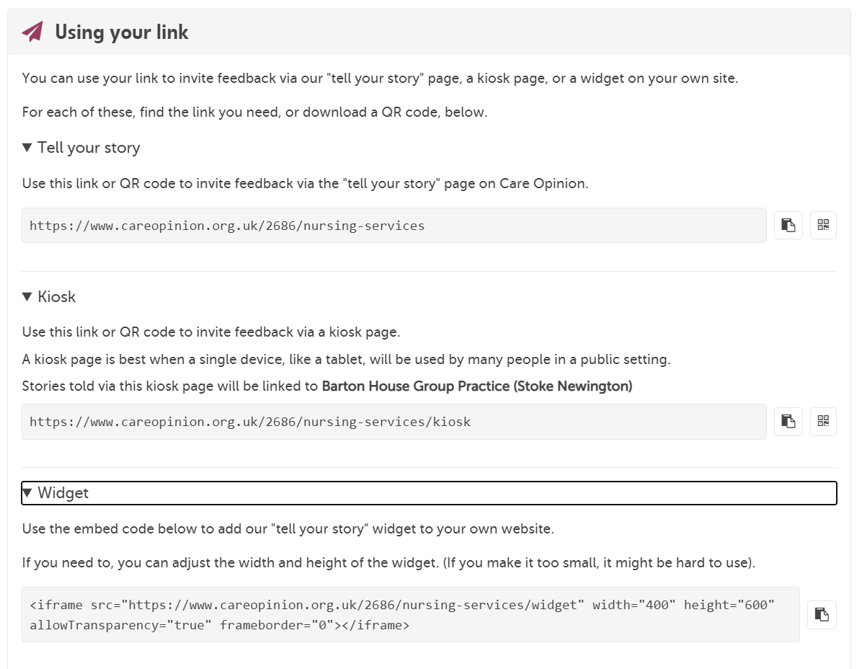
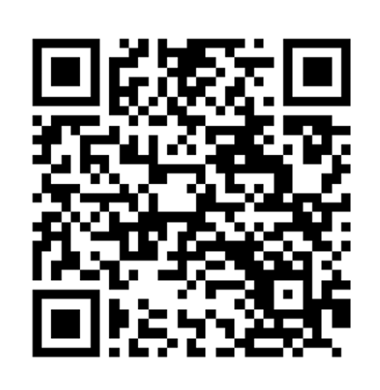
Create QR code
Copy link

Slide 33
#COconf21
Thank
you
Sarah Ashurst
Associate Director of Subscriber Services
Ssarah.ashurst@carepinion.org.uk

Slide 34
For more information on this session or any of the sessions today email info@careopinion.org.uk
The next session is…
Feedback during the pandemic – what’s changed, what can we learn and how can we use this to plan for the future? at 10.30am

