Slide 1
Next stage of Online User Feedback Service
in Northern Ireland
Linda Craig:
Regional Lead for Regional PCE Programme, PHA

Slide 2
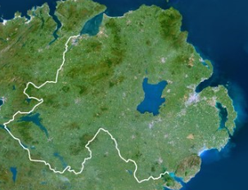
 Priorities for 2023/2024
Supporting the voices of people in NI who are ‘seldom asked’
Notes:
People with cognitive impairment – Learning Disability, Dementia
Deaf community - Sign Language
English not first language

Slide 3
 The Plan
Two focus areas:
How is the promotion material designed to be accessible?
What processes can ensure the service is accessible to the population of NI?
Notes:
Timescales – Impact a whole system at the same time
Ref: Pandemic – launched following the first wave of COVID 19 Pandemic – people needed a mechanism to share experience – a timely opportunity from COVID

Slide 4
 Empowering people with Cognitive Impairment
Promotion:
Co Design of promotional material supported by NIPEC and TILII (Easy read translation service led by group of people with Learning Disability)
Supported promotion within Care Home setting and Learning Disability groups

Slide 6
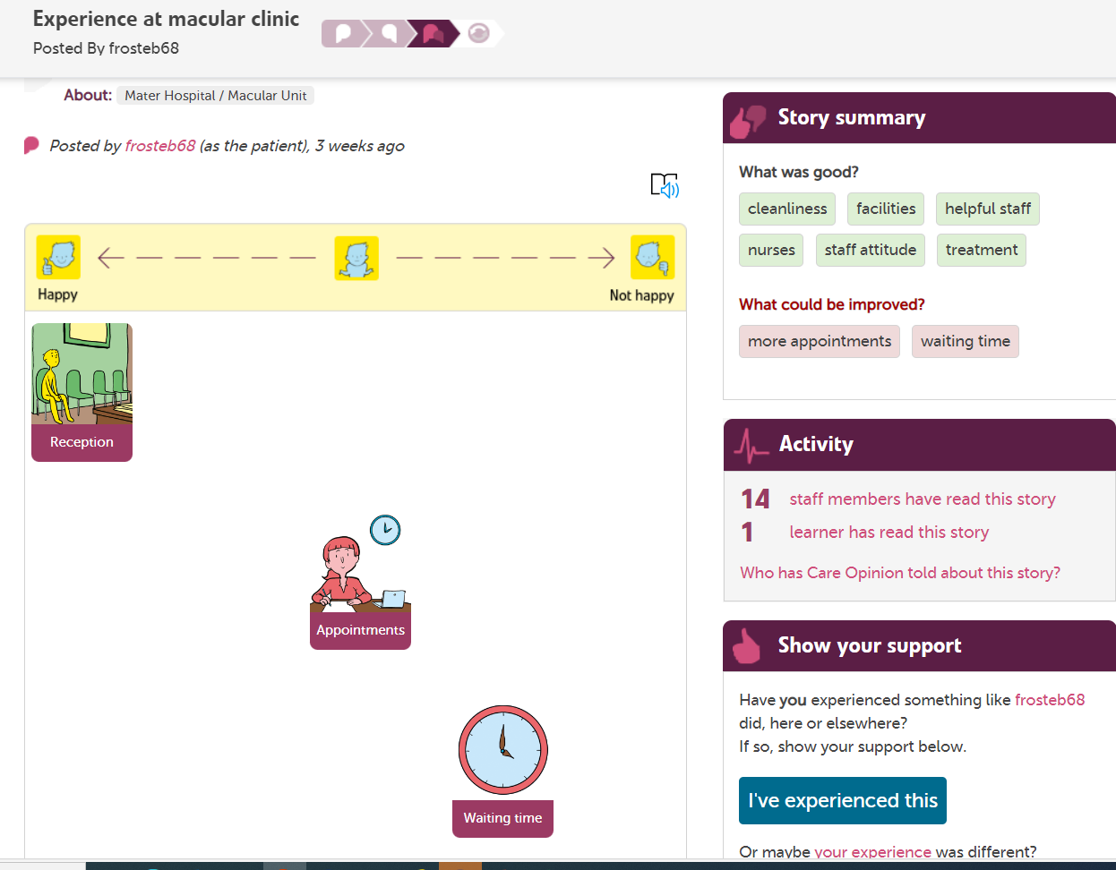
 Empowering people with Cognitive Impairment
Process:
Building upon Picture Tiles within the platform, extended the skill set of trust facilitators to use “Talking Mats” model to enable someone to share their story through pictures
Completion of Communication Access UK Modules

Slide 7
 Empowering people with Cognitive Impairment
Next Step:
Create a programme of activity to actively sit alongside people to share their experiences through picture tiles where required
Currently 130 stories captured through picture tiles but definitely more to be done….
Also need to explore how the response can be effectively shared in picture tiles

Slide 8
 Empowering Sign Language users
Process
Engagement with all stakeholders in design of a process to support sign language users to share their story in their language and receive a response which is accessible
Key stakeholders identified within deaf community with support of BDA
Process was shaped around what mattered to deaf community

Slide 9
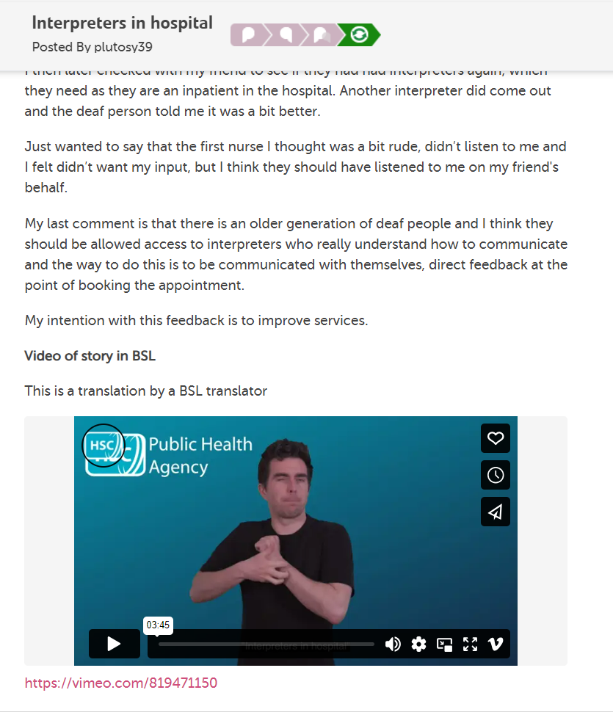

Slide 10
 Empowering Sign Language users
Promotion
In collaboration with BDA and a willing group of sign language users developed script and role pay to demonstrate how the process works
Next Steps
Communicate widely to the deaf community the opportunity through Care Opinion in collaboration with Sign Video
Generate trust in the process through learning and change at all levels of the system

Slide 11
 Empowering people to share their story in their language
Promotion:
Creating promotion material in the top 15 languages in UK and testing how the platform communicates through browser translations
Promotion material to be shared through a regional campaign for School Nurses, providing resources in the languages identified within the locality

Slide 12
 Empowering people to share their story in their language
Process:
Process piloted locally within Ukranian Refugee service in one trust with support of a local translator
Next Step:
Scale and spread across all organisations, building opportunities to engage with people through translators and promoting the opportunity
Understand how a response can be effective, when communicating in the authors language

Slide 13
“…Hear the patient voice at every level – even when that voice is a whisper…”
Don Berwick
August 2013

Slide 14
 Lessons moving forward
Engagement is key
Building Trust/Relationships
Shared Purpose
Open, honest Communication
Challenging Assumptions
It is our job to ask the question in the right way and empower people to share their stories to effect every level of the system

Slide 15
For more information contact:
Linda Craig:
Regional Lead for Regional PCE Programme, PHA
 Linda.craig3@hscni.net

