Slide 1


How to Respond to People's
Stories

Slide 2
In this session, we’ll help you...
Learn how to respond using the Care Opinion site
Think about what the author might want from a response
Understand what makes a good response
Get impact from your feedback - and show it
Think strategically about responding and how it can create change in services

Slide 3
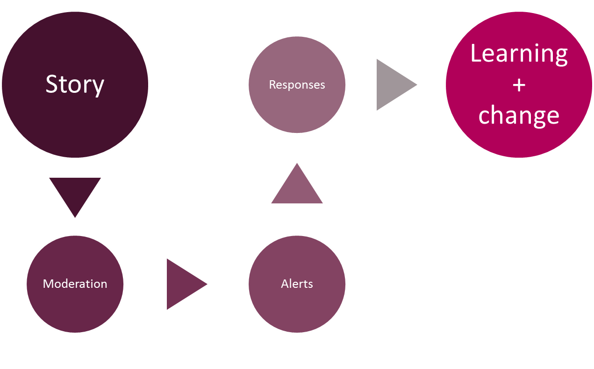
Stories – it’s about the conversation

Slide 4



Points before we start!
You, other responders and the author can respond to each other as many times as you wish
Never ask an author to disclose their personal information publicly – All responses are public once published on the website
By having a transparent, honest and safe conversation on Care Opinion, you can demonstrate to the public, how your service listens to feedback, resolves problems and works towards positive change

Slide 5
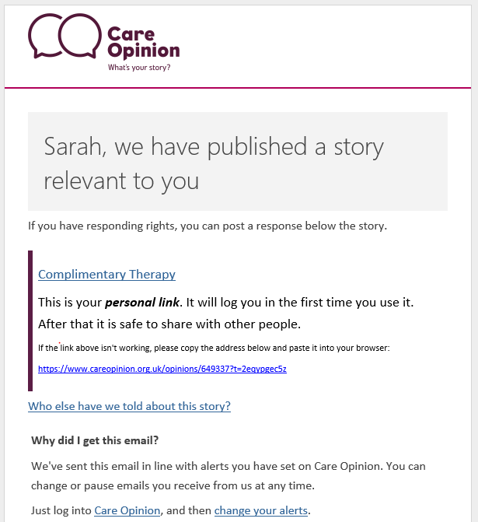

Practical Tip!
The link only log’s you into the site the 1st time

Slide 6
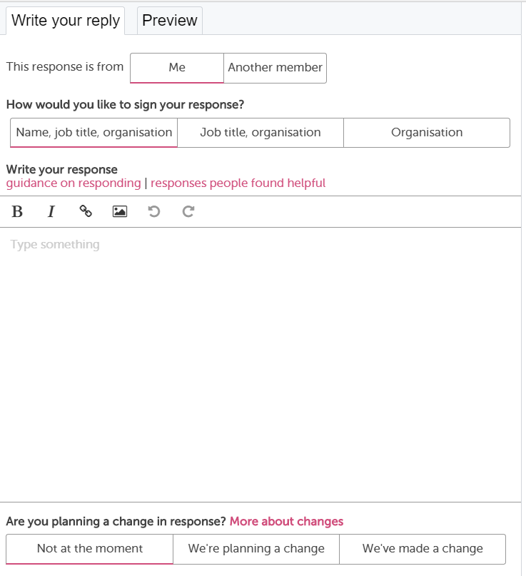

Slide 7

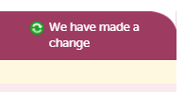
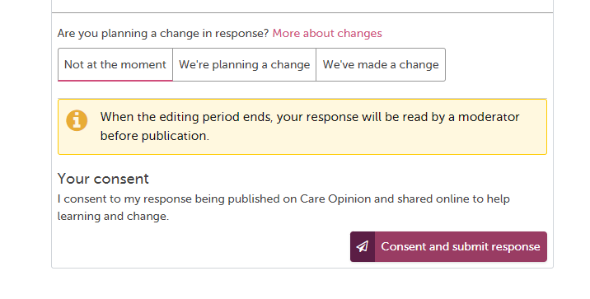
30 minutes editing time once submitted

Slide 8
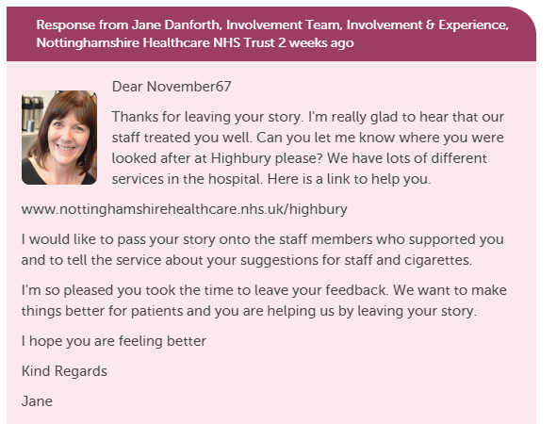
What does a Response look like on Care Opinion?
Respond more than once to a story
Have multiple people respond to a story
Show you are making a change
Include a profile picture
Add links and images
Invite the author to reply to you or
offer a method of contacting you/service

Slide 9
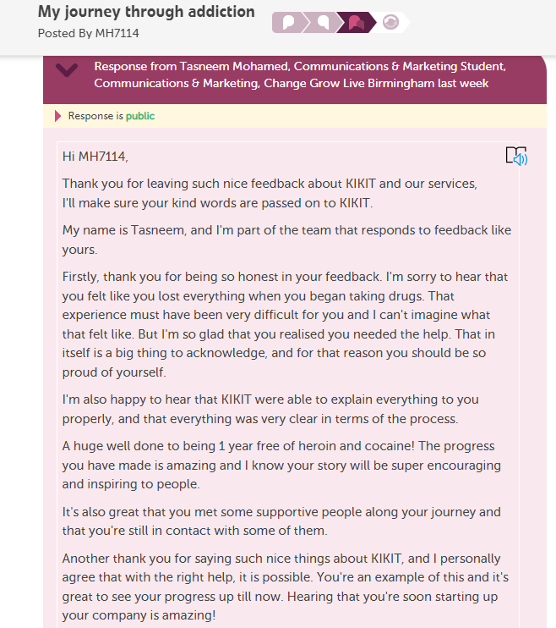
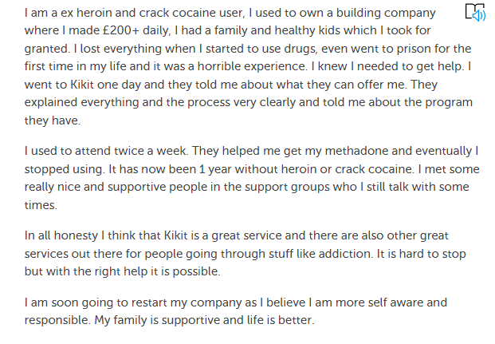
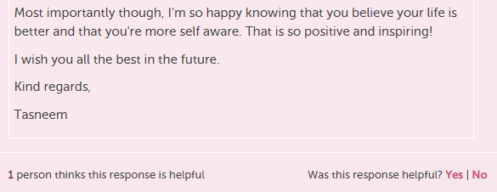
What does a really great Response look like on Care Opinion?
https://www.careopinion.org.uk/913476

Slide 10
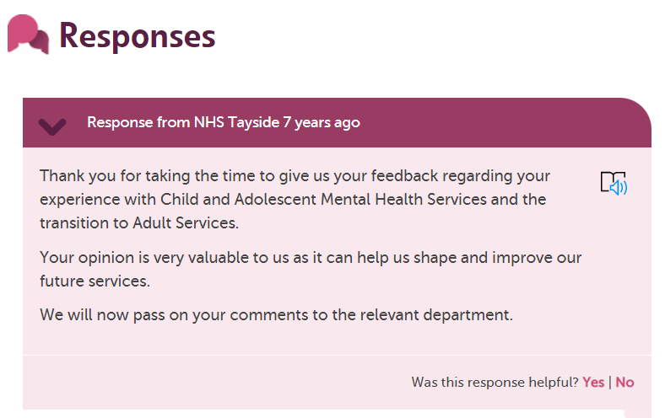
What would we prefer not to see?
My daughter spend a long time in and as a mother when she was initially placed there my heart was broken, but after seeing the care she received not only with her but us all as a family it was fantastic.
There was so much progress made with her there.
My daughter was there over 5 years ago. She then went onto adult services and sadly this was a disaster, excluding the Community Mental Health Team.
Life was a battle and sadly I lost her in 2013. I believe if people are receiving help from a place it should remain in place until the patient is in a good place but I feel this transfer from child to adult transition is not great.
I’d just like to say anyone that’s involved with it’s 5 star treatment and I can’t thank them enough for everything they did do for my daughter and us as a family.

Slide 11
Discussion/take notes:
Compare the two responses

Slide 12

Examples of good responses
Apologising
Empathy and understanding
Explaining what normally happens or why things happen
Saying what you will do with the feedback
Saying what you will do to make an improvement

Slide 13
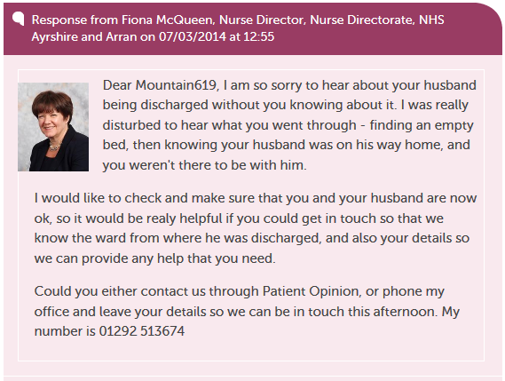
Apologising
https://www.careopinion.org.uk/143573

Slide 14
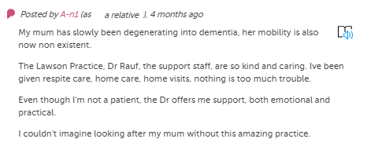
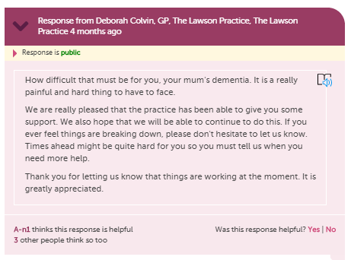
Empathy and understanding
https://www.careopinion.org.uk/739814

Slide 15
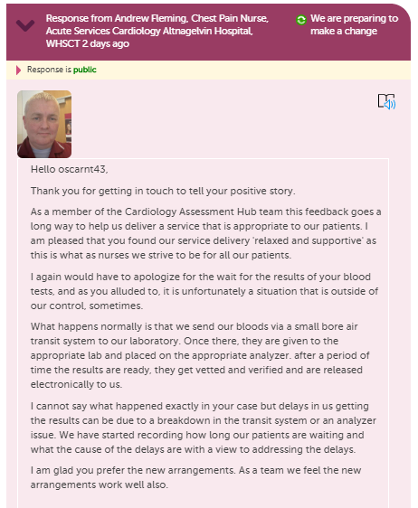
Explaining what normally happens or why things happen
https://www.careopinion.org.uk/773058
Notes:
Great example of how to respond thoughtfully.

Slide 16
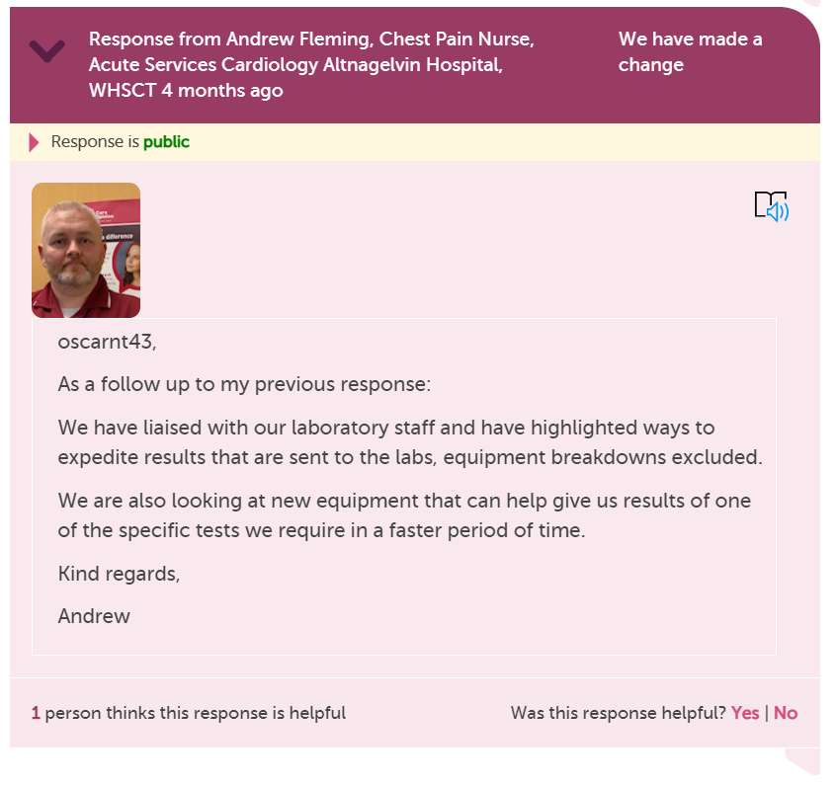
Making that ‘Planned Change’
into a
‘Change made’
https://www.careopinion.org.uk/773058
Notes:
Great example of how to respond thoughtfully.

Slide 17
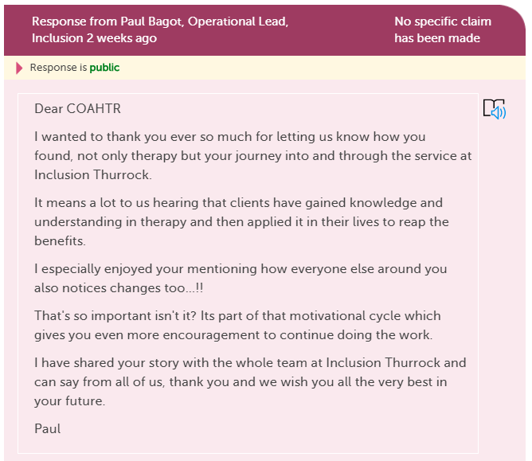
Saying what you will do with the feedback
https://www.careopinion.org.uk/708178

Slide 18
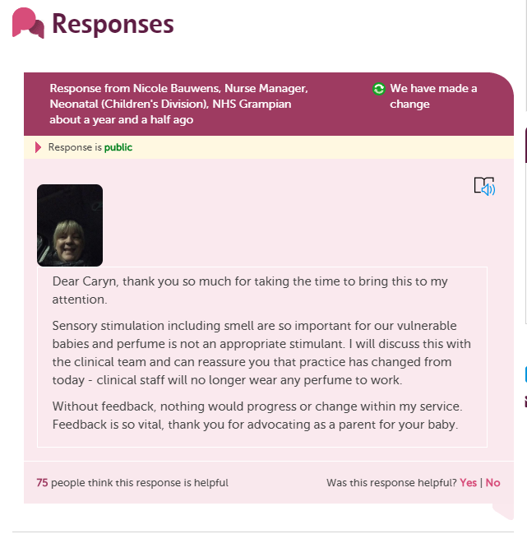
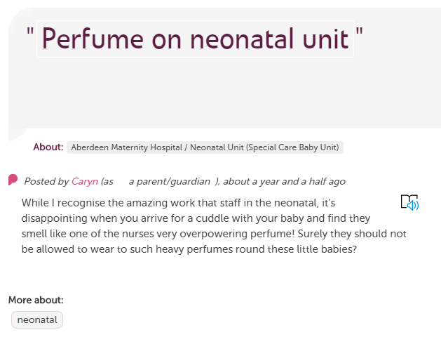
Saying what you will do to make an improvement
https://www.careopinion.org.uk/508341

Slide 19
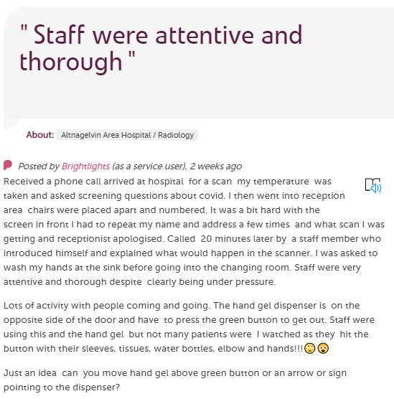
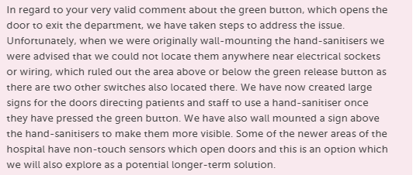
Saying what you will do to make an improvement
https://www.careopinion.org.uk/770867

Slide 20
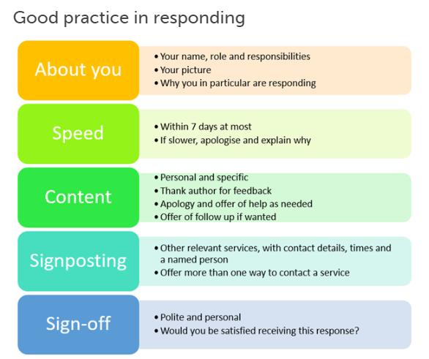
https://www.careopinion.org.uk/blogposts/813/how-do-i-respond-well-to-stories

Slide 21
The strategy of responding to stories
Which staff are to respond? Authors like to see responses from staff within the service they have been using.
Responding in a timely fashion; custom alerts can be set up to show when stories haven’t been responded to, and reports can show which stories have had a response and which have not.
Escalating responses; alerts can be set up based on story criticality and more critical stories could then be responded to by more senior levels of staff, or have their input in the response.

Slide 22
Responding goes beyond typing a response!
How are you distributing feedback internally? You can forward on an alert email to other members of staff or an entire team safely, making them aware of the feedback.
“It was a real light in a difficult time” District Nursing in Northern Ireland found that sharing positive stories amongst staff improved morale during the pandemic.
Taking the time to investigate and enact change; as seen in the responses covered earlier, the best responses also involve action and taking initiative.

Slide 23
Responding Re-cap
Prepare yourself for the feedback, don’t rush, ask for support from other staff if you need a 2nd opinion
Take your professional hat off, put yourself in the authors shoes, what response would Ibe happy with?
Try not to be defensive & apologise sincerely
Use the ‘Change’ logos in your responses
Sign off with full signature as often if you can
Be personal but polite, no cut & paste generic responses

Slide 24


Thank
you

