Slide 1


Session 1
The Care Opinion platform: Introductions and Top Tips
Notes:
Welcome to conf
Welcome to session
Questions in chatbox or contact info@careopinion.org.uk
Recording
Continue the conversation on social media using the hastag COconf22

Slide 2
Agenda
Introduction to the Care Opinion Platform
New Reporting Features –Sarah Ashurst
Revalidation/Private Invitation Links – Tim Hunt
Service Pages – Dayle Goldie
Accessibility Features – Tracy Molloy
Picture Tiles in Stories – Lisa Dendy

Slide 3
Careopinion.org.uk
Care Opinion is a place where people can share their experiences of health or care services.
At Care Opinion we make it safe and simple to share stories of care online and for people to see other stories too. The public, services and regulators can see how stories are leading to change.
We think that by sharing honest experiences of care, we learn to see the world differently. Working together, we can all help make care better. As a social enterprise, this is very important to us.
https://vimeo.com/215724873

Slide 4
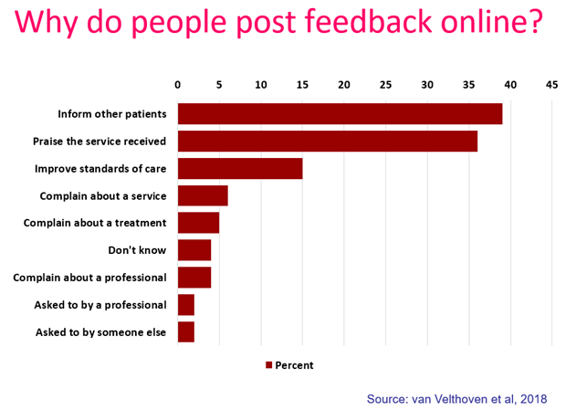
“To give people a chance to read what I went through and maybe give them some hope.”
“It was a difficult time for me to go through and Care Opinion allowed me to control the speed
and words rather than be rushed through Q&As or tick box scenario where things don't quite fit.”
“To highlight the problem without making a formal complaint and to thank the staff for excellent care”
“People need to know how valuable this care is”

Slide 5
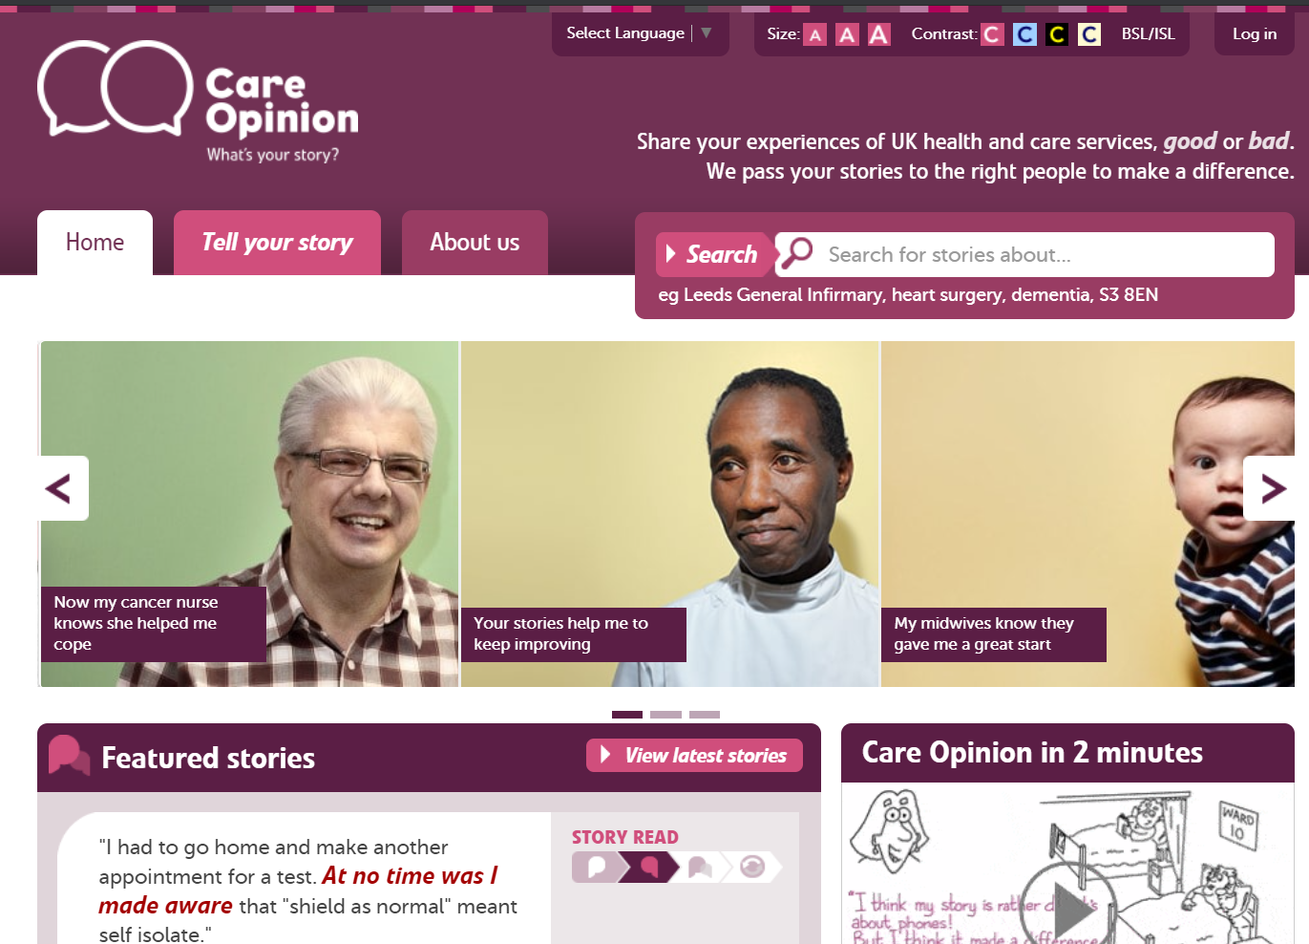

Slide 6

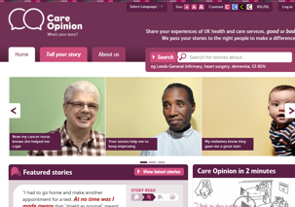
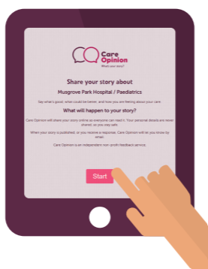
Ways to share a story with Care Opinion…
Online careopinion.org.uk or careopinion.ie
Freephone 0800 122 3135 (UK Only)
Freepost leaflets
Via a Kiosk link
From an invitation Link
With support from Volunteers or Staff
All stories are subject to moderation and are uploaded to the website, making sure the author remains anonymous.

Slide 7
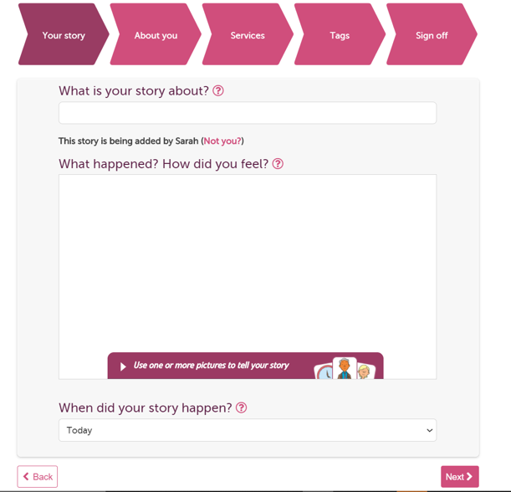

Slide 8
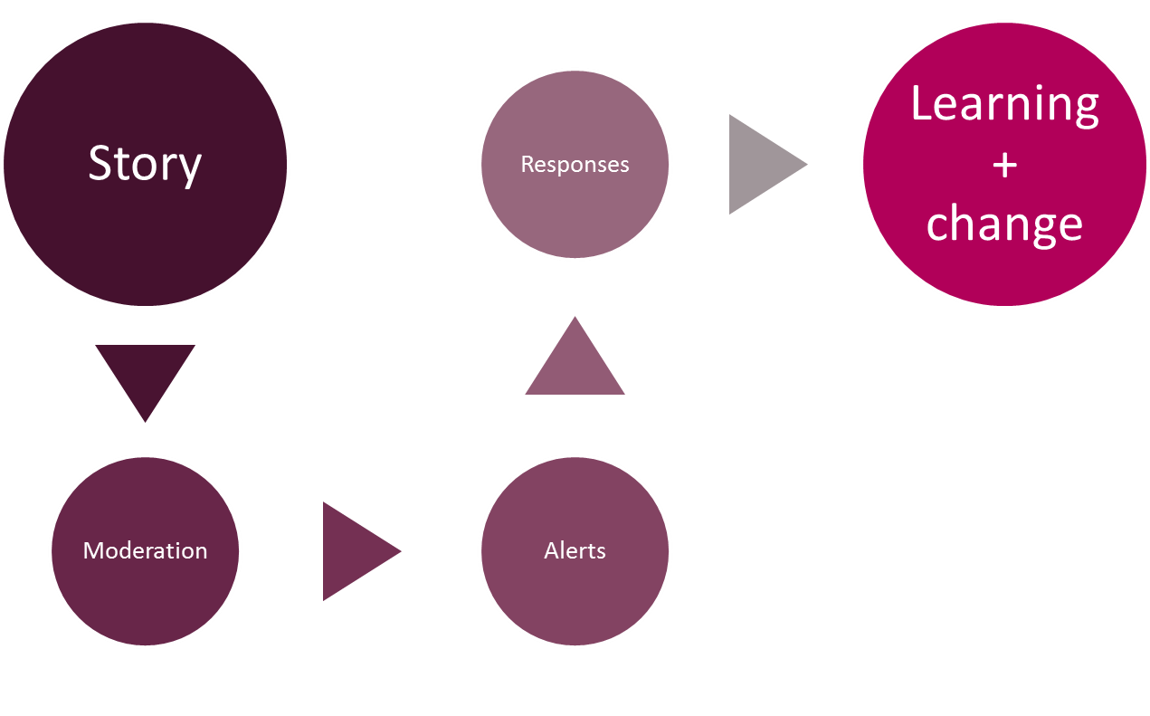
Stories – it’s about the conversation…

Slide 9
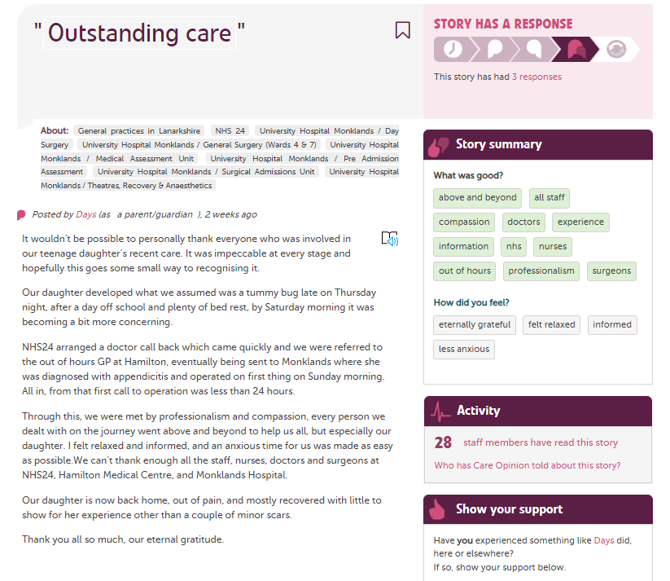

Slide 10
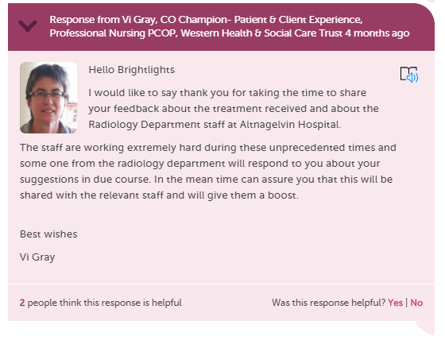
When responding as a member of staff to a story you can…
Respond more than once
Have multiple people/services respond
Show you are making a change
Include a profile picture
Add links and images
Invite the author to reply to you
https://www.careopinion.org.uk/info/responding

Slide 11
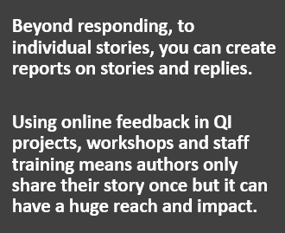
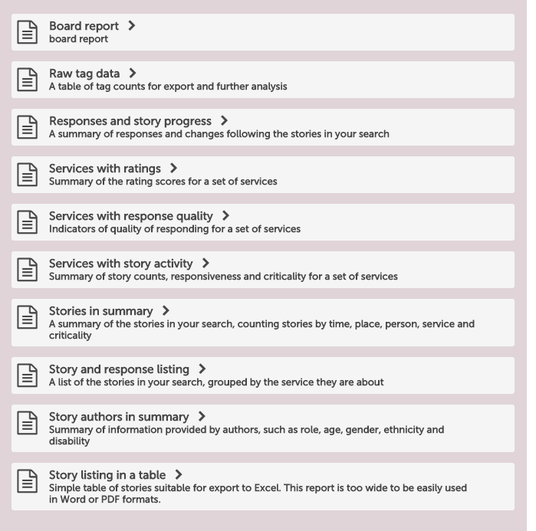
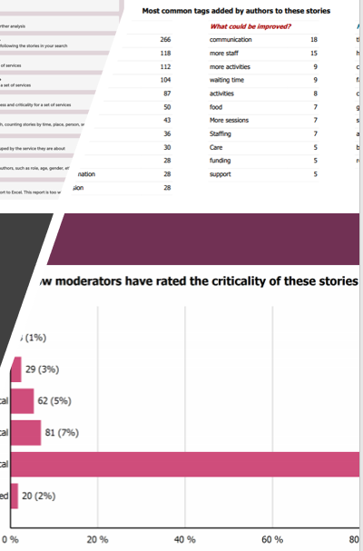
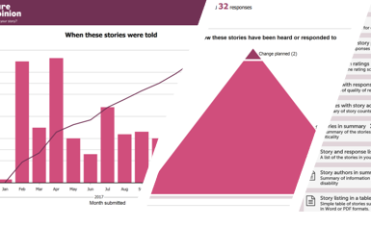
Care Opinion Reports

Slide 12
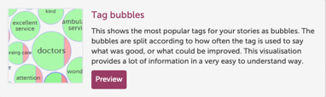

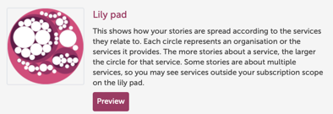



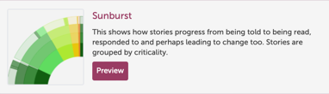


Visualisations
From your searches, you can create interactive visualisations that display information in a variety of ways, including;

Slide 13

Running reports
Sarah Ashurst - Associate Director, Subscriber Support Services, Care Opinion

Slide 14
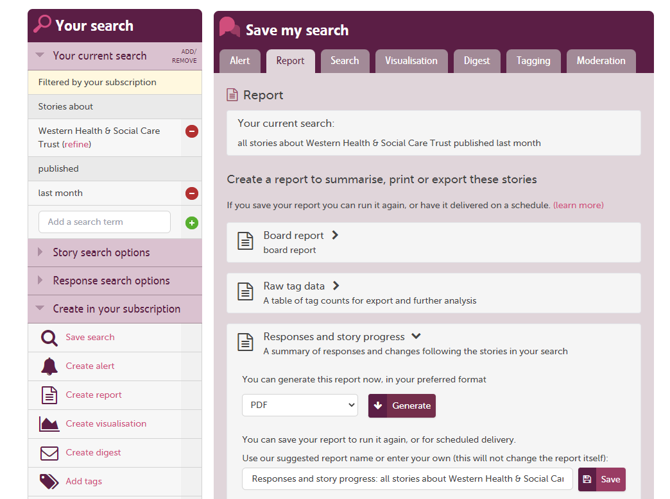

Slide 15
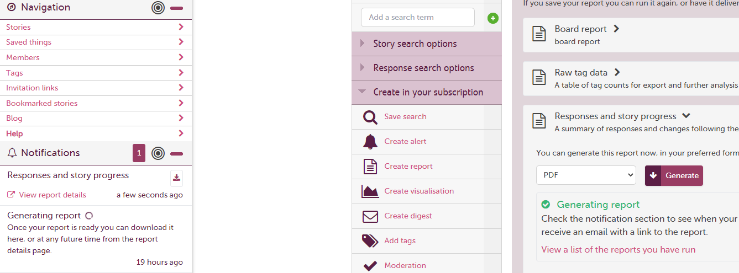

Slide 16
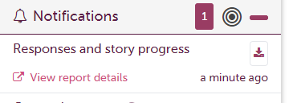

Download immediately
See all reports you have created or set on a schedule
We also send you an email when your report is ready

Slide 17
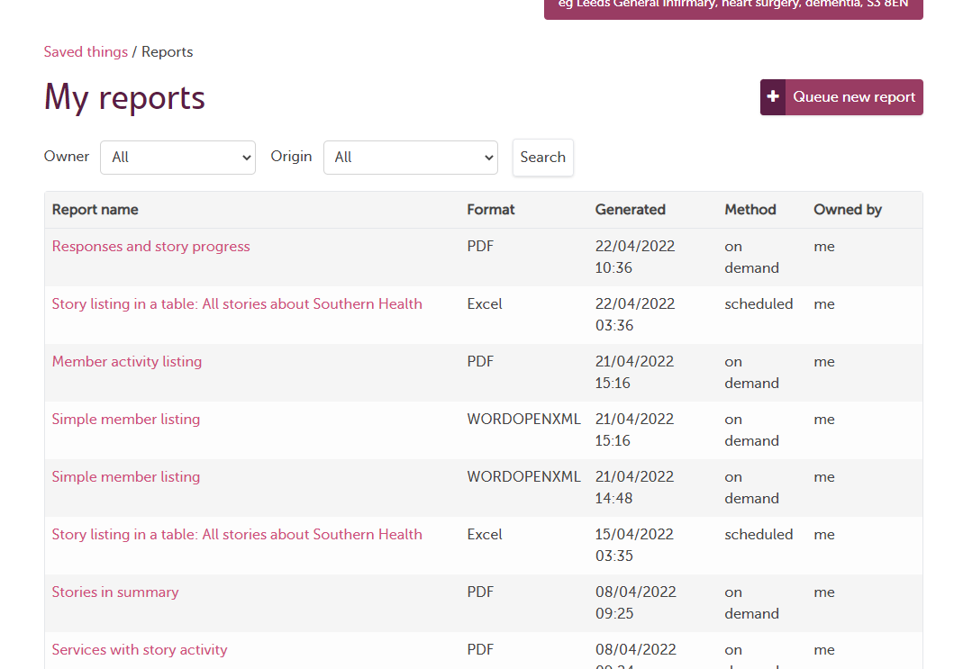

Slide 18
Private Invitation Links-Revalidation
Tim Hunt
Head of Safeguarding & Partnerships, Care Opinion

Slide 19
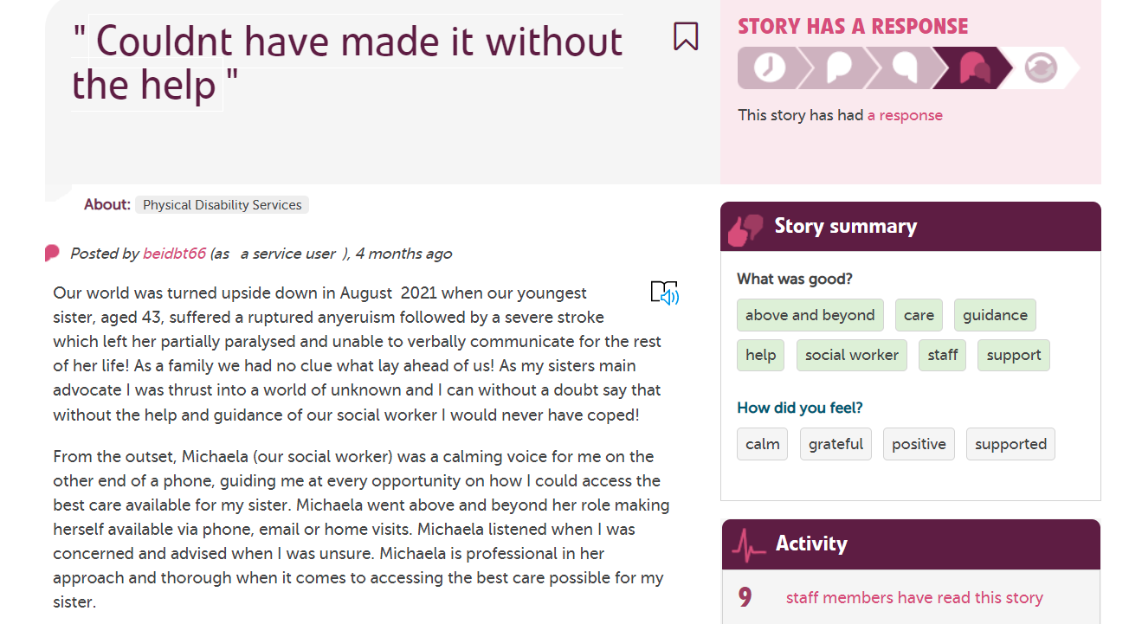
Individual Feedback-Safe and Transparent

Slide 20
How it works
Private Invitation Link-Sent out with message
Simple to set up
Stories Moderated as normal. Negative ones are anonymous
Practitioner sees all feedback
Reports and Visualisations available
Meets requirements for revalidation-independent moderation

Slide 21
RCP Recommendations
“Feedback… should happen often, with sufficient numbers, and as reasonably close as possible to the time of clinical contact.”
“Lack of coherent infrastructure for feedback to take place… has created a disproportionate burden for doctors and led to difficulties with the distribution, collection, analysis and reporting.”
“Harnessing opportunities provided by advancing sophistication of IT and learning from providers of web-based platforms that already collect patient feedback is essential.”

Slide 22
The benefits:
1. Become continuous rather than episodic
2. Be simple to use, for practitioners and users
3. Be online and real-time, where possible
4. Emphasise learning and improvement over measurement
5. Give narrative feedback at least as much status as quantitative feedback
6. Public can feedback about any aspect of care
7. Practitioner can respond
Notes:
Care Opinion has a highly evolved moderation policy that is informed by legal advice.
22

Slide 23
Thank you for listening
Email: tim.hunt@careopinion.org.uk

Slide 24
Service Pages
Dayle Goldie
Support & Engagement Officer,
Care Opinion

Slide 25

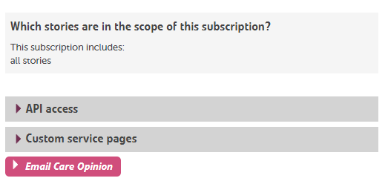
Personalised Service Pages
Did you know?
Service pages can be customised so that they are more helpful for site users, as well as looking brighter.
What can be customised:-
The Image
Service Description
Additional Links
This can only be done if your subscription has access to this feature, has linked services and you are an administrator for the subscription. All service pages start with no custom content.
Personalising your service page can be done by clicking on the “custom service pages” at the bottom of your subscription Page
https://www.careopinion.org.uk/info/subscriber-help-custom-service-pages

Slide 26
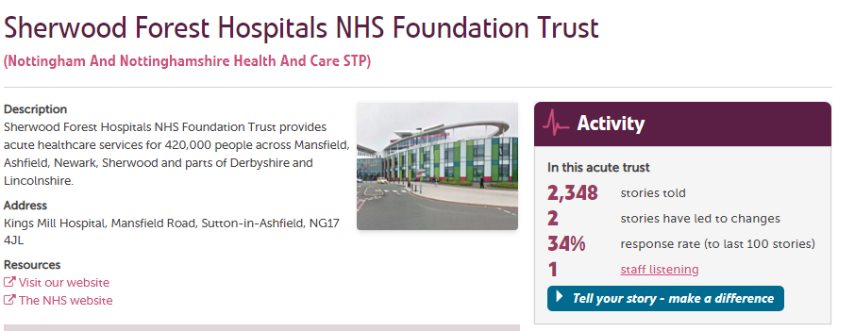
Example Customised Service Page
Description
Image
Links

Slide 27
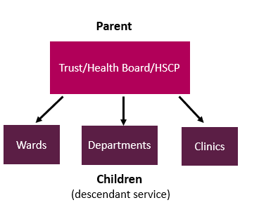
Understanding how it works
Before you can customize your page, you need to understand how services are listed. We normally list them in a hierarchy, so this could mean that a service belongs to a part of a service above and may have services below.
Something to bear in mind, if you customize a page, changes may affect lower descendant services in the tree. If you change the parent service, the children will be changed too.
You can however personalize each child service with its own image, description and links
https://www.careopinion.org.uk/info/subscriber-help-customise-a-service

Slide 28
Accessibility
Tracy Molloy
Senior Support & Engagement officer, Care Opinion

Slide 29


Keep it Simple!
Care Opinion Vision & Mission
We want people to be able to share their experiences
of health and care in ways which are:
safe
simple
and lead to learning and change

Slide 30
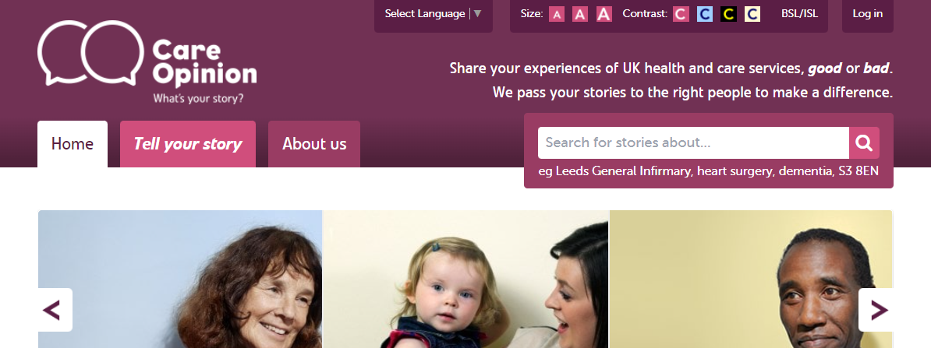
Accessibility
Font Size
Contrast & background colour
Sign Language
Language/Translation (currently being improved)

Slide 31
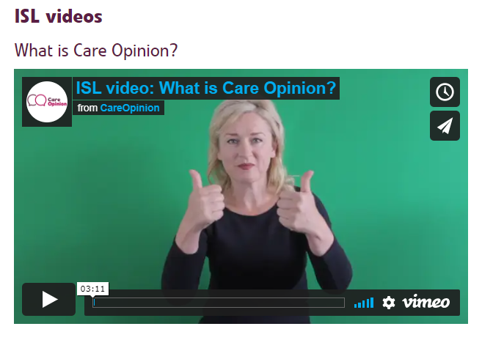
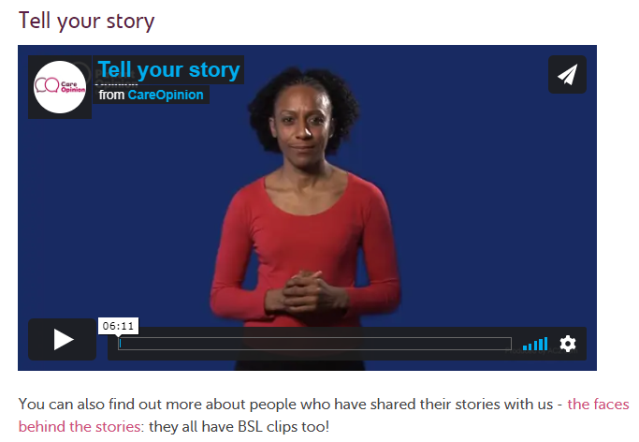
British Sign Language &
Irish Sign Language

Slide 32

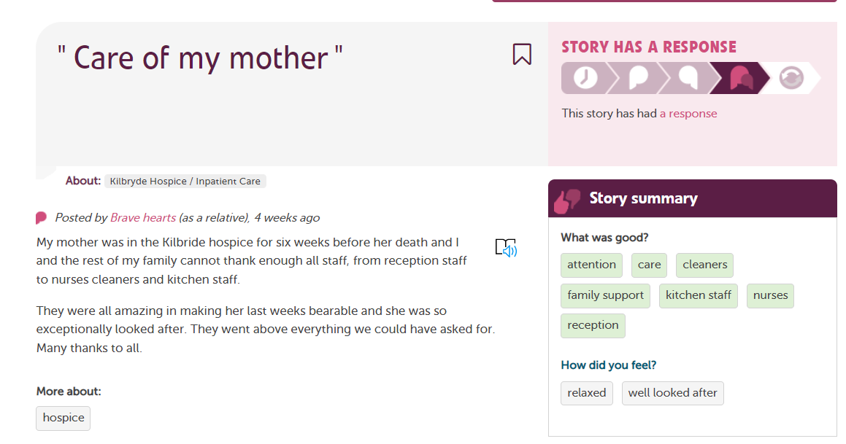
Immersive Reader =

Slide 33
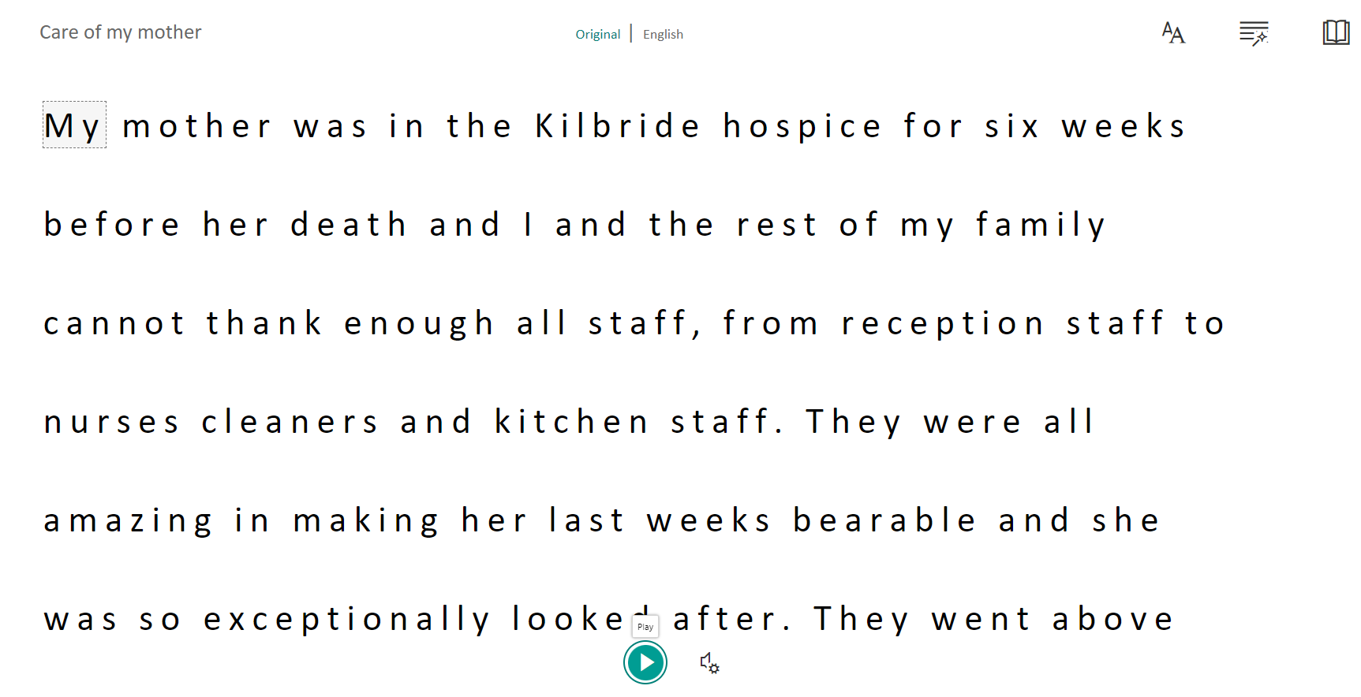
Immersive Reader

Slide 34
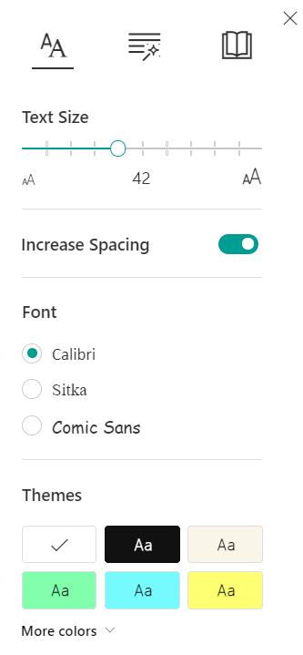

Options within Immersive reader
Break words down by syllables
Emphasize certain parts of the speech
Text Size
Spacing
Font
Theme

Slide 35
Useful links
Blog: A little help with reading
https://www.careopinion.org.uk/blogposts/814/a-little-help-with-reading
More info on Accessibility on Care Opinion: https://www.careopinion.org.uk/info/accessibility
Contact us:
https://www.careopinion.org.uk/contact

Slide 36
Picture Tiles
Lisa Dendy
Support & Engagement officer, Care Opinion

Slide 37
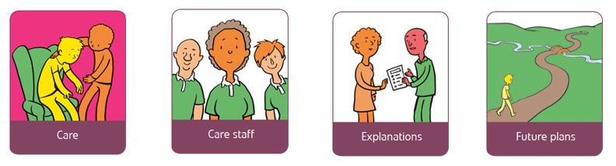
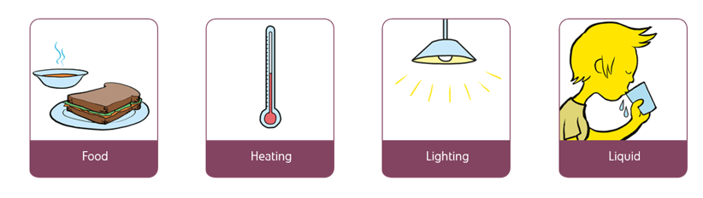
Picture Tiles in Stories

Slide 38
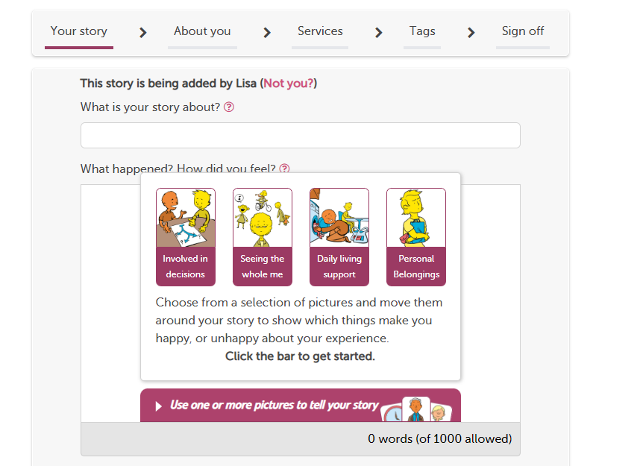
Picture Tiles
Everyone can use pictures to share their story if they want to.
Dementia
Learning Disability
Low literacy
English not 1st Language
Cognitive Impairment

Slide 39
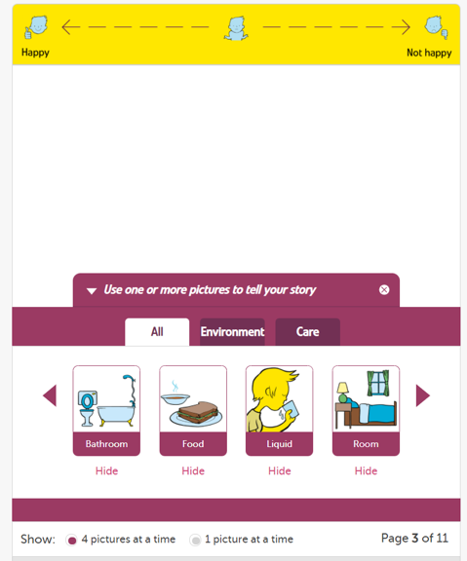
Happiness scale
Story content
View and select (click and drag up) Picture Tiles

Slide 40
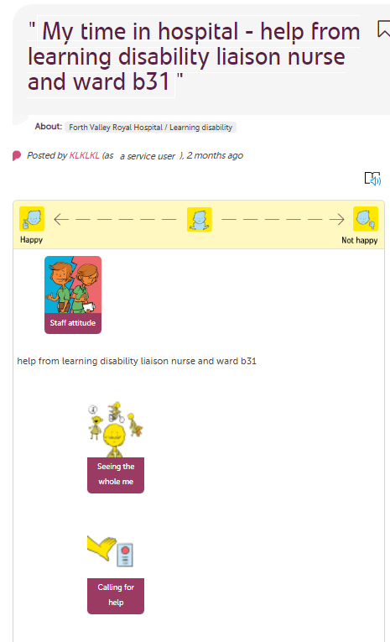
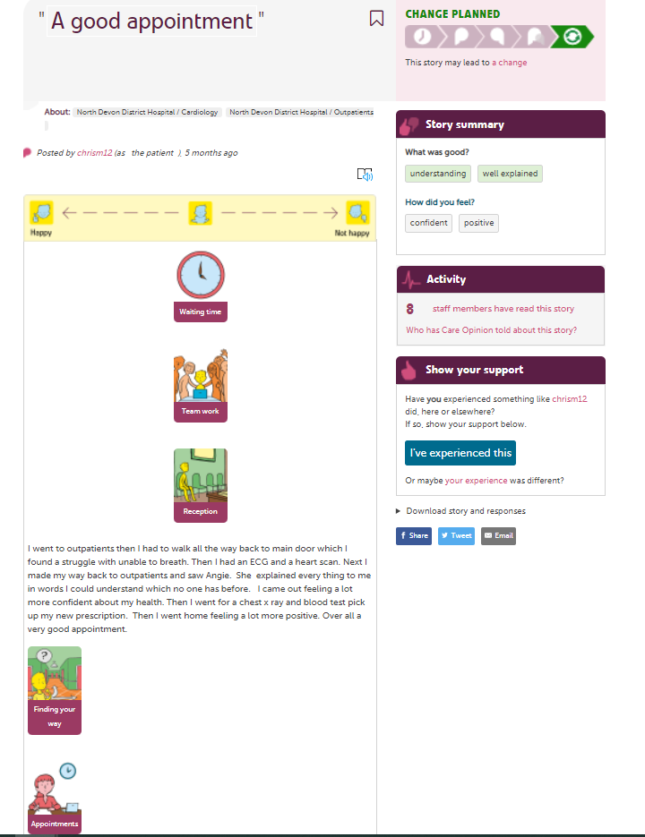
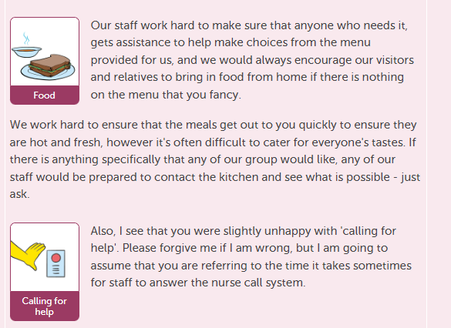
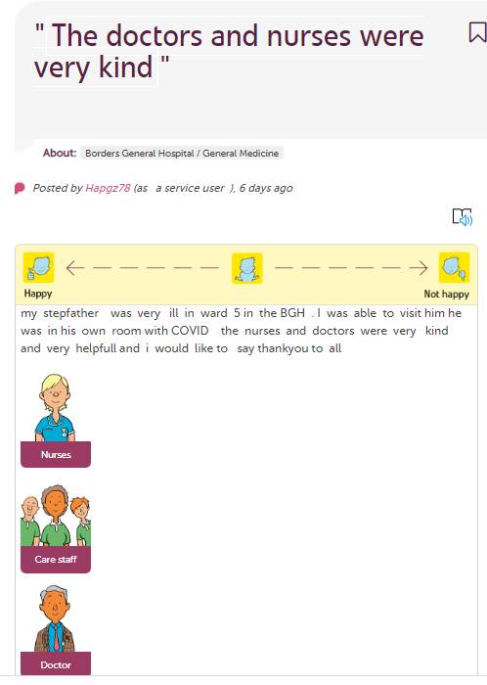
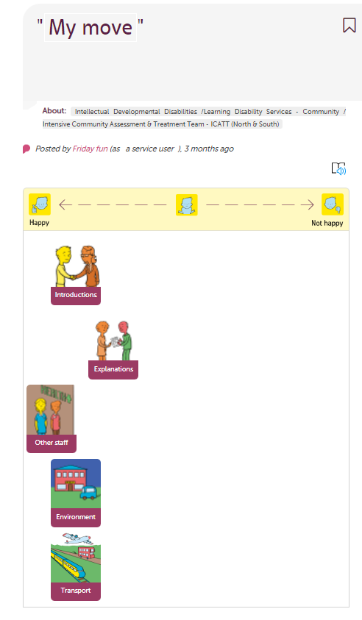

Slide 41
Thank you for Listening!
If you have questions, comments or feedback, please contact us at:
info@careopinion.org.uk
@careopinion
@CareOpinionScot
@CareOpinionIre
#CoConf22
Notes:
Next Session - Feedback at the end of life – 2:10pm

