Slide 1


Workshop – 15th Dec 2025

Slide 2

Not Recording
Camera & Mic
Interactive
Post session email
Before we start…

Slide 3
In this workshop we will help you to:-
Part 1 – 45 mins
Learn about basic searching
Advanced searching functionality
Subscriber or Story tagging
Bulk upload tagging
5 mins Comfort Break
Part 2 – 40 mins
Case Study One (with activity) – Anne-Marie the patient experience facilitator
Case Study Two (with activity) – Preparing for an inspection from the independent care regulator

Slide 4

Quick Poll

Slide 5
Basic Searching

Slide 6


Searching is the start of everything on Care Opinion

Slide 7
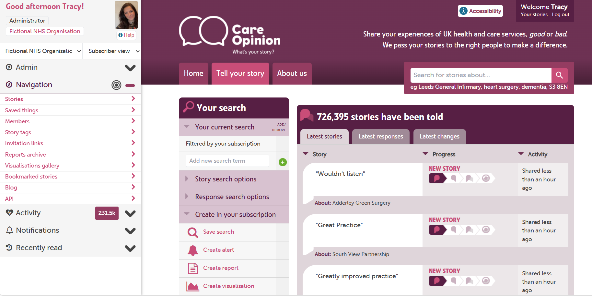
Notes:
This is what the Main search page looks like, when you log in at CO you are taken to your profile page.
To get to this search page either type in your organisation name, there may be an acronym, if unsure ask your support lead.
Or simply hit RETURN in the search box!

Slide 8
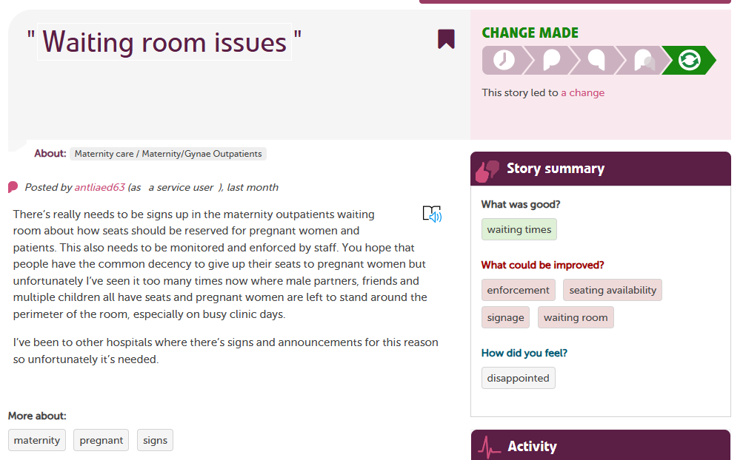
Basic Searching
More stories about the same service
More stories by the same author
More stories with the same tag
https://www.careopinion.org.uk/info/subscriber-help-searching
Notes:
When we talk about basic searching at CO, we mean searching for stories about a service, story by the same author or more stories with the same tag.
We say a lot that most things on CO are Clickable and advise you to play about, you cannot break the site!
Finally you can search for stories about a certain Test, Treatment or Condition.

Slide 9
Searching on Care Opinion
What can I search by?.......
Service (Service) eg hospital, care home
Services within services – your friend (refine), e.g. endoscopy, A&E…
Population Area (Area) e.g. Sheffield, Midlothian, Belfast…
Speciality (Treatment function) e.g. Cardiology, Emergency medicine, Addiction services…
Tag (Tag) e.g. nurse, compassion, staff, parking …
Phrase e.g. “scan, “blood transfusion” “children”
Notes:
When you type into the search term box, we will try to make a good guess on how best to use what you type.
If you type the name of a service we know (for example “Musgrove Park Hospital"), we will filter your search to just stories about that service
If you type the name of a population area we know (for example "Sheffield"), we will filter your search to just stories from that area
If you type the name of a specialty we know (for example "cardiology"), we will filter your search to just stories about services which provide that specialty
If you type the name of a tag (for example ‘Staff’ we will filter your search to just stories with that tag
If you type something we don't recognise (for example “staff attitude"), we will filter your search to just stories containing that exact phrase
You can add as many filters to your search as you need.

Slide 10
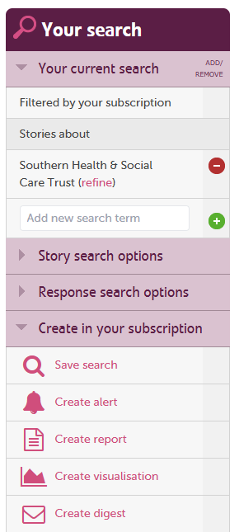
Adding and removing search terms (filters)
Our search system is based on the idea of adding and removing search terms (which we also call filters).
To narrow down the set of stories you want, you add a new search term. If you have narrowed the search too much (perhaps you have no stories left in the results), you remove a search term.
You can see which search terms you have already included in your search by looking at the filters listed under "your current search" on the search page:
Notes:
Once you have your selected service for example, you can then apply what we call ‘Filters’
On the ‘Your Current Search’ page
These are called Story Search Options & Response Search Options

Slide 11
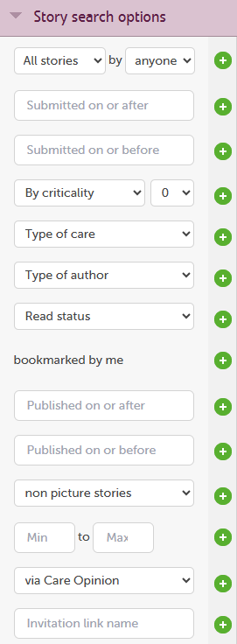
Additional search terms
The additional search terms available in Story search options:
Story progress (unheard, heard, has response, led to change)
Story submitted on or before
Story submitted on or after
Story criticality (as rated by Care Opinion)
Type of care (e.g. A&E)
Type of author
Read status
Bookmarked by me
Published on or before
Published on or after
Includes picture stories
Story count
Story source (via Care Opinion or nhs.uk)
Invitation link name
How to add additional search terms

Slide 12
Criticality scores
Score | Title | Examples
0 | No critical content | Entirely positive or neutral postings with no hint of criticality.
1 | Minimally critical | Mention of dissatisfaction with non-clinical non-personal aspects of care, typically “facilities” issues such as food, parking, or waiting.
2 | Mildly critical | More specific but still mild criticism, which may also include non-clinical but interpersonal issues such as attitude of staff, compassion, politeness. This might include the timely nature of the service whether in hospital or in the community where it has caused distress, eg carers not turning up on time
3 | Moderately critical | Criticism which may include alleged shortcomings in clinical or non clinical aspects of care, the author may not say what the effect of these are. Also includes serious comments about facilities: ‘never cleaned’; and where people’s essential basic care needs are not being met, eg inadequate nutrition and hydration, development of bedsores
4 | Strongly critical | Serious criticisms of specific unnamed staff or groups of staff, or of clinical or other care or facilities. This might have had very serious consequences for physical or emotional health. These will be described by the author. There might also have been social consequences that have increased the risk or vulnerability of an individual
5 | Severely critical | Posting alleges or describes actions or events which may be illegal, grossly negligent, or allege serious misconduct by named members of staff or organisations.

Slide 13
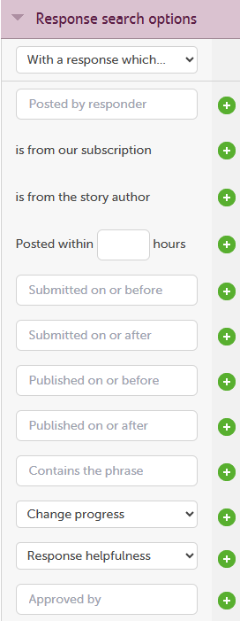
The additional search terms available in Response search options:
Response progress (with a response with, without a response with)
From our subscription
From story author
Posted with xxx hours
Submitted on or before
Submitted on or after
Published on or before
Published on or after
Contains the phrase
Change progress (has no change, has a change planned, change made, planned or made)
Helpfulness
Approved by

Slide 14
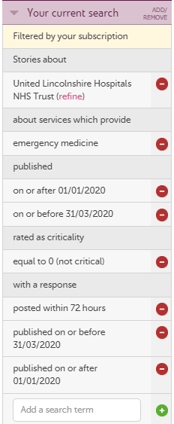
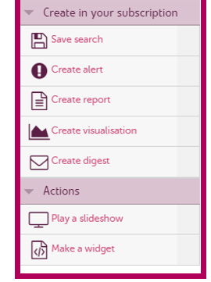
The results of your search can be saved or used to create!
Notes:
This ‘current search’ is all stories about United Lincs, about services which provide ‘Emergency Medicine’ Published on or after etc

Slide 15
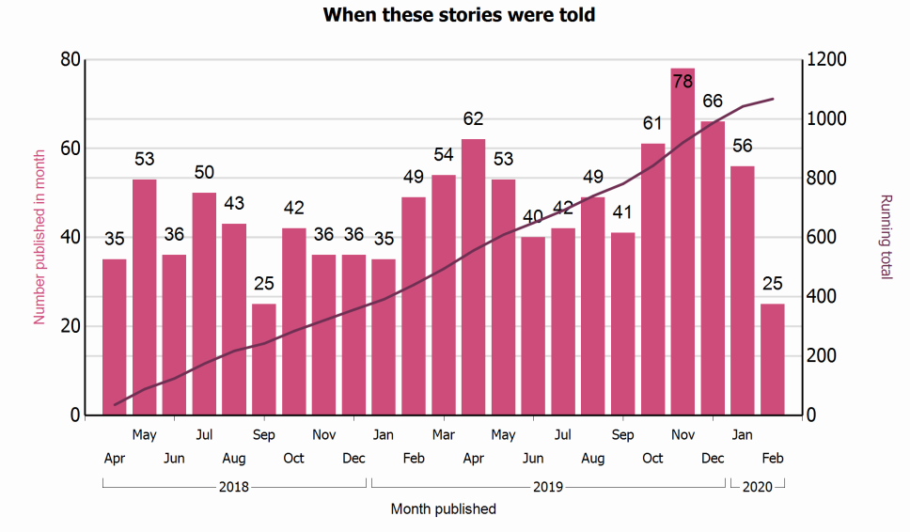
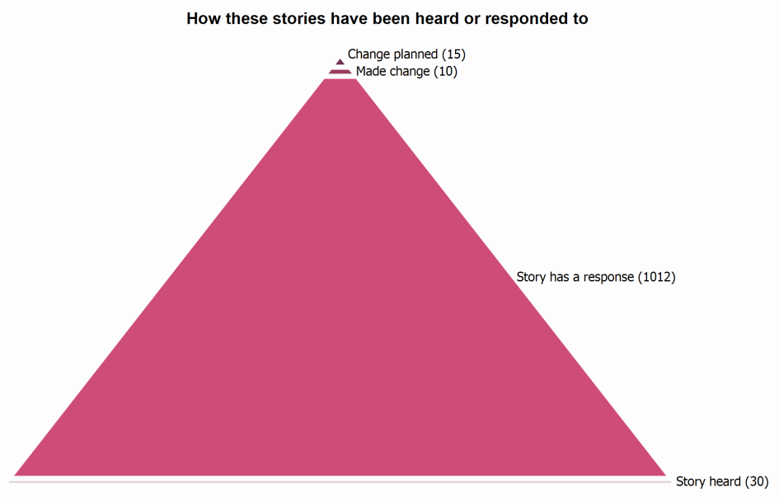
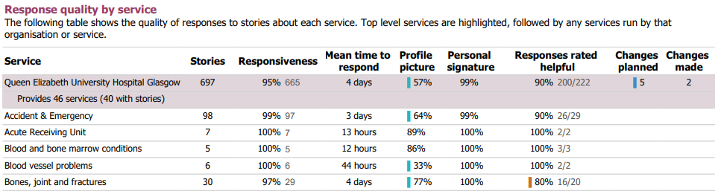
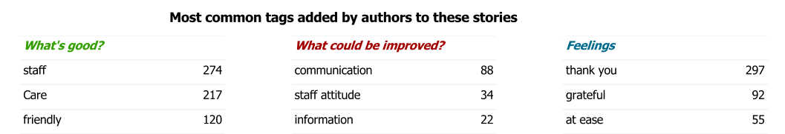

Slide 16
Any Questions?
Next up:
Advanced Searching

Slide 17
Advanced Searching

Slide 18
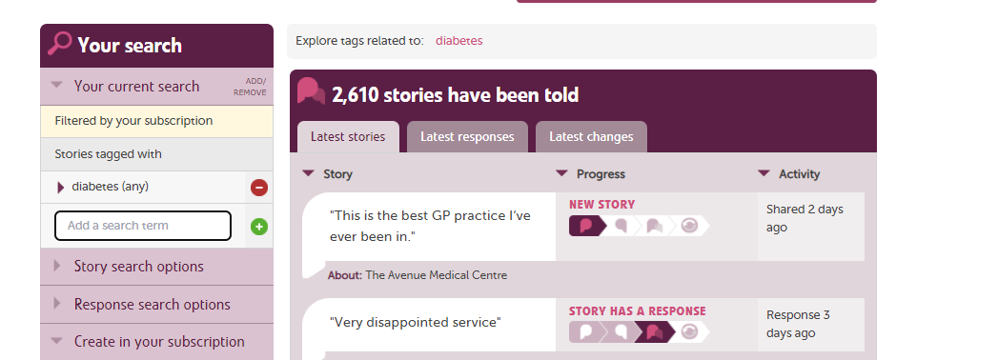
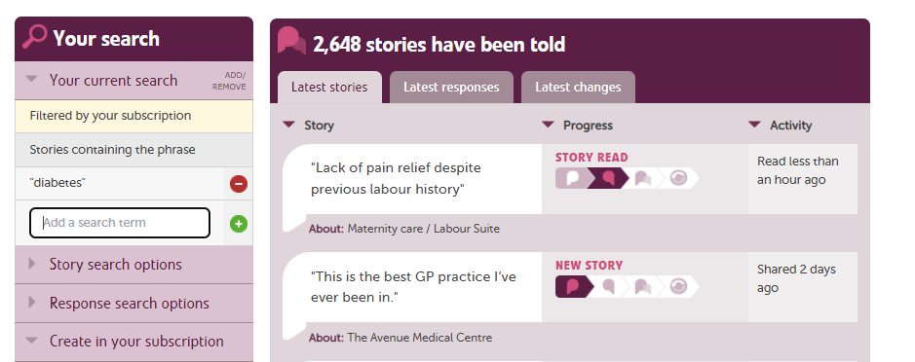
Advanced Searching
Original Phrase searching
Advanced Phrase searching
The quotation marks are the essential signal for us to do a phrase search = “xxxx”
https://www.careopinion.org.uk/blogposts/475/search-for-the-hero
Notes:
Ordinary phrase searching
If you enter the word diabetes into our search, we'll look for stories tagged with diabetes. If instead you want all stories which include the word diabetes, put double-quotes around diabetes, like so: "diabetes".
We call that a phrase search. The double-quotes are the essential signal for us to do a phrase search.

Slide 19
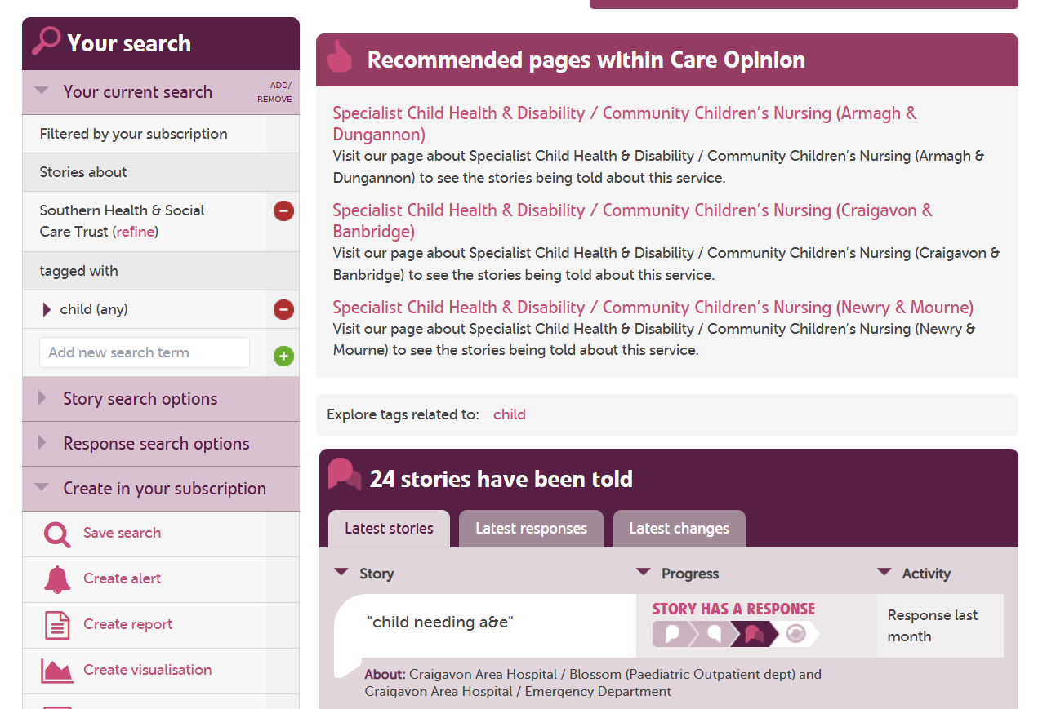
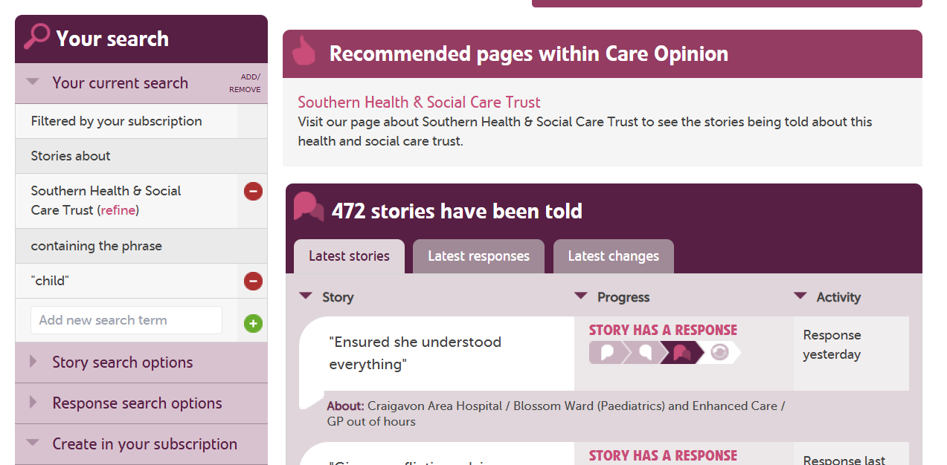
Notes:
Essentially by changing your search from a ‘tag based’ search to a phrase based search you are widening out your search.

Slide 20
Stem Searching on Care Opinion
You might want all stories which include words like diabetes, diabetic, diabetologist, diabetology. Or to put it another way, any word that starts with "diabet"
To do that, add a star to your phrase search, like this: "diabet*"
This AND that
"diabetes” AND “blood pressure"
"diabetes” AND NOT “blood pressure.“
One OR other
"sonographer” OR “scan” OR “ultrasound"
The world is your bookmark
Find the right stories for you Blog
Notes:
Advanced phrase searching
Now you know how to do a phrase search, here's how to push it further.
Stem search
You might want all stories which include words like diabetes, diabetic, diabetologist, diabetology. Or to put it another way, any word that starts with "diabet".
To do that, add a star to your phrase search, like this: "diabet*".
This AND that
What about stories which include the word diabetes AND the phrase "blood pressure"?
This phrase search will do it: "diabetes AND blood pressure".
But wait - what about stories including the word diabetes but NOT mentioning blood pressure?
Ah, you mean "diabetes AND NOT blood pressure." Simples!
One OR other
You might want a broader sort of search, like stories including the words sonographer OR scan OR ultrasound.
Enter a phrase search like this: "sonographer OR scan OR ultrasound".
Isn't that OR-some? (joke.)

Slide 21
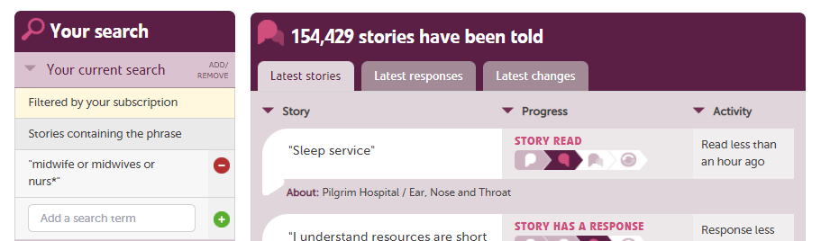
Example Stem Search!
https://www.careopinion.org.uk/opinions?phrase=midwife+or+midwives+or+nurs*

Slide 22
Any Questions?
Next up:
Subscriber Tagging

Slide 23
Subscriber Tagging / Story Tagging

Slide 24
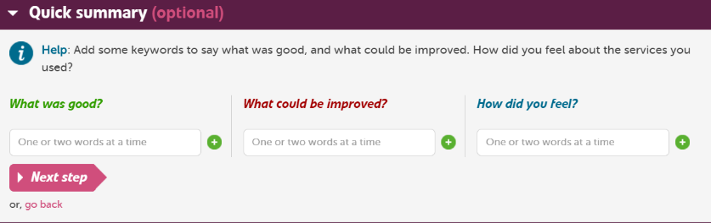
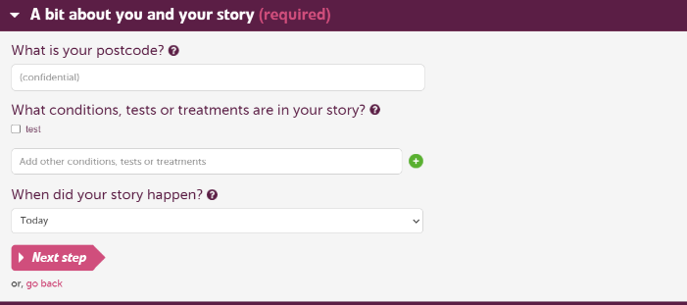
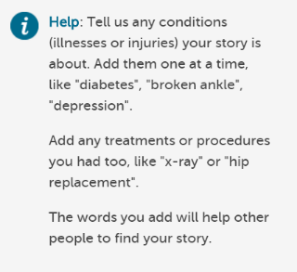
Notes:
During the Tell your Story workflow the author gets the option to add some tags of what was good, what could be improved and how they felt

Slide 25
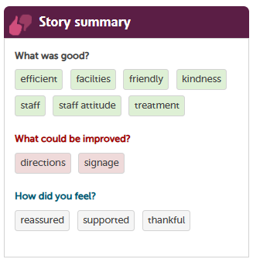
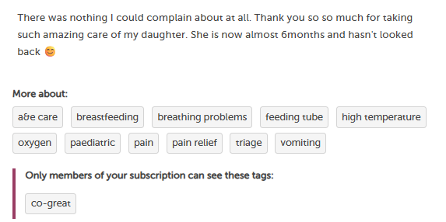
Different types of Tags
Primary tags Secondary Tags OR Story Tags
Notes:
Almost every story on Care Opinion will have one or more tags attached to it. Tags help to describe a story to make it easier to find related stories or explore topics of interest.
Primary Tags
Almost all the tags you see attached to stories have been added by story authors (when they told their story) or by moderators (when they moderated the story).
These tags don't usually change after the story is published.
Stories may also be tagged with how the story author felt: for example, upset, ignored, happy, relieved.
Secondary Tags or Story Tags
For example, stories are tagged with conditions (diabetes, heart disease, dementia), procedures (scan, blood test, endoscopy), parts of the body (head, stomach, feet) or aspects of services (nursing, communication, timeliness, appointments).
AND Subscriber Tags added post publication

Slide 26
Why would I want to add tags to stories?
Other tags on stories are added by the author. You might want to group stories differently.
Some examples, you might want to:-
Compliment types
Group stories together
Find and count stories according to a set of Quality Standards
Research project
Highlight stories in for use in training & education
Now you can tag stories too
Notes:
And now you (as a subscriber) can add your own tags too.
Identify stories relating to a compliment types like they do in Northern Ireland such as staff attitude and behaviour
Group stories together in a way which may not be defined on Care Opinion, eg “facilities”, “domestic staff”;
Find and count stories according to a set of quality standards your organisation defines eg “person-centred care” “safety” or Consent for CQC in England
“Safe and effective care” & “Effective Communication & Information” for the RQIA – Regulation & Quality Improvement Authority in NI
Or “Well being” “Be Included” “Compassion” for the Care Inspectorate in Scotland
Gather stories for a research project which requires a set of stories about a given issue E.G “Project 1 EOLC”
Highlight stories in for use in training & education which you want students/staff to read and discuss, eg “attitude & behaviour”

Slide 27

Why would I want to add tags to stories? Example:
Northern Ireland regional compliments group headings:
Quality of Treatment & Care
Staff Attitude & Behaviour
Information & Communication
Environment
Other
These can be created as subscriber tags –
e.g. “compliment treatment and care” or “compliment staff”
This can be visible to people on your subscription only

Slide 28
Tags can have different visibility
Private (visible to me)
Shared in my subscription
Public

Slide 29
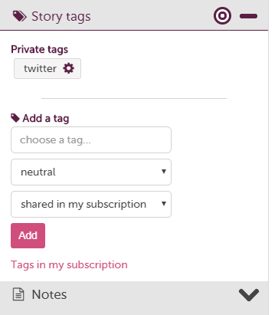
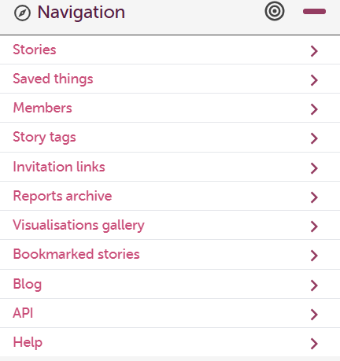
Add a Subscriber Tag while on a story
These are only visible and clickable for you
Notes:
To add a Tag to a story, you need to be on the story then open the ‘Story tags’ drawer on the left, add the tag, chose the polarity and finally select the visibility

Slide 30
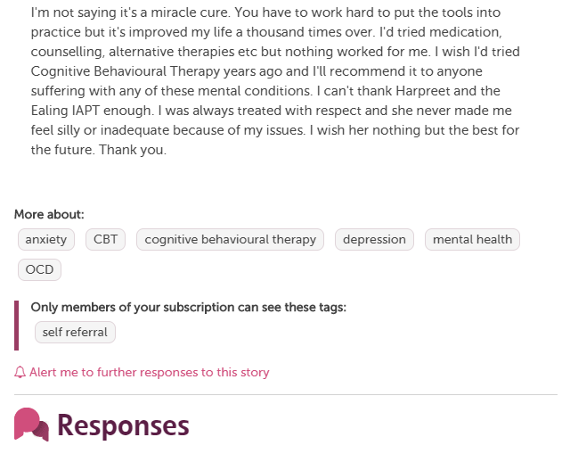
Subscriber Tags appear under the story when logged in
Anyone in your organisation can see these and click them

Slide 31
Private Tags appear in the drawer (menu on the left) when logged in
These are only visible and clickable for you

Slide 32
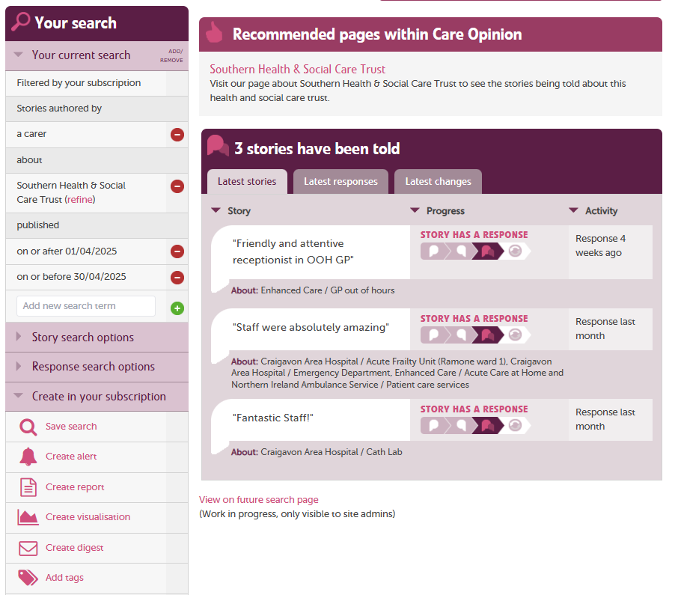
Bulk Tag up-loading

Slide 33
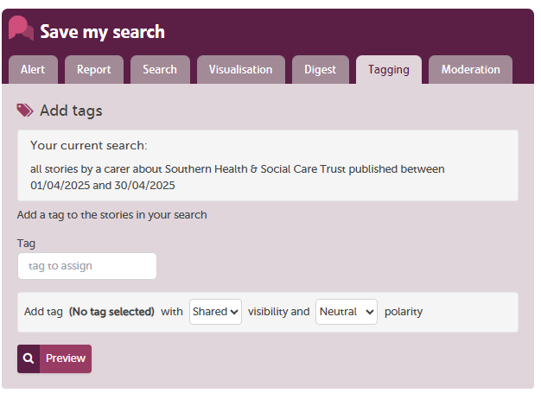
Bulk Tag up-loading

Slide 34
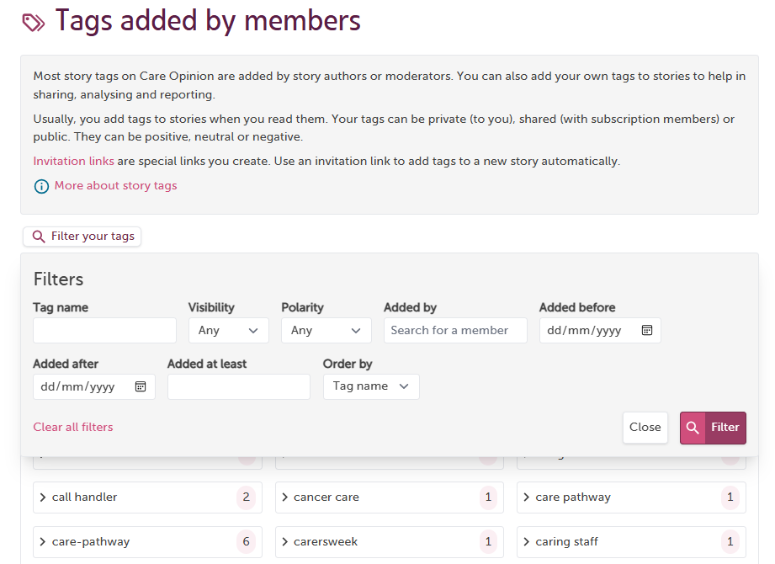
Bulk Tag up-loading

Slide 35
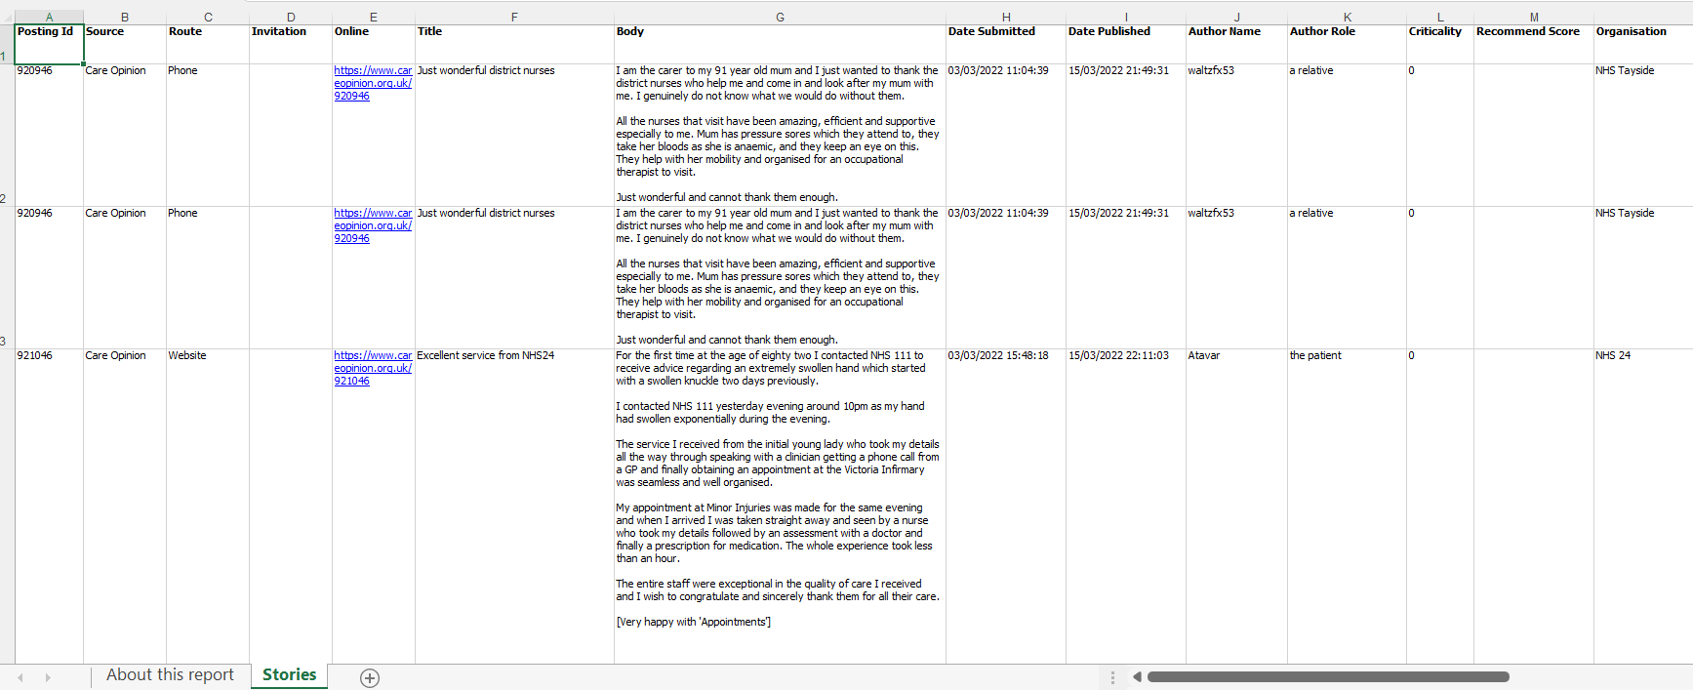
Story listing in a table report

Slide 36
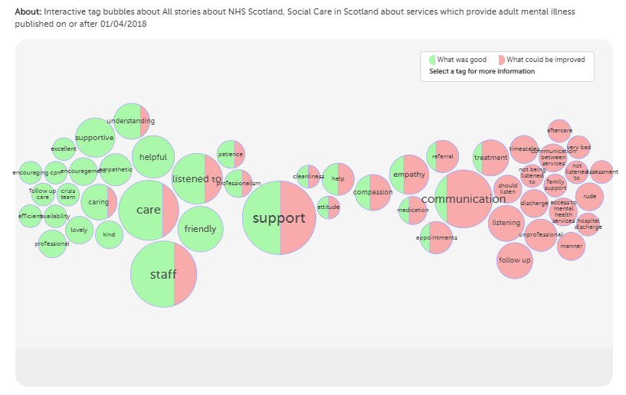
https://www.careopinion.org.uk/vis/6u528

Slide 37
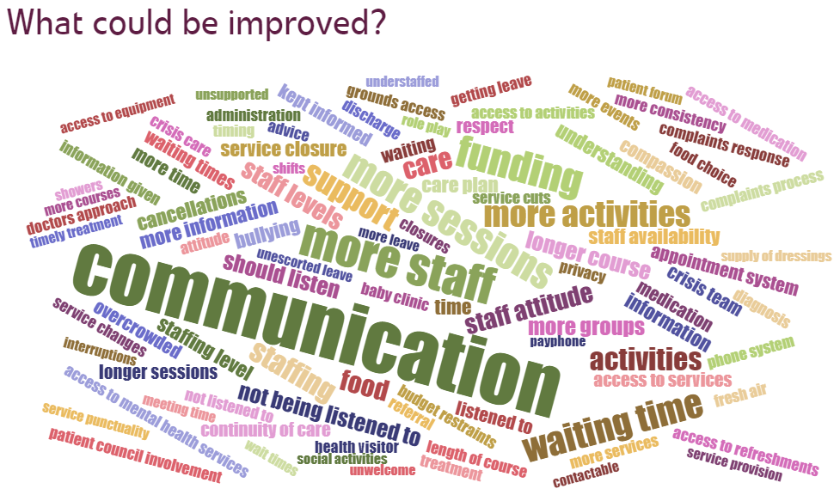
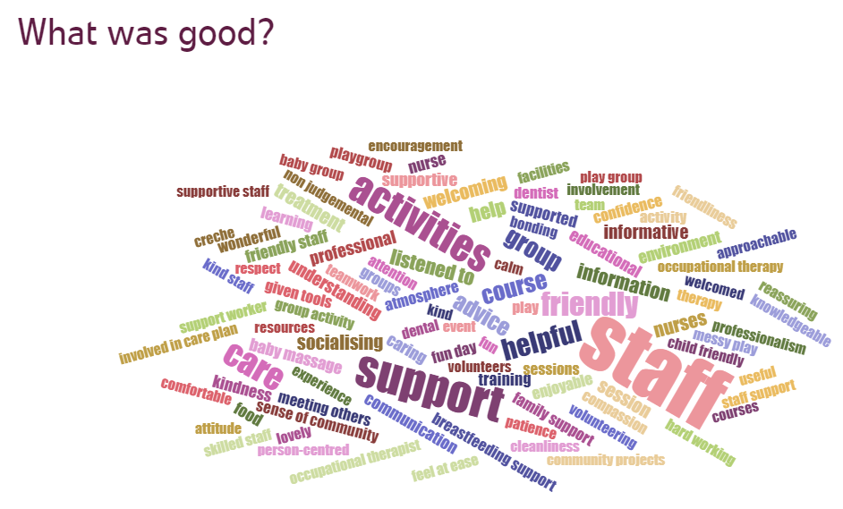
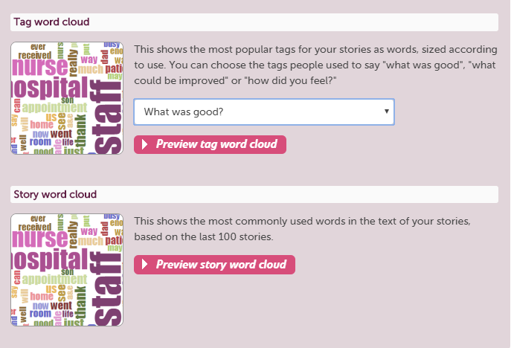

Slide 38
Ideas other subscribers have done with Subscriber tagging
Royal Devon University Healthcare NHS Foundation Trust:
Introduced a process that combines the Care Opinion Subscriber Tagging function with the national KO41 complaint coding framework: READ Full blog-post.
Southern Health and Social Care Trust:
Track positive stories using the 'Subscriber Tagging' feature on Care Opinion and tag these stories with the Tag 'Staff mentioned by name’. So, staff can be recognised and then nominate them through the Trusts GREAT-ix system: READ full blog-post.

Slide 39
Any Questions?
Next up:
Comfort Break & Case Studies Tasks

Slide 40

5 Min Break

