Slide 1
What matters?
Ensuring cancer experiences drive policy
Care Opinion Conference, April 2022
Rae Thomson, Scottish Government Cancer Policy Team

Slide 2
Vision and Objectives
Vision
The voices and experiences of people affected by cancer will be at the heart of policy.
Meaningful involvement will be embedded through inclusive practices and ongoing engagement.
Objectives
Actively include the views and experiences of patients, carers, families and other stakeholders groups
Offer a range of opportunities to participate and optimise existing sources of experience
Involve people in ways that are meaningful to them as well as us
Ensure diversity of voice through methodology
Continuously review and improve opportunities for participation
Lead by example and influence the wider cancer community to embrace and embed community engagement practices to impact service provision and individual decision making

Slide 3
Framework for Change
Level 3:
Collaborate
Level 2:
Dialogue
Level 1:
Insights
Limited representation/
High engagement
Representatives involved in decision making
Listen to individual experiences and
engage in discussion on issues basis
High representation/
low engagement
Understand key trends and
issues at national level

Slide 4
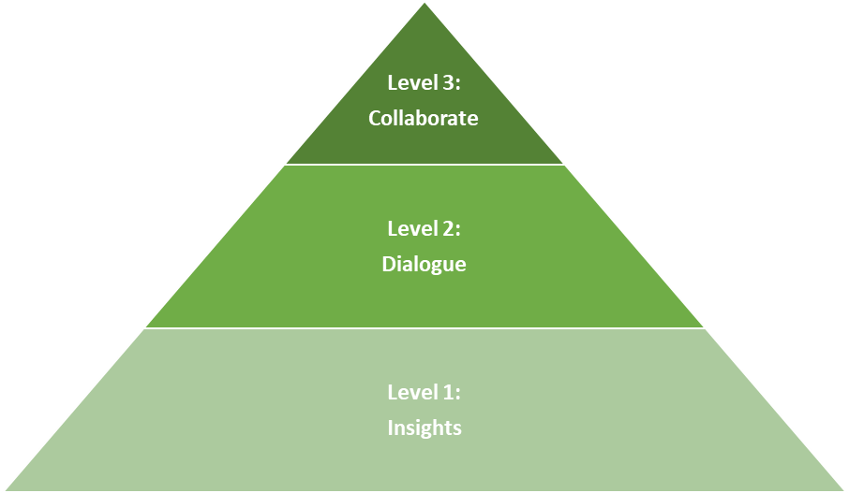
Scottish Government Remit and Actions
SG Cancer Policy
Cancer Community
Via Regional Networks, Health Boards, Third Sector
Notes:
Presenter note: read blue box from bottom up.

Slide 5
How do we use patient insights for learning and change?
Action
Impact
Insights Analysis
National Cancer Policy
Other National Policy
Care Opinion
Correspondence
Commission national surveys
Review other research, guidance and evaluations
Services
Individual Patients

Slide 6
1100 stories 2010 – Feb 2022

Slide 7
How do we use insights for learning and change?
Action
Impact
Insights Analysis
National Cancer Policy
Other National Policy
Care Opinion
Correspondence
Commission national surveys
Review other research, guidance and evaluations
Services
Individual Patients

Slide 8
Going a step further…
Action
Impact
Insights Analysis
National Cancer Policy
Other National Policy
Promotion & Partnerships
Boards
Third Sector
Services
Individual Patients

Slide 9
Further Information
Debbie Provan Debbie.Provan2@gov.scot
Rae Thomson Rae.Thomson@gov.scot
Cancer Policy Team

