Slide 1

Inclusion
@Inclusion_NHS www.inclusion.org
Closing The Loop
Karen Marsh – Quality Manager
April 2022

Slide 2

Inclusion Services
Inclusion is part of Midlands Partnership Foundation Trust.
National Service covering
  community substance misuse services,
  Prisons mental health and substance misuse,
  Sexual health services,
  IAPT services
  in the process of opening a gambling service.
Currently our Community SMS, IAPT and Sexual health services use care opinion.
Care opinion is a key part of or Service user strategy.
Notes:
Service from York to the Isle of Wight

Slide 3
Inclusion Services
The Journey:
Inclusion have been part of care opinion for over 8 years with IAPT
SMS 2 years later
Sexual Health last year
Story numbers fluctuate between service types
Last two years have been concentrating on the “closing the loop”
Notes:
SMS services number of stories is not as great as IAPT and Sexual health - more static population
Encouraging services to log changes and feedback what these changes look like for the service users.
Encouraging services to display these changes in services for all service users to see.
Educating that development stories is what makes our services better for service users.

Slide 4
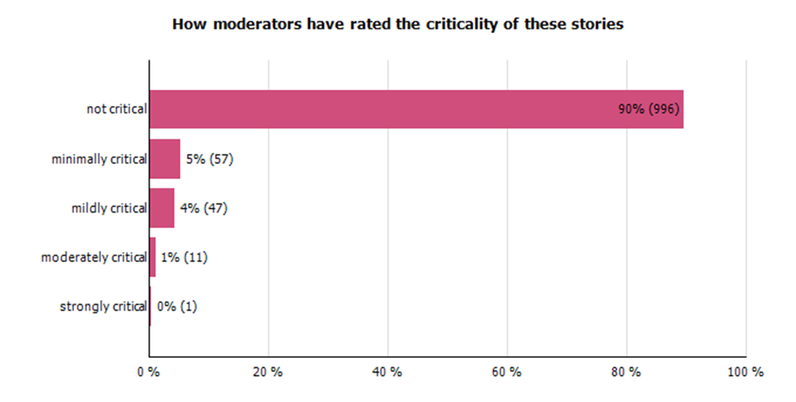
The last year on Care Opinion
In the last year:
1112 stories told
996 Not critical
116 tagged with some level of critical
25 stories mark as changed planned or made
Notes:
Just under a quarter of our stories were marked as change planned or made
This is a huge improvement on previous years.
Impact it has had on services ; Shown a need for better systems for example telephone, enabled conversations with staff about communication styles, helped to create timetables that are service user led, change routines

Slide 5
Impact on services
Some examples;
Shown a need for better systems for example telephone, appointment booking,
enabled conversations with staff about communication styles,
helped to create timetables that are service user led,
change routines
Notes:
SMS services number of stories is not as great as IAPT and Sexual health - more static population
Encouraging services to log changes and feedback what these changes look like for the service users.
Encouraging services to display these changes in services for all service users to see.
Educating that development stories is what makes our services better for service users.

Slide 6
Examples:
The Story
The staff at this clinic have always made me feel genuinely cared for and have provided compassionate support and treatment I have needed in the past.
However the current phone system is terrible, it took me over a week to get through, as I was calling in between work breaks. They should consider using a messaging service where the service user could text the clinic and receive a reply when next available, rather than waiting on the phone listening to that really annoying automated message. But other than that, thanks to all staff for the great service you provide.
What was good? Care Compassion Staff Support treatment
What could be improved?
Automated Messages Phone system

Slide 7
Examples
Response:
Thank you for taking the time to provide feedback on the service you received. I would like to apologise for the difficulties you have had in accessing our service via the telephone. Our telephone lines are extremely busy and this does mean we have patients who struggle to get through to book appointments. We are looking to upgrade our telephone system to improve access for our patients and also advise our patients of the call waiting time, as well as introduce online appointment booking for some of our services. Your feedback helps to escalate the importance of these changes and I would hope you will see an improvement in the next 3-6 months.
I appreciate you making positive comments about the care you receive when you attend our clinic, as the staff are committed to providing a high quality service.
If you continue to experience issues with the contacting our service, I would be happy with you emailing me directly.
Kind regards.
Acknowledges the concern.
What the plan is.
Timescale for improvement.
The impact there story has.

Slide 8
Examples:
The Story
Removal of implant was quick and efficient, however I was 20 minutes late going into my appointment. Frustrating when it was the first appointment of the day and I could see & hear staff talking about their weekends.
What was good? Care efficient
What could be improved?
Wait for appointment

Slide 9
Examples
Response:
Many thanks for taking the time to offer feedback about your visit to our service. I am pleased to hear that the removal of your implant was quick and efficient, but do understand the frustration you felt while waiting for your appointment.
I appreciate that you were booked in for the first appointment of the day and apologise that you were not seen on time.
At the start of each day staff have a short meeting to discuss working arrangements in clinic and unfortunately the reception area is the only space able to facilitate this. We have taken on board your comments and moving forward, the meeting will end prior to patients entering the waiting room.
Thank you again for your feedback, without it this change to practice would not have occurred.
Kind regards,
Acknowledges the concern.
Apologises
What the plan is.
The impact there story has.

Slide 10
The Future
Continue to build on the number of stories told
Look at those stories that have a “critical” element – what can we do to improve?
Ensure that all stories are, responded to timely and those with a critical element are:
  apologised to where appropriate
  Are advised how there story will impact the service
  Timescales where appropriate
The final element of closing the loop.
Notes:
I like to use developmental rather than critical
An apology where the service has not delivered as it should shows the service is taking responsibility
Not all concerns can be changed some processes are there for a reason, however we should not assume this. change could be a team discussion could this be improved if the answer is no then why and this should be feedback to the service use
The final element of closing the loop for me is to go back to the service user once the change has been implemented for a period of time and let them know what the bigger impact has been on the service and service users.

