Slide 1
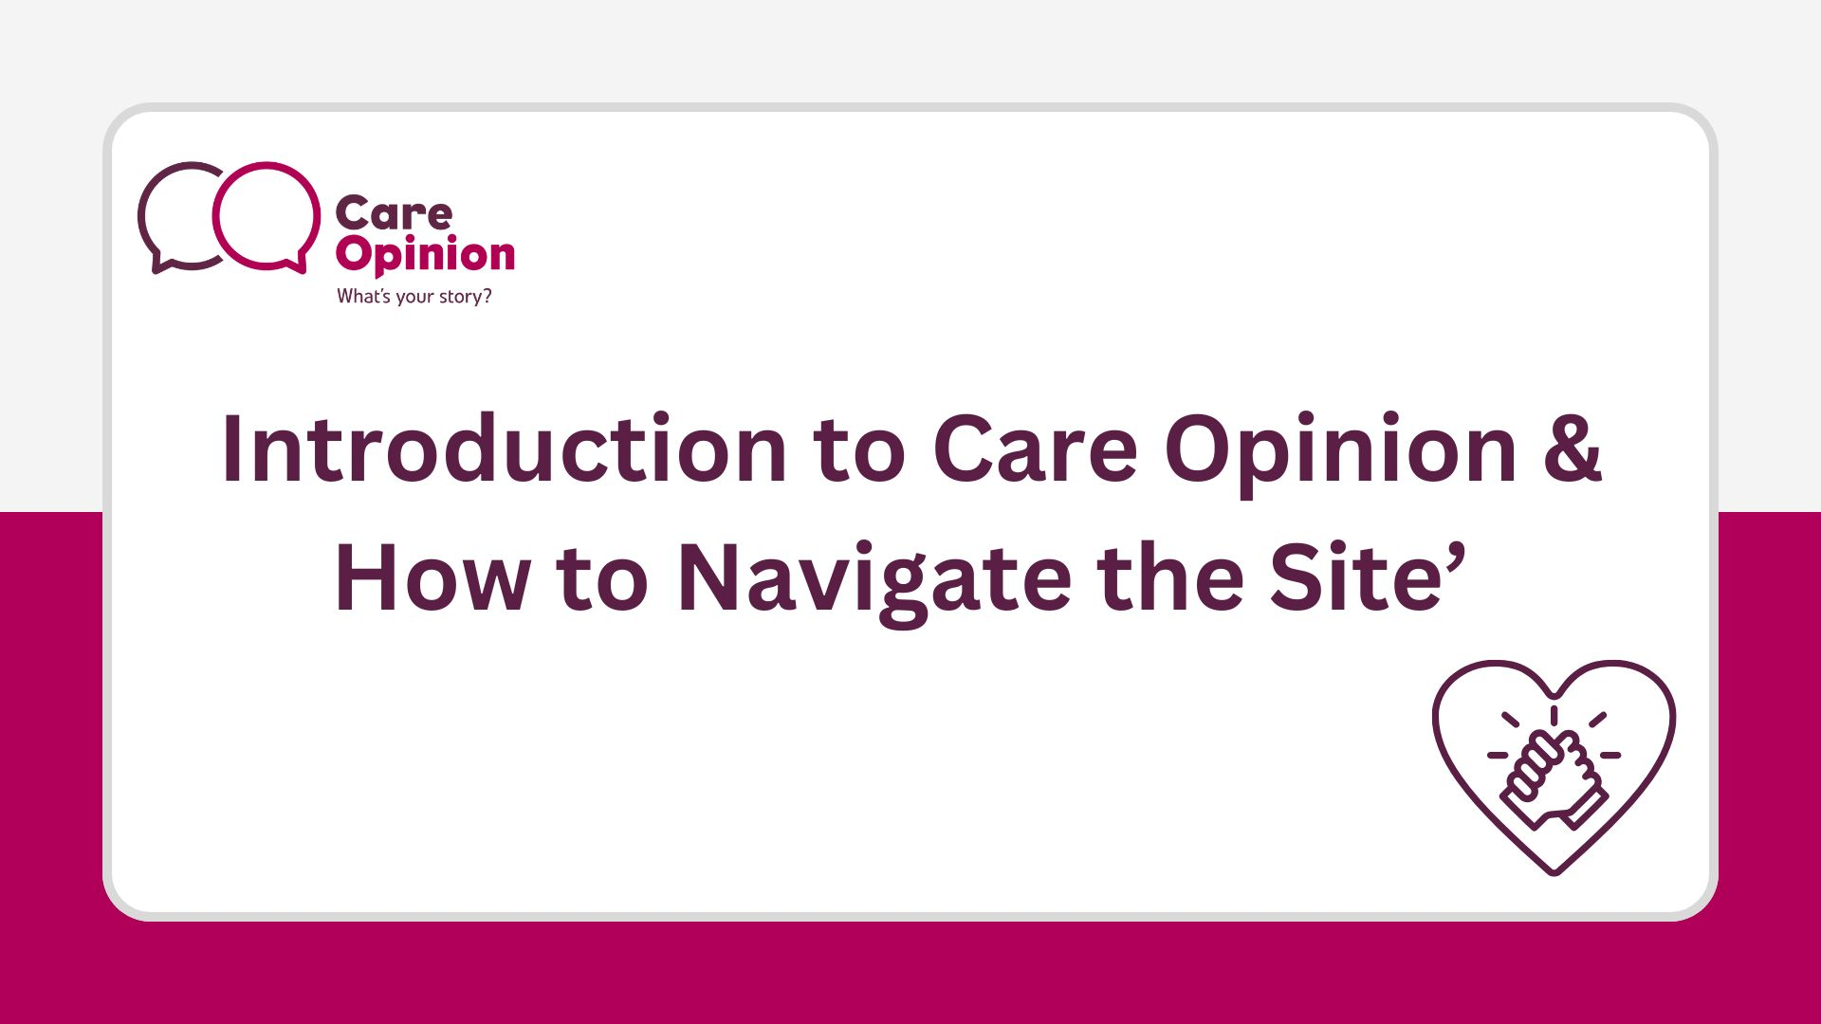

Slide 2

The website examples and terms in this presentation are based on the UK versions of Care Opinion, but the features work the same across all Care Opinion sites, including Canada and Australia.

Slide 3

What we will cover:
Who we are
The process of a story and response
Accessing the Care Opinion website
Searching
Where to find help

Slide 4


Slide 5


Who are we?
Care Opinion is a non-profit social enterprise, based in Sheffield and Stirling.
We have been sharing people’s experiences of health and care services online since 2005, and we have built a national and international reputation for our innovative and value-led approach to online feedback.
At Care Opinion we make it safe and simple to share your story online and see other people's stories too. You can see how stories are leading to change.

Slide 6

Mission, Vision & Values
Our vision
What do we want to see?
We want people to be able to share their experiences of health and care in ways which are safe, simple, and lead to learning and change.
Our mission
Our mission, in a nutshell, is to provide an online platform so that people can share honest feedback easily and without fear
Our values
How will we pursue our mission?
Innovation Transparency Inclusivity Positivity Humanity

Slide 7
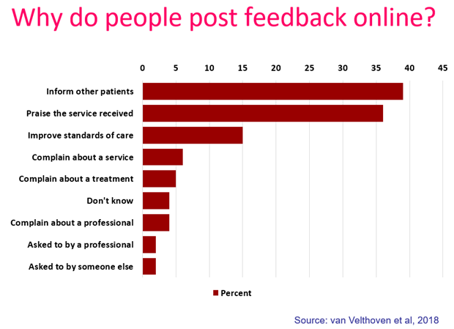

Slide 8
“People need to know how valuable this care is”

Slide 9
“To give people a chance to read what I went through and maybe give them some hope.”

Slide 10
“To highlight the problem without making a formal complaint and to thank the staff for excellent care”

Slide 11
“It was a difficult time for me to go through and Care Opinion allowed me to control the speed
and words rather than be rushed through Q&As or tick box scenario where things don't quite fit.”

Slide 12


Slide 13
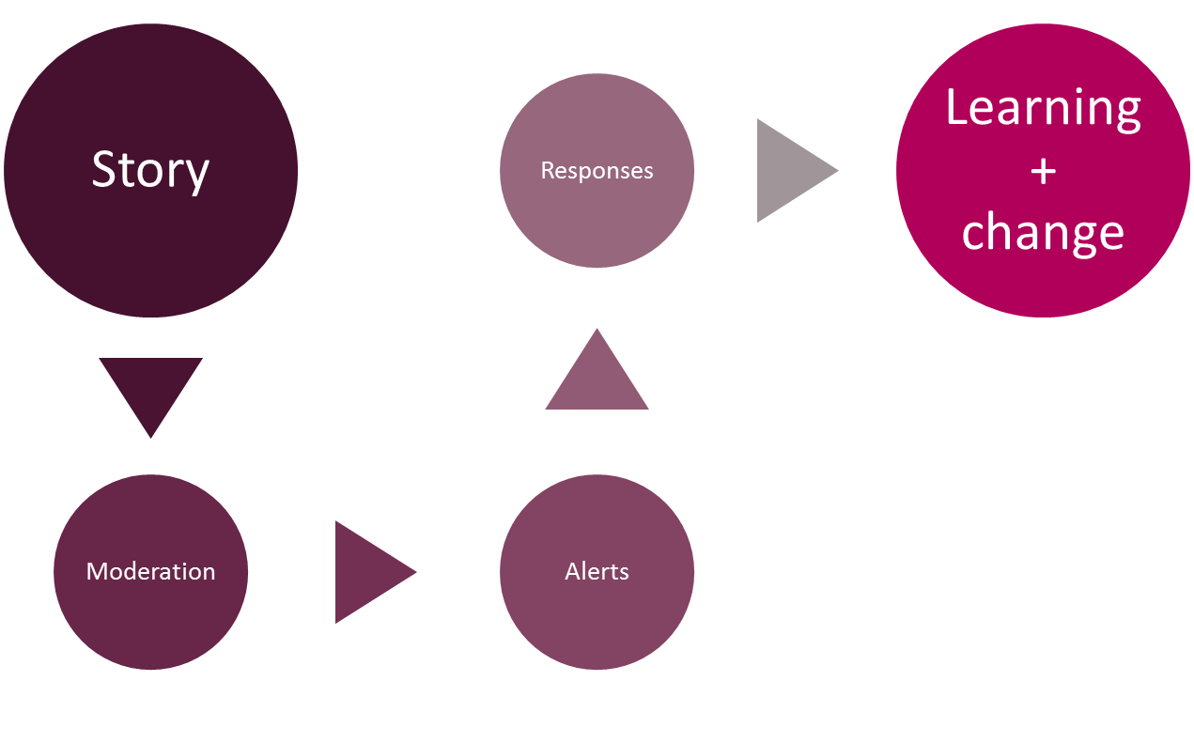
The story-telling flow – it’s about the conversation

Slide 14


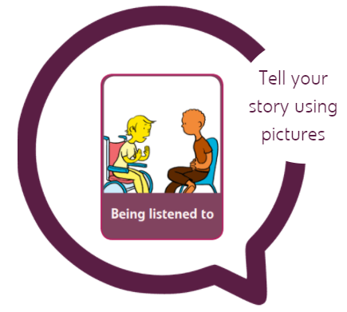

Accessibility
Accessibility features on Vimeo

Slide 15
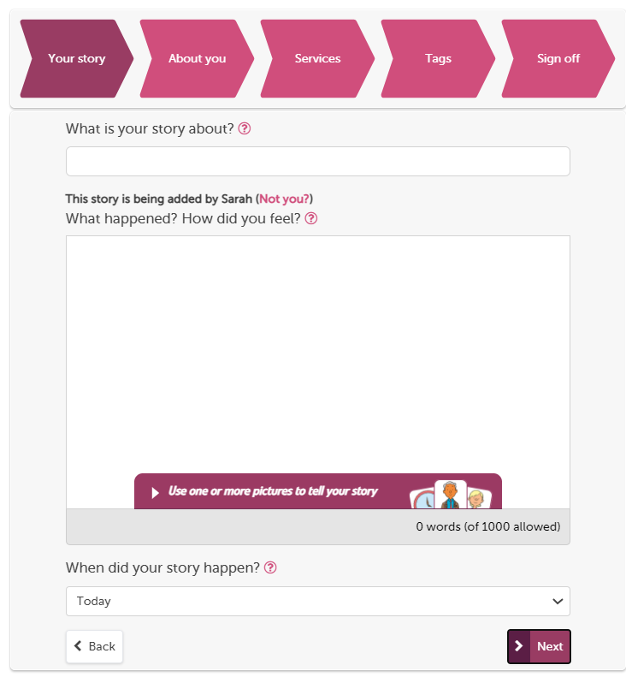
The “tell your story” workflow is our full process on the website
You can use pictures
Give what was good/could be improved tags
Provide optional demographic information, FFT and ratings.
Tag story to multiple providers
Formatted to work on mobile devices
Notes:
You can use pictures
Give what was good/could be improved tags
Provide optional demographic information, FFT and ratings.
Tag story to multiple providers
Formatted to work on mobile devices

Slide 16
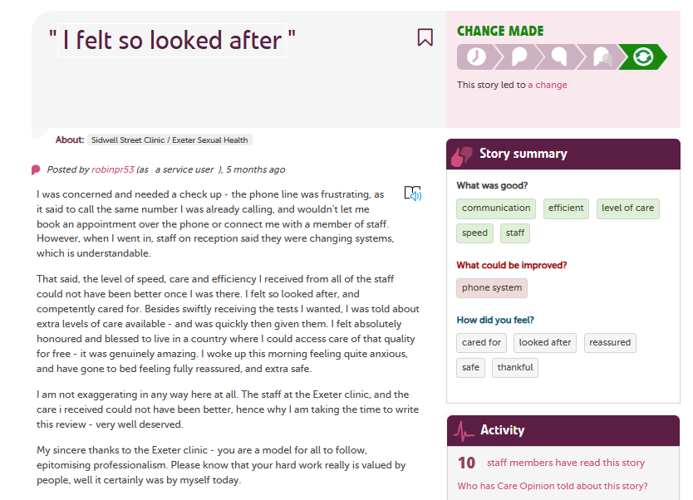
https://www.careopinion.org.uk/1140828

Slide 17
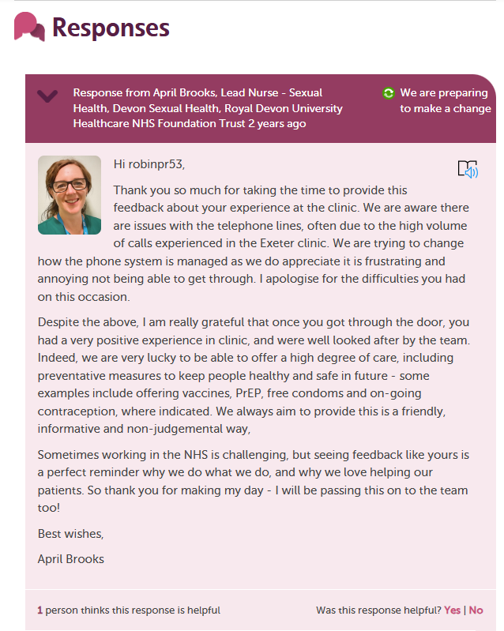
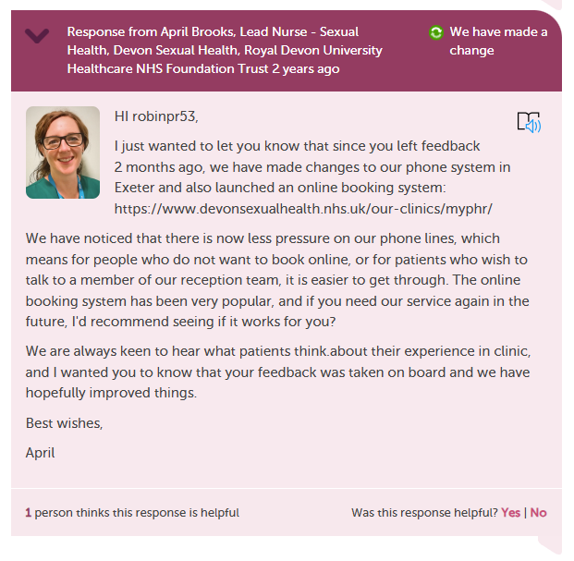
Notes:
April Brooks “Sometimes working in the NHS is challenging, but seeing feedback like yours is a perfect reminder why we do what we do, and why we love helping our patients. So thank you for making my day - I will be passing this on to the team too!”

Slide 18


Inviting online feedback with an Invitation Link
Bespoke Invitation links can be added to most correspondence
Here are some ideas:
QR code on posters/flyers/leaflets
Texts – appointment reminders etc
Appt or follow up letters
On staff email footers
In emails
Social Media
On a tablet or Ipad - Kiosk
The simplest way to invite people to share their experiences on Care Opinion is just to provide a link to the site.
Notes:
The simplest way to invite people to share their experiences on Care Opinion is just to provide a link to the site.
Another way is to make an "invitation link“ and provide that instead. They look like this https://www.careopinion.org.uk/49/aah-ed
What does an invitation link do?
An invitation link allows you to:
customise various aspects of our story-telling workflow
easily access widget codes, kiosk links or QR codes to share with people using services
keep track of which stories came via which invitation links, and run reports and visualisations easily

Slide 19

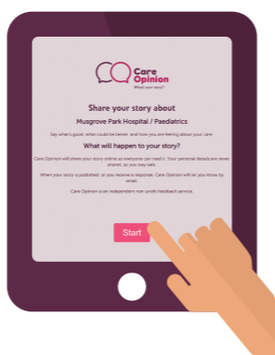

Slide 20





Print Materials
All materials, excluding the freepost leaflets, are available to download
https://www.careopinion.org.uk/info/new-materials
Support available from Care Opinion:
Care Opinion high-res logos available
Can provide examples

Slide 21
* NEW * Subscriber Chat Sessions for 2026
We very excitingly launched our new Subscriber Chats shaped by the topics our subscribers most often ask us about earlier this summer. These podcast-style sessions are designed for open conversation, shared learning, and practical ideas you can take straight back to your teams. These have shown to be very successful thus far, with some amazing conversations taking place, making way for lots of learning!
🚀 Subscriber Chat 1: Embedding Care Opinion Organisation-Wide
📅 Tuesday 7th May 2026 @ 2.30pm - 3.30pm - Watch the recording here
🌍 Subscriber Chat 2: Care Opinion in Remote Communities
📅 Tuesday 2nd June 2026 @ 2.30pm - 3.30pm- Watch the recording here
🗣️ Subscriber Chat 3: Supporting Care Opinion in Mental Health Services
📅 Wednesday 17th June 2026 @ 10am - 11am - Watch the recording here
🗣️ Subscriber Chat 4: The Human Touch in an AI Age: A Deeper Dive into Care Opinion Responses
📅 Tuesday 11th August 2026 @ 2pm - 3pm - Register

Slide 22
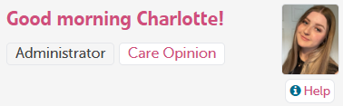

How to find help?
Help button
Support page
Contacting your lead within your organisation
Contacting your Care Opinion support lead
Emailing: info@careopinion.org.uk
Need help navigating the site? Watch our webinar on all things navigation here!
Sign up for our Spring Conference here!

Slide 23


Slide 24
