Slide 1

Where are we going next?
#coLondon17
James Munro, CEO
@jamesfm55

Slide 2
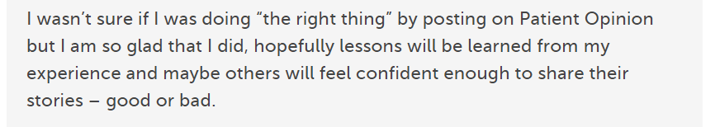
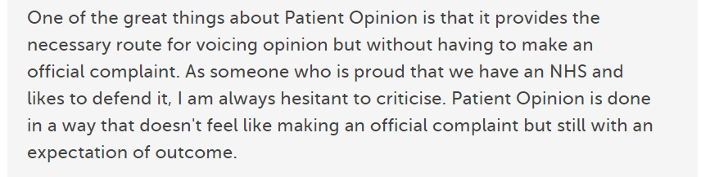
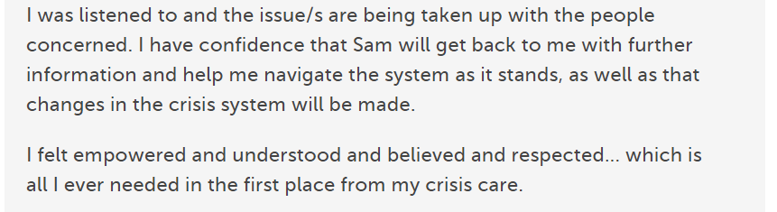

Slide 3
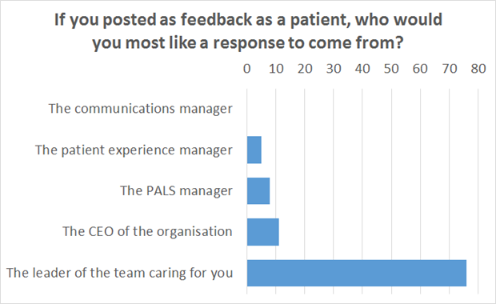

Slide 4
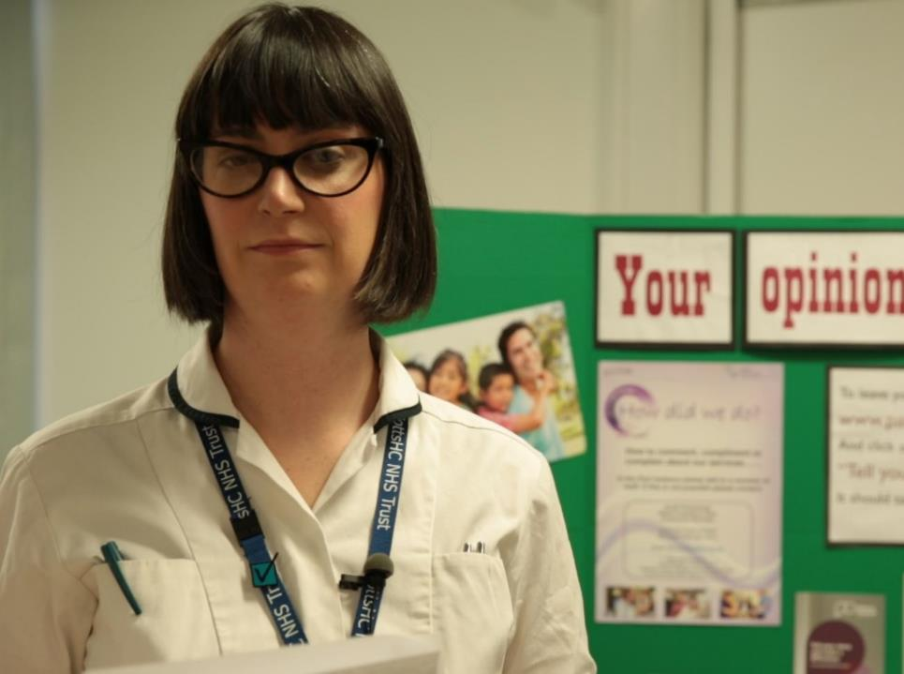
“More than just listening, it has helped us to focus on what we can change to improve our service.
We’ve learnt that Care Opinion gives patients a powerful voice, which in turn has empowered us.”
Lisa Metcalf
podiatrist

Slide 5
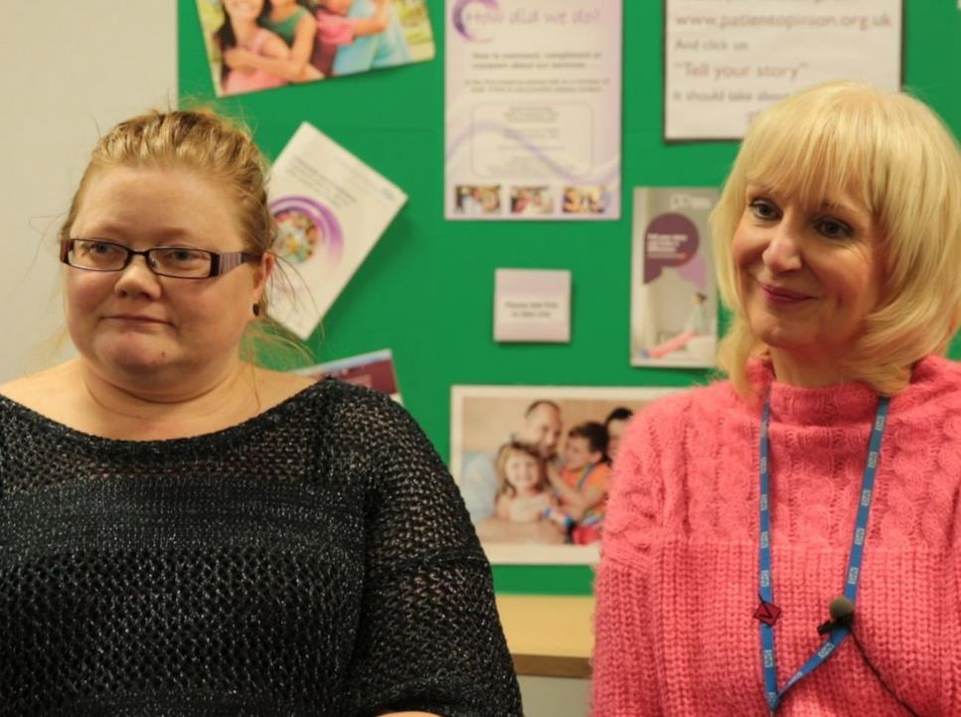
“As we’ve been on a journey, so have the users and carers been on a journey. They now have trust in us, to know that we do want to hear it, warts and all, and that we will work on what the issue is.”
Jenny Newman and Sue Dyke, public engagement

Slide 6
Direction of travel
Quality improvement
Clinical teams
  End of life care programme
  Also learning disability, dementia, CAMHS…?
Learning
  Health/care students
  Continuing professional development

Slide 7
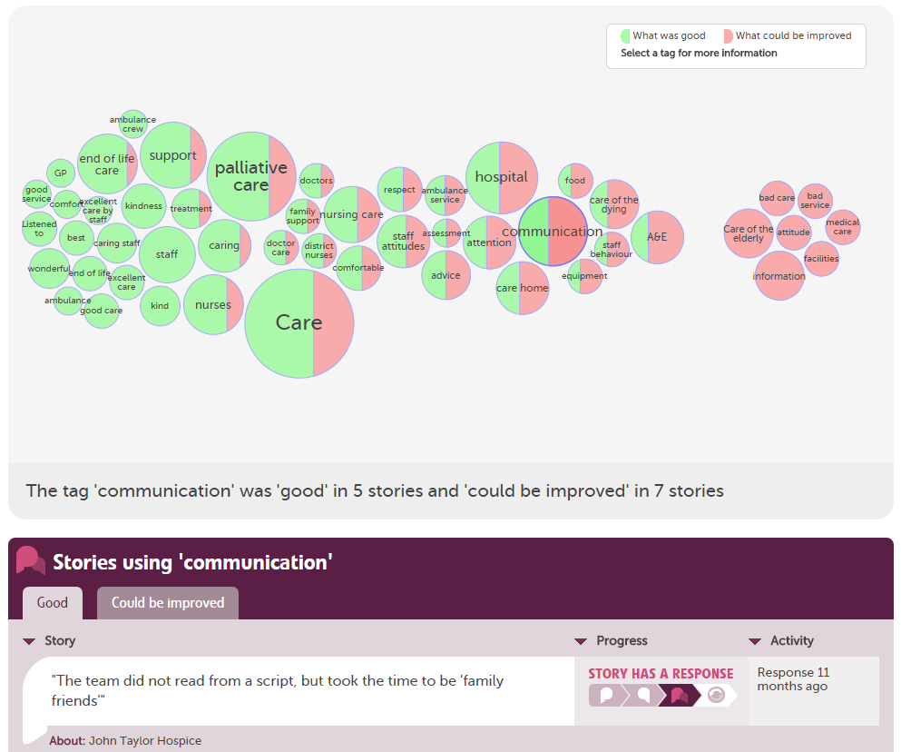

Slide 8
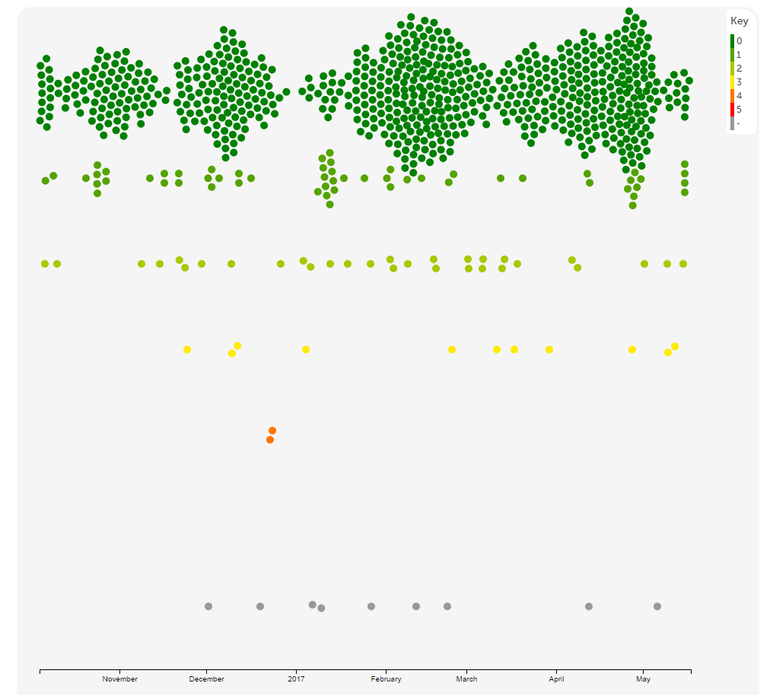

Slide 9
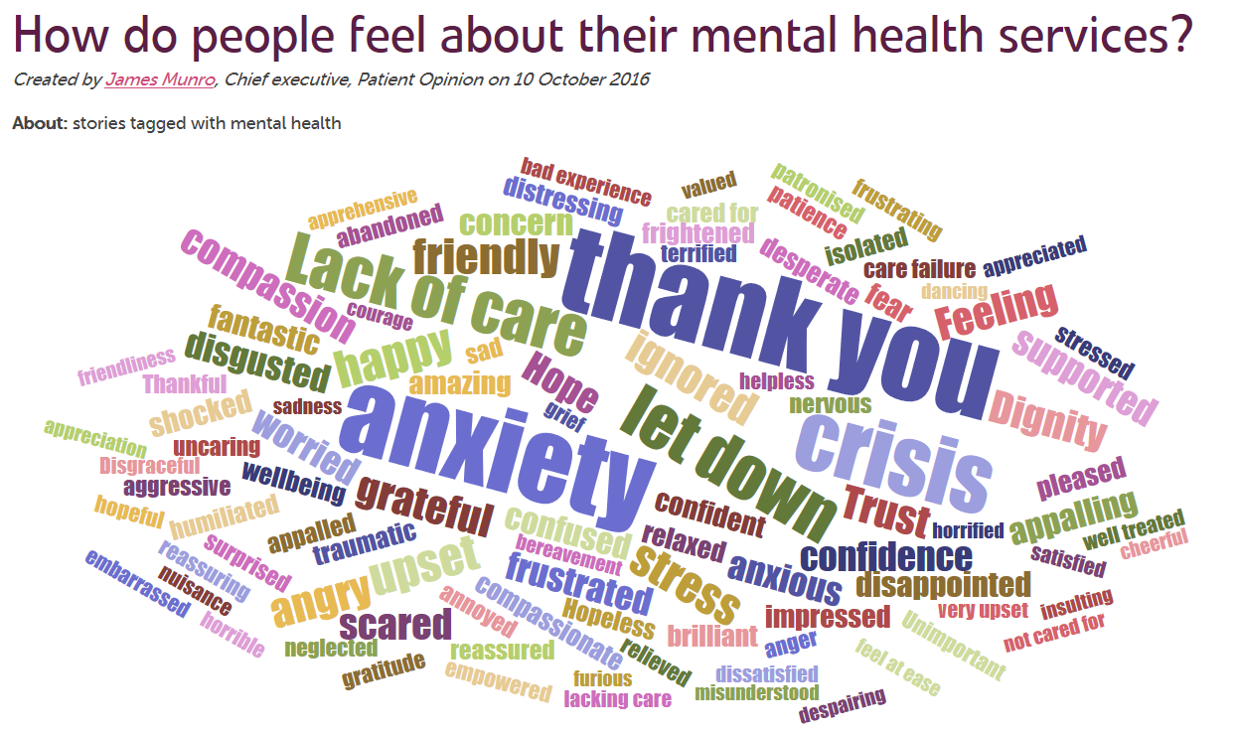

Slide 10
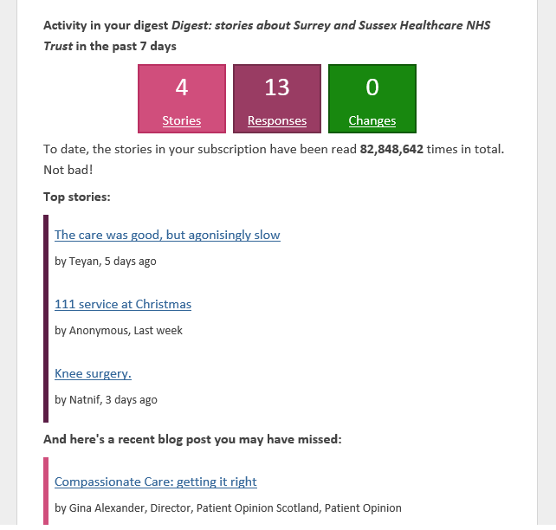

Slide 11
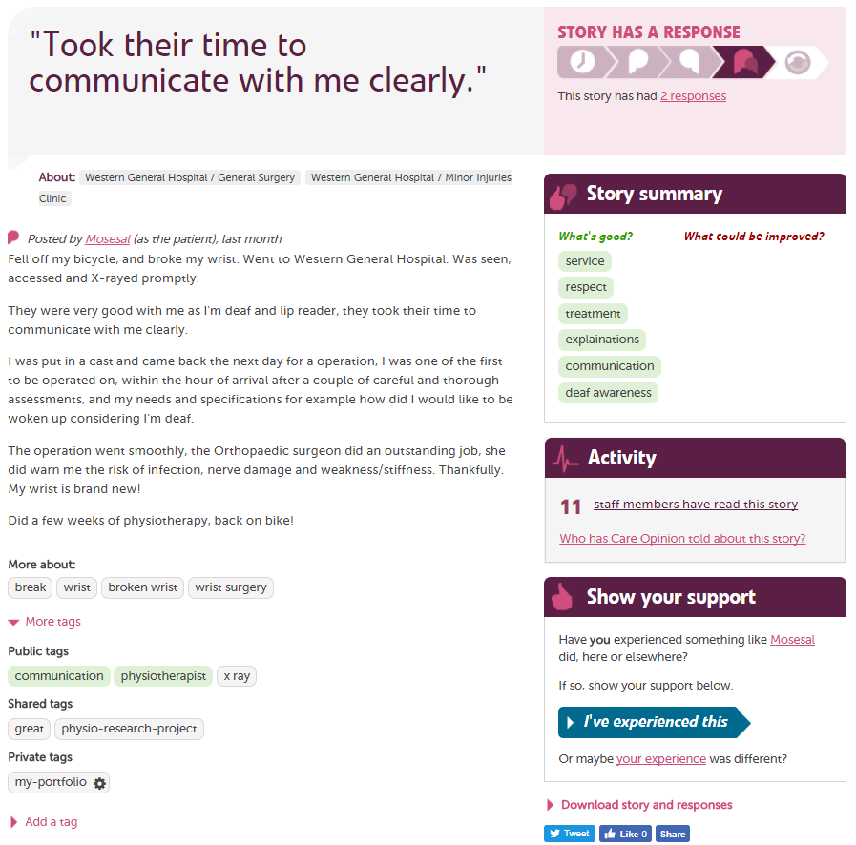

Slide 12
The world is changing – fast
Old world | New world
Hierarchy | Network
Broadcast | Conversation
Hiding | Sharing
Few | Many
Closed | Open
Passive recipients | Active participants

Slide 13

“Thank you for fixing my brain, its chuffing great.”
“I wanted Jules to know how much I appreciate everything he has done for me.”
“I never feel rushed and always feel I can ask questions.”
“She greeted us with a big smile. My girls felt at ease at once.”
“He had so much patience with my husband, who suffers from Alzheimer's.”
“They allowed us to spend our time with mum.”

