Slide 1

People helping mental health care get better
#coLondon17
James Munro, CEO
@jamesfm55

Slide 2
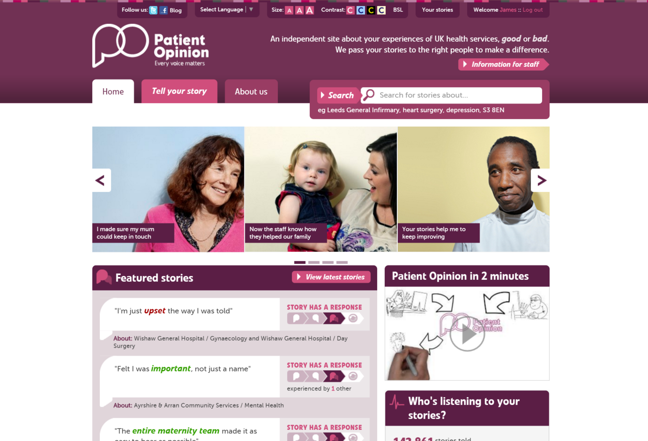

Slide 3
Mission
Our mission is to provide an online platform so that:
people can share honest feedback easily and without fear
stories are directed to wherever they can help make a difference, and
everyone can see how and where services are listening and changing in response

Slide 4
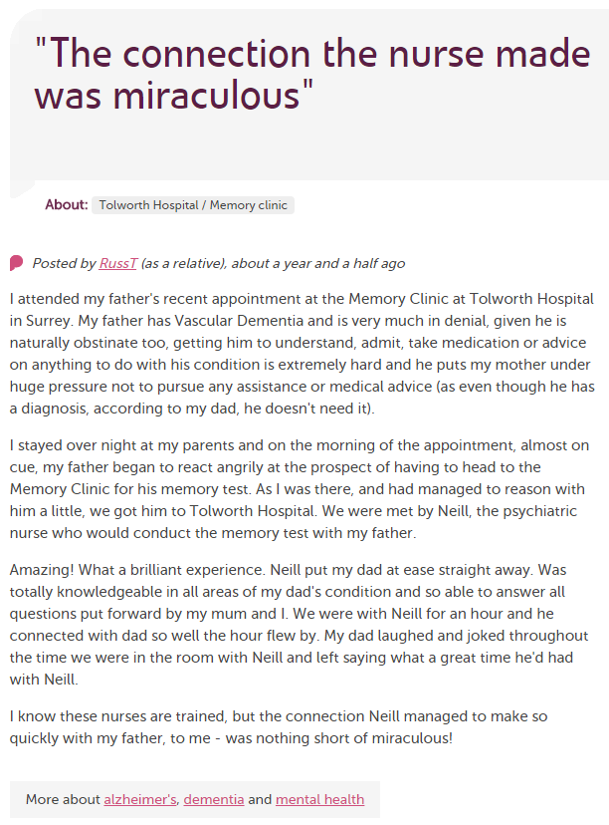
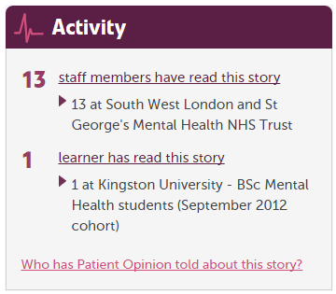
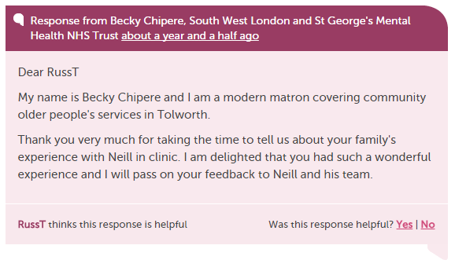

Slide 5
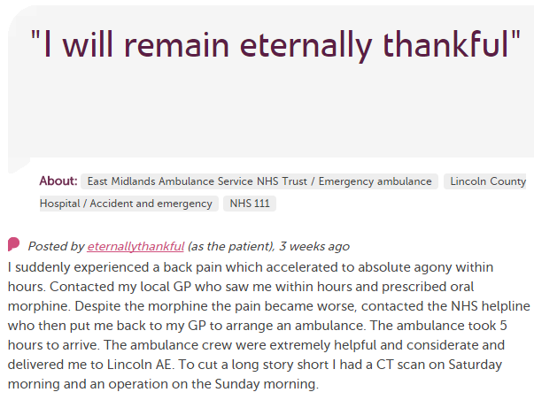











In each provider
Moderation
Clinical staff
Porters, reception, catering…
Pt exp, comms, complaints…
Alerting
CEO
Commissioners
Nursing, AHP students
Healthwatch
Researchers
Patient groups
CQC
Local authority

Slide 6
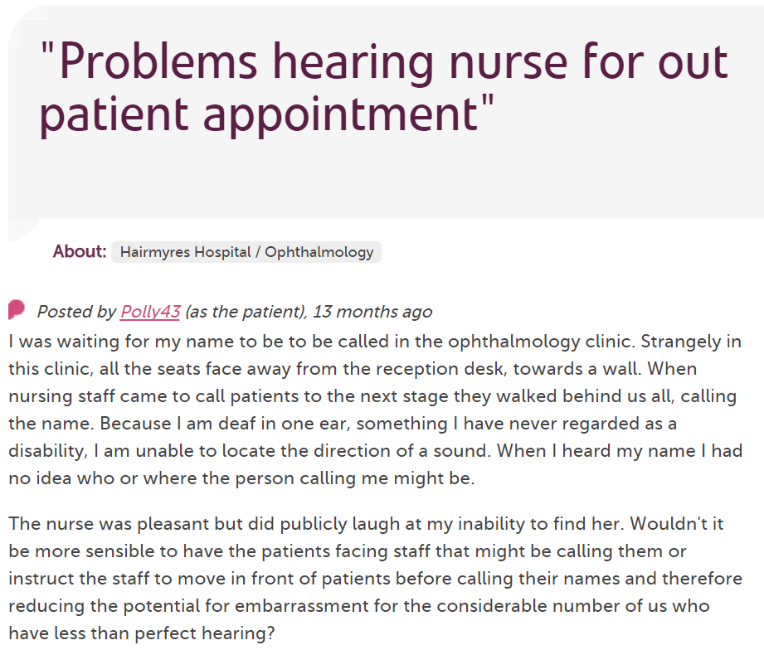
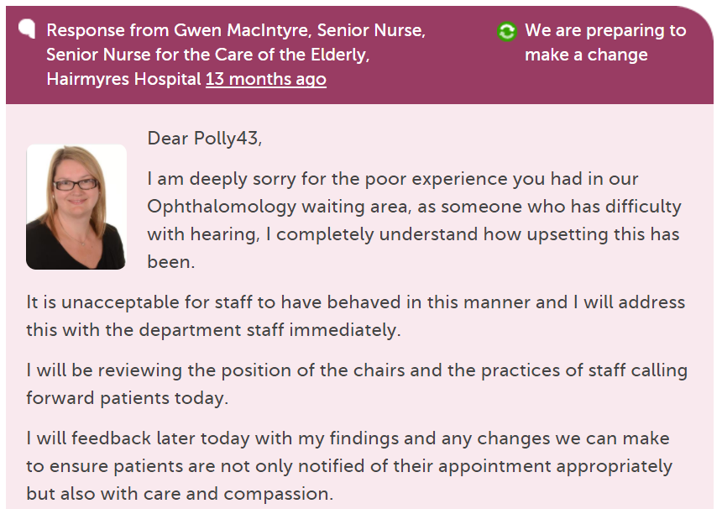
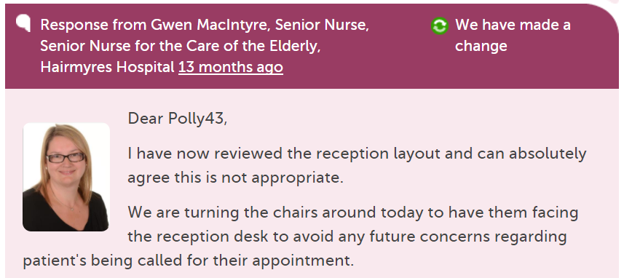

Slide 7
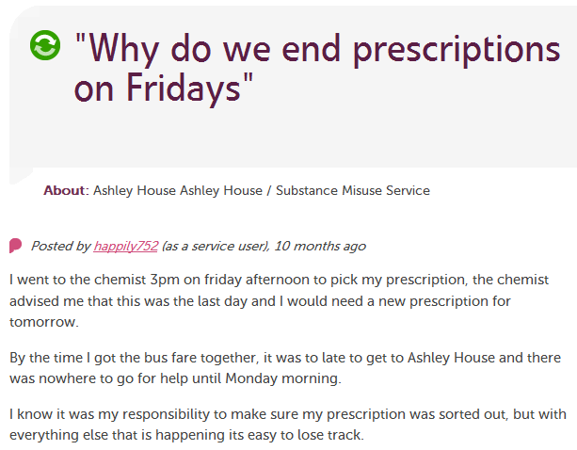
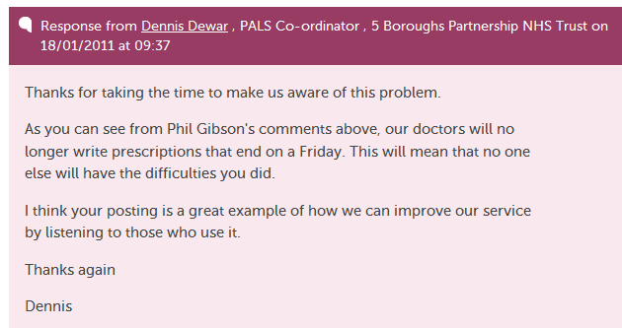

Slide 8
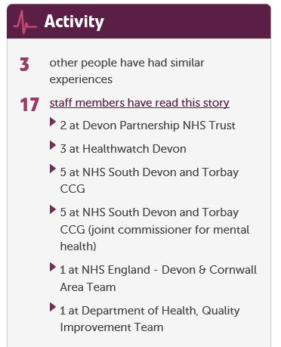

Slide 9
200,000
stories
7,000
staff + students listening
stories read
90 million
times
100,000
visitors per week

Slide 10
Our values
Innovation
Transparency
Inclusivity
Positivity
Humanity

Slide 11
