Slide 1


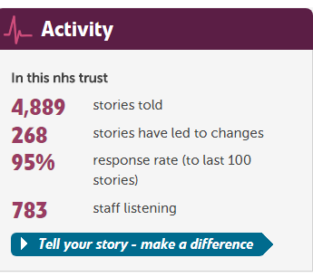
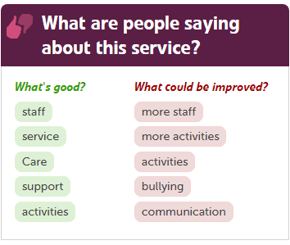
Creating an Inclusive Environment for Feedback

Slide 2
Forensic & Adult Mental Health Services
Substance Misuse Services
Mental Health Services for Older People
Child and Adolescent Mental Health Services
Intellectual and Developmental Disabilities Service
Integrated Offender Healthcare, East Midlands and Yorkshire.
Community Healthcare
100 + sites 9000 staff Budget 444 million 2016/17

Slide 3
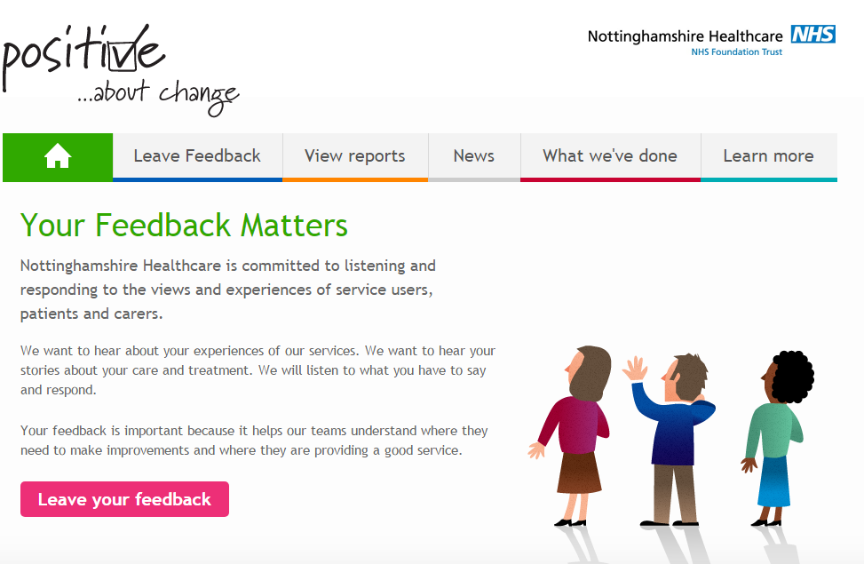
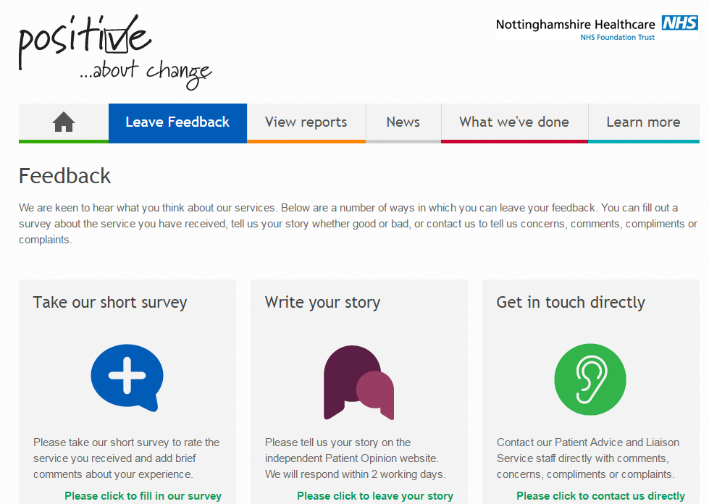
Your Feedback Matters
http://feedback.nottinghamshirehealthcare.nhs.uk

Slide 4
Feedback Expectations
Pain Point: Time, virtual communication. Working with available tech when staff are not tech savvy E.g. Response times
Solutions: Prevention is better than cure! Personalised conversations using CO data to improve services
Strategic: E.g. Quality & Governance Groups, Trust board meetings
Local: Ward and community involvement
Tech: Use it wisely and creatively with humanity

Slide 5
CO & Quality improvement
CO tells us what we do well and what we need to improve
Change is a continuous process. Communication should to be too
Making improvements to services, culture and lives in partnerships
Kings’ Fund, Patient Experience collaborative

Slide 6
Staff Learning
Pain points
Challenges - feedback in ‘hard to reach’ services
Where, when and how to gather feedback
Austerity in the NHS
‘You still don’t listen to us’
Solutions:
Feedback themes from patient and carer meetings
Volunteer Feedback collectors
Own it. Get creative and ‘break the rules’. Tenacity.
NottsHC, an improved percentage of patients posting stories
Working closely with CO subscription services

Slide 7
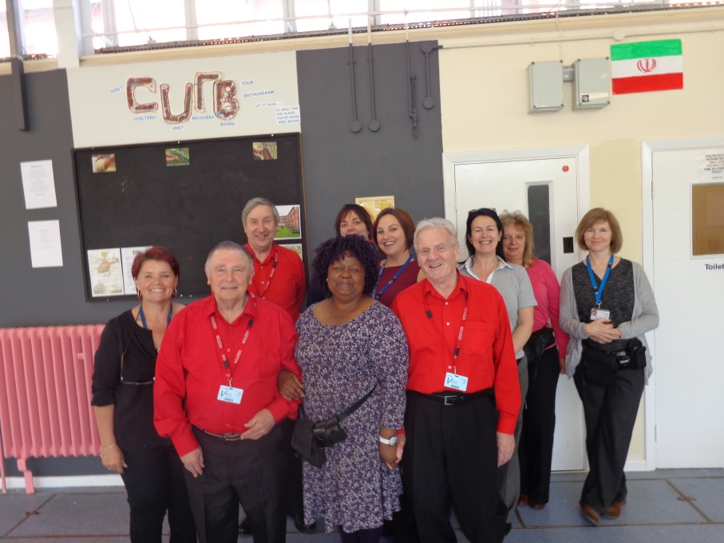
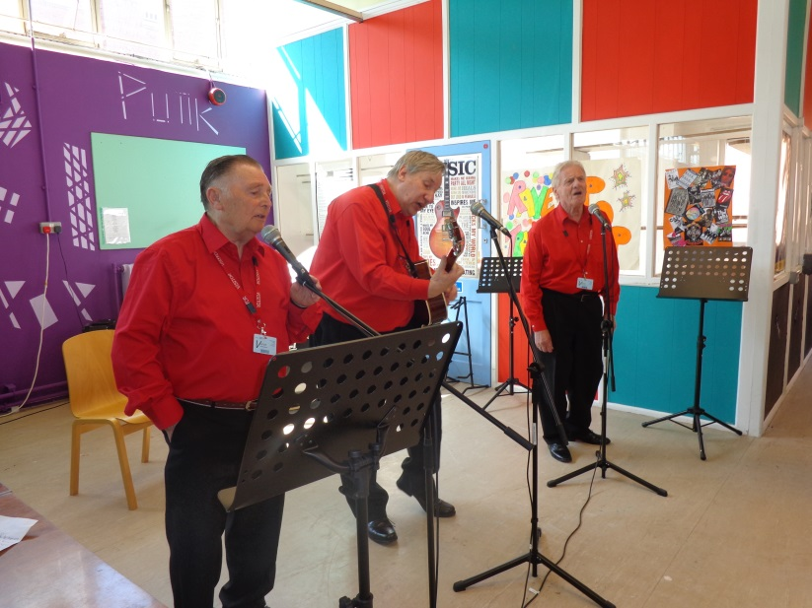
‘Patients do not have access to the internet. Talking to volunteers, as opposed to staff,
I hoped that people would feel safe enough to be honest in their replies.’
Adele Bryan – Interim General Manager Mental Health & National LD Directorate
https://www.careopinion.org.uk/blogposts/624/using-care-opinion-in-high-secure-services

Slide 8
Staff Recognition
Care Opinion blog shared with staff
Nigel Groves, Involvement and Experience Lead
Dear Nigel
Great that Care Opinion have chosen to highlight the work that is taking place at Rampton and well done for the approach and work you are taking forward. It is so important that the patients are supported and provided with the opportunities to give their views and know that they are being listened to , heard and action is taken when possible
Ruth Hawkins CEO

Slide 9
Impact
More involvement - care planning
‘The first care plan wasn't right so another plan had to be done. A nurse sat down with me to write a new care plan that was right’.
Tracking impact, welcoming a feedback culture
Personalised staff responses connect with the storyteller
The Ideal Waiting Room Project https://www.careopinion.org.uk/opinions/253657
‘I am sorry that my friend's last year was not made easier by visits to the memory clinic because the surroundings and lack of a human touch on arrival there were so disconcerting’.

Slide 10
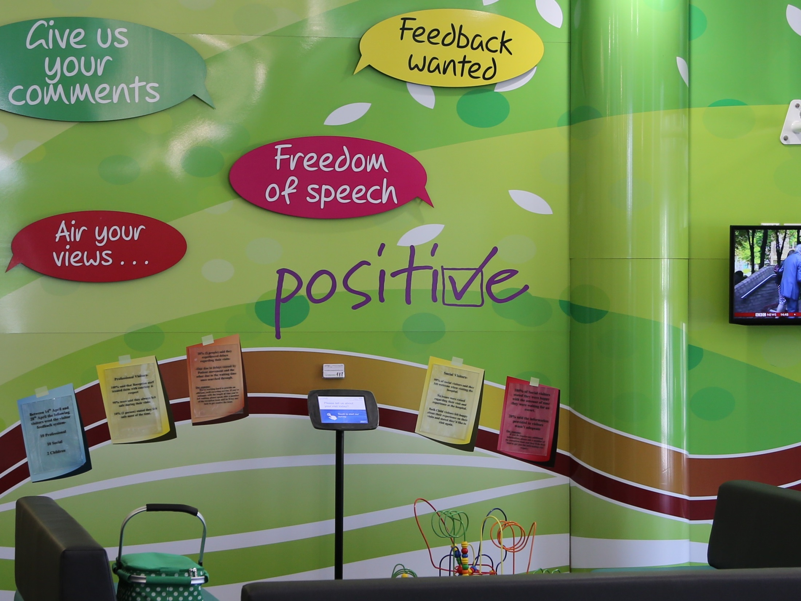

Slide 11
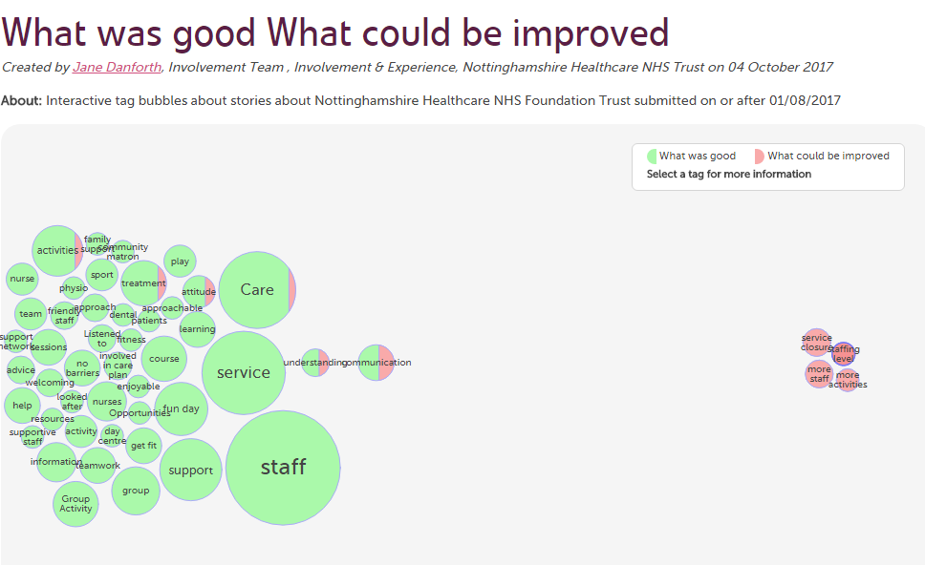

Slide 12
Changing lives Changing services Changing culture
‘It offers us the chance to say sorry, to make things better in a very open and transparent way’
Julie Grant - Head of Communications Nottshc
360 degree assurance

Slide 13
