Slide 1
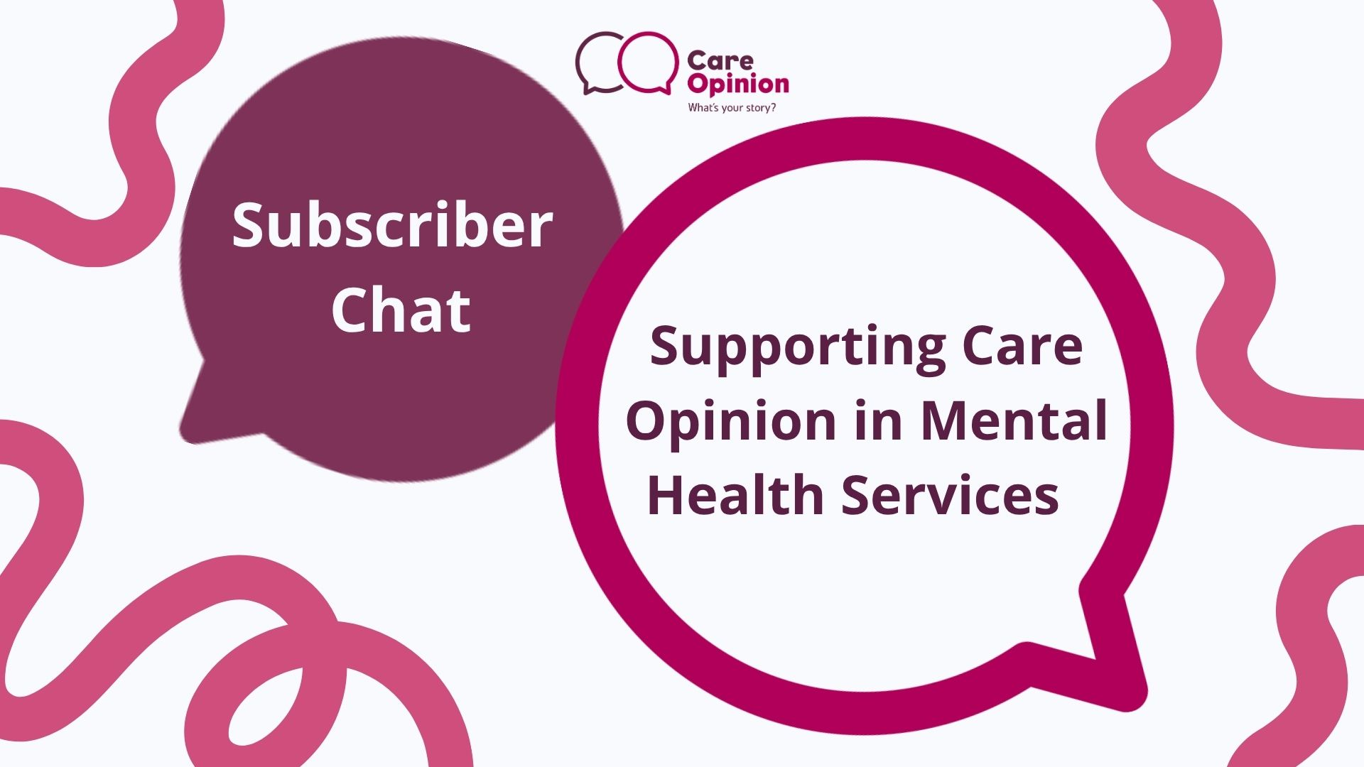

Slide 2



Webinar recording – Camera & mic
Accessibility - Turn on ‘live captions’
Teams ‘chat’ feature – get involved in the conversation!
Follow up email and resources
The terms and examples in this presentation are based on the UK version of the Care Opinion website. However, the same features operate consistently across all Care Opinion platforms,
including those in Canada and Australia

Slide 3
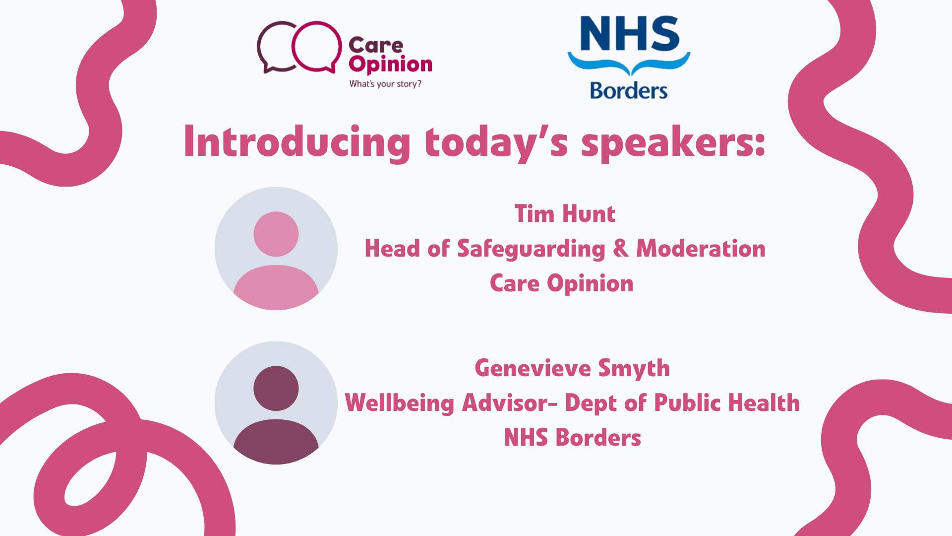

Slide 4

Today’s session:
This session will aim to explore how mental health services are using Care Opinion in practice, share learning from frontline teams, discuss the unique challenges of online feedback in mental health settings, and provide practical ideas for promoting and responding to feedback safely and effectively.
This session will be interactive, with polls to answer and plenty of time for questions & discussions- so please, if you have any questions, this is a great opportunity!
We hope that you leave the session today feeling more confident, ready and able to use Care Opinion within your services.

Slide 5
Setting the Scene: Why Feedback Matters in Mental Health Services
Mental health feedback is often deeply personal, emotional and complex
People may need different ways to share their experiences, especially when speaking up feels difficult
Online feedback can help services listen, respond and learn in a more visible way
Public responses can build trust, show compassion and demonstrate that feedback leads to action
The challenge is balancing openness, safety, confidentiality and staff confidence
Notes:
Before we move into the main discussion, it’s worth taking a moment to set the scene for why this topic matters and why we chose to have this Subscriber Chat around Care Opinion in MH services.
We often hear from subscribers how feedback in mental health services can feel very different from feedback in other parts of health services.
People may be sharing experiences that are highly personal, emotionally complex, or connected to times when they felt particularly vulnerable. For some people, giving feedback face to face may feel difficult, or they may not know whether what they say will be heard or acted on or whether its going to affect their care going forward.
Care Opinion gives people another route to share their experience — in their own words, and in a way that services can listen to, respond to and learn from. When responses are public, they can also show others that the service is listening, that feedback is valued, and that there is a commitment to improvement.
At the same time, we know there are understandable concerns in mental health settings.
Services need to think carefully about confidentiality, safeguarding, how to respond to distressing or critical stories, and how to support staff to feel confident when replying publicly.
So today’s session is really about exploring that balance: how we can encourage openness and learning, while also keeping people safe, protecting confidentiality, and supporting staff and services to respond well.

Slide 6
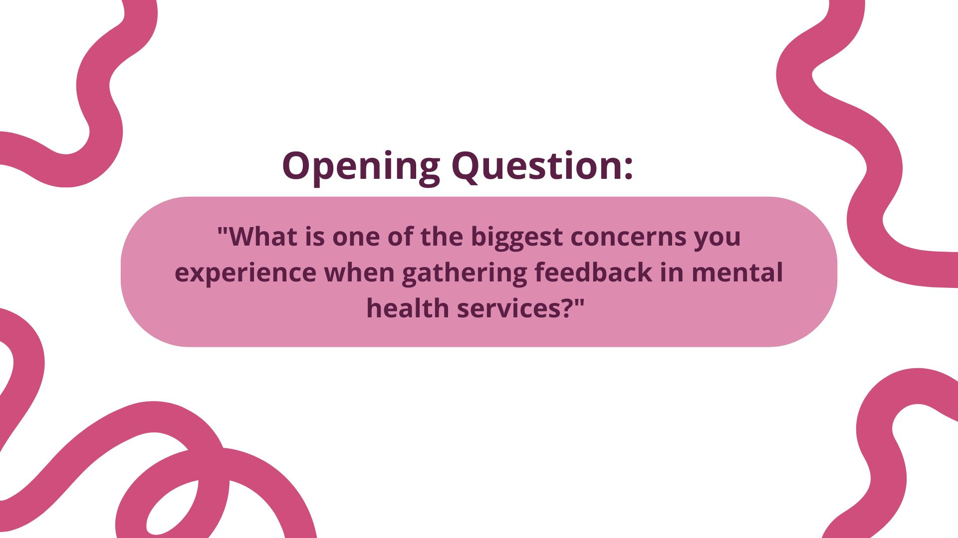

Slide 7
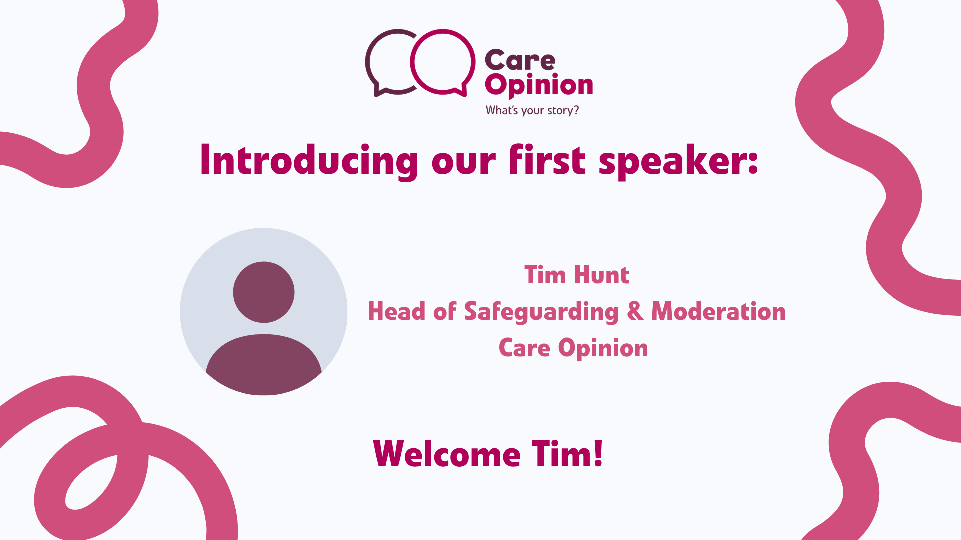

Slide 8
Managing Mental Health Postings:
Where did it all begin?
Capacity, Comprehension, Conversations, Consequences
Duty of Care and Safeguarding
Our Moderation Processes- where it gets tricky

Slide 9
Care Opinion and Mental Health Services:
Where are we now across the UK?
Specialist Services Forensic and Prison Services
Successes and Challenges
How do we compare with other feedback mechanisms?
Where to from here?

Slide 10
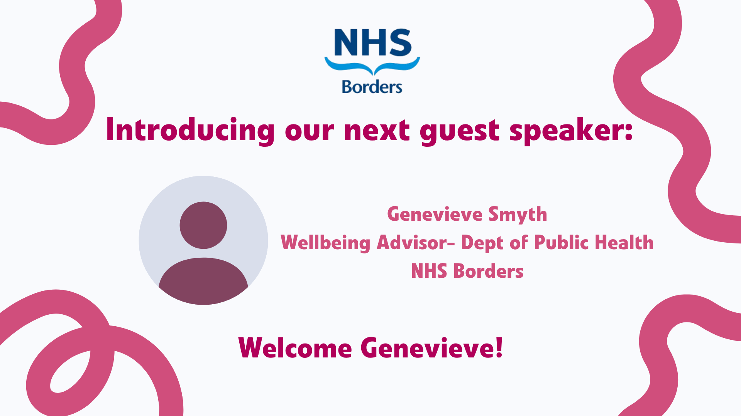

Slide 11
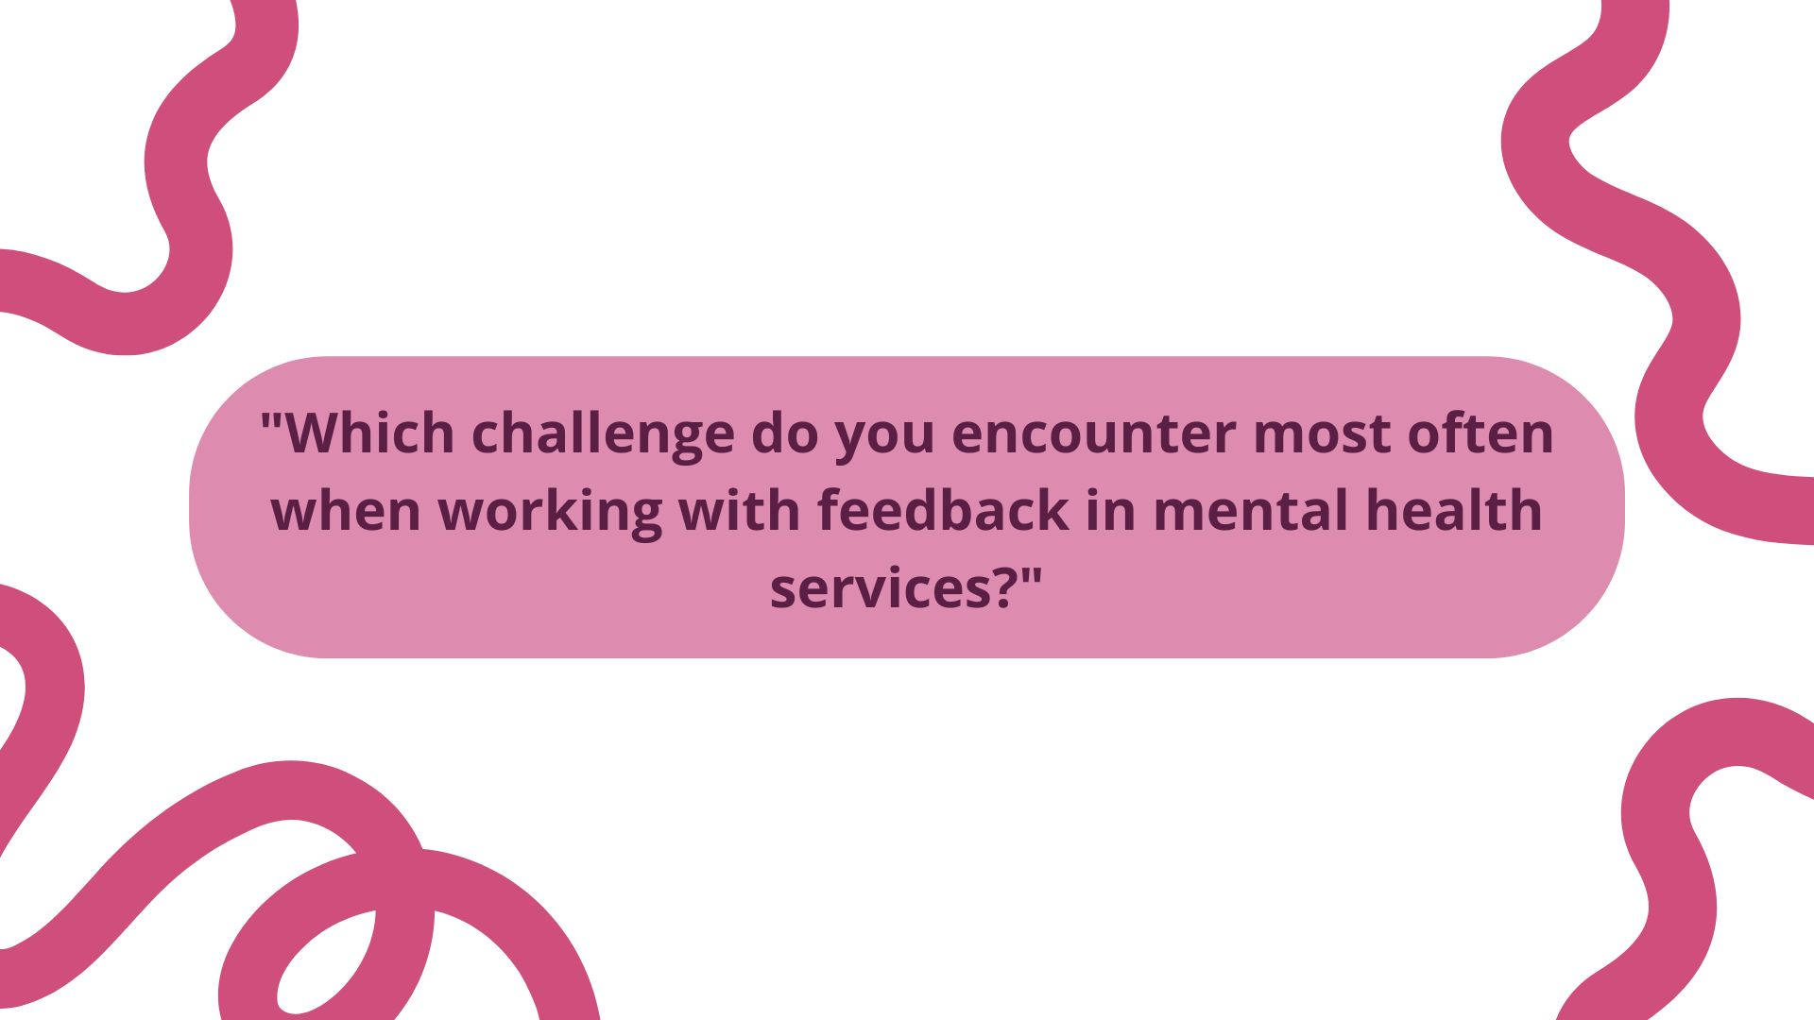

Slide 12
A Catherine Wheel: Author quote:
“Feedback is a way to tell you how the services I have, help me, hinder me, fill me with despair, and make me sing along with Abba”.
“Anonymity makes feedback a less scary and risky thing to do. I can’t help worrying about life’s what ifs… what if they take my services away if I speak out? If they’re horrible to me afterwards? If they see my anger as poor mental health, rather than being quite frankly fed up with your service?
Posting here takes feedback out of the helping relationship and stops it from being seen as biting the hand reaching out to us. Care Opinion is a step removed. We share with you, the providers, instead. No one takes it personally or feels misunderstood”.
Read the amazing blog from Nottinghamshire Healthcare NHS Foundation Trust →

Slide 13



Helpful guidance/ resources:
Mental Health Awareness Week at Care Opinion Blog
Safeguarding & Assigning Criticality Workshop (including slides & recording)
Care Opinion for in-patient mental health & learning disability services- Southern Health & Social Care Trust Blog
Humanity in Action: Reflections from Our 10th Care Opinion Conference
Visit our pages on ‘Understanding Moderation’ here!
For all other help, guidance and information on future sessions like these, visit out ‘know how pages’ here!

Slide 14


