Slide 1
How Care Opinion can be used across a range of mental health services
Sara Kerry, Patient Experience Coordinator

Slide 2
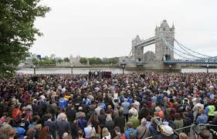
West London Mental Health NHS Trust
Providing care and treatment for around 62,570 people each year
Around 3,560 staff and serve a local population of around 700,000 people
Notes:
One of the most diverse providers of NHS mental health and community services in the UK
Large Trust with 29 sites – Hounslow, Southall, Acton, Richmond, Hanwell, Hammersmith, Northolt, Ealing, Greenford, Isleworth and Crowthorne in Berkshire

Slide 3


Implementation of Care Opinion
Previously used ‘Meridian’
Subscribed to Care Opinion in June 2015 and aimed for full implementation by 1st December 2015
Notes:
Meridian’ for patient feedback and audit
The Trust developed an implementation plan and a communication strategy

Slide 4

Implementation plan
Leads allocated from services
Regular leads meetings
Attendance at meetings and forums
Resources distributed
Mapping/organisational Tree developed
Training given
Notes:
Attendance at Senior Management Team Meetings and Users Forums
Resources - Posters/leaflets/cards
Training – via WebEx sessions,

Slide 5
Roles & Responsibilities outlined

Slide 6

Concerns - Responses
Should it just be senior managers?
Would staff know how to respond?
Would the response be suitable?
Do we need to do an internal quality check?
How will staff react to negative?
Notes:
One major concern at the beginning was regarding responses to stories posted

Slide 7

Concerns - Confidentiality
A number of service users were/are concerned about confidentiality
Notes:
Small uptake in Forensic Services
In Broadmoor Hospital, all outgoing mail is x-rayed, opened & inspected before being forwarded to the recipient, with the exception of mail items sent to those individuals/bodies identified in section 134 (MHA 1983 amended 2007) which will only be x-rayed

Slide 8

Bespoke Service
We are in the process of creating bespoke feedback for the following services:
Broadmoor Hospital
Child and Adolescent Services
Cognitive and Dementia services

Slide 9

Success
1st year
  40 stories were posted
  viewed 7609 times
2nd year
  150 stories were posted
  viewed 24,350
16,741 additional views
Notes:
1st April 2015 to 31st March 2016, 40 stories were posted and viewed 7609 times
1st April 2016 to 31st March 2017, 150 stories were posted and viewed 24,350

Slide 10
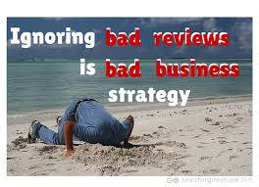
Responders
All staff added as subscribers are now responders
Responses are provided by professionals within the service area
All responses are of a high standard
Notes:
Give example of story and good response

Slide 11
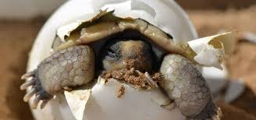
Taking it slow
In the first year 40 stories were posted and in the second, 150
We have spent at lot of the time distributing information and ensuring that people are aware of the service
Setting a three day timescale for providing a response

Slide 12

Now
We are actively offering to assist in writing stories with service users/carers
Attending service user forums, community meetings etc. with resources
Using Mind and our Advocacy Service to gather stories

Slide 13

Next steps
Continue to encourage feedback
Responders to think about ‘change’
Extract learning
Development of bespoke Care Opinion workshops
Monthly ‘good practice’ flyer
Notes:
Learning – Triangulation of data with PALS, Complaints, Incidents,

Slide 14

Thank you

