Slide 1
New
features

Slide 2
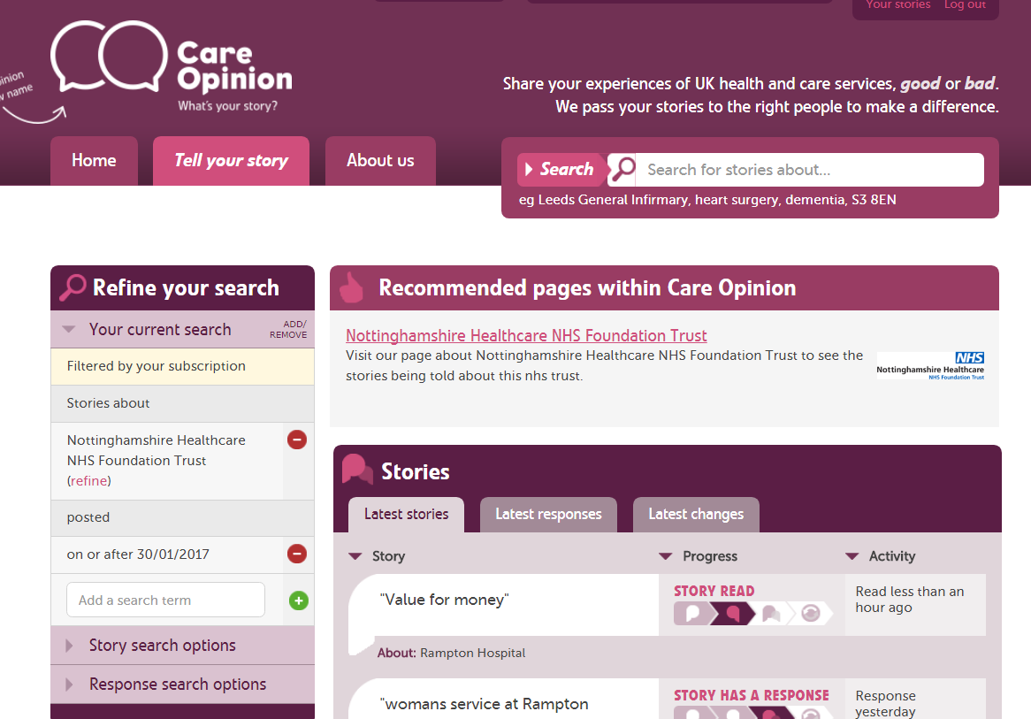
Use your specific requirements to create a report, e.g. an annual report 2017-2018

Slide 3
Existing Reports
Story and response listing
A list of the stories in your search, grouped by the service they are about
Stories in summary
summary of the stories in your search, counting stories by time, place, person, service and criticality
Response and story progress
A summary of responses and changes following the stories in your search

Slide 4
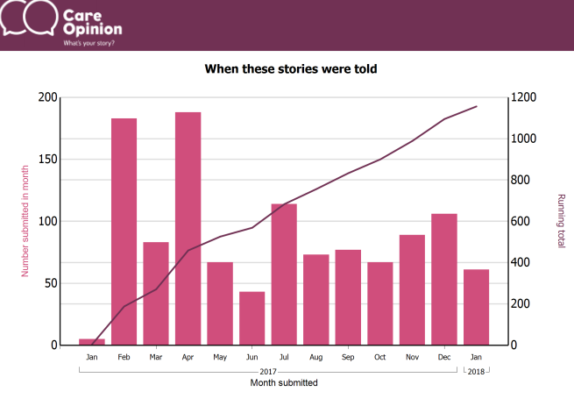
Notes:
Screenshot from stories in summary report

Slide 5
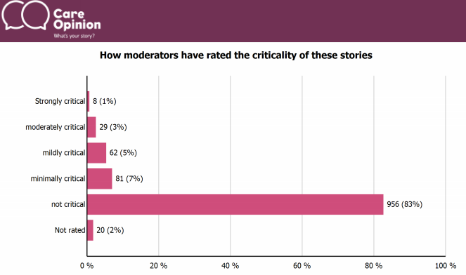
Notes:
Screenshot from stories in summery report

Slide 6
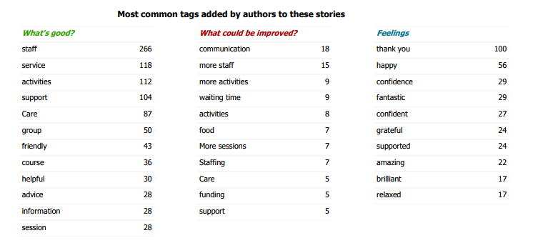
Notes:
Screenshot from stories in summary report

Slide 7
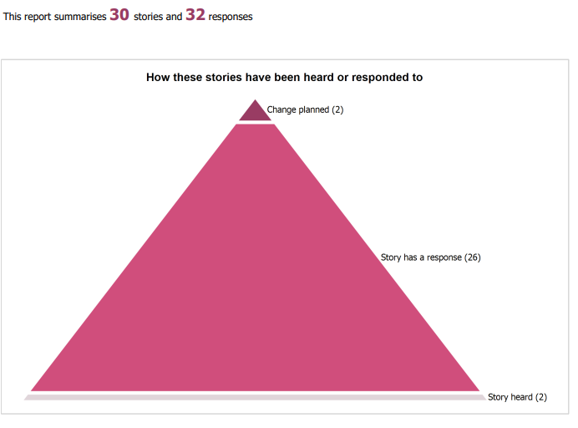
Notes:
Screenshot from response and story progress bar

Slide 8
New reports
Story listing in a table
Table of stories suitable for export to Excel. Includes positive/negative tags, author role and changes.
Opinion authors in summary
Summary of information provided by authors, such as role, age, gender, ethnicity and disability

Slide 9
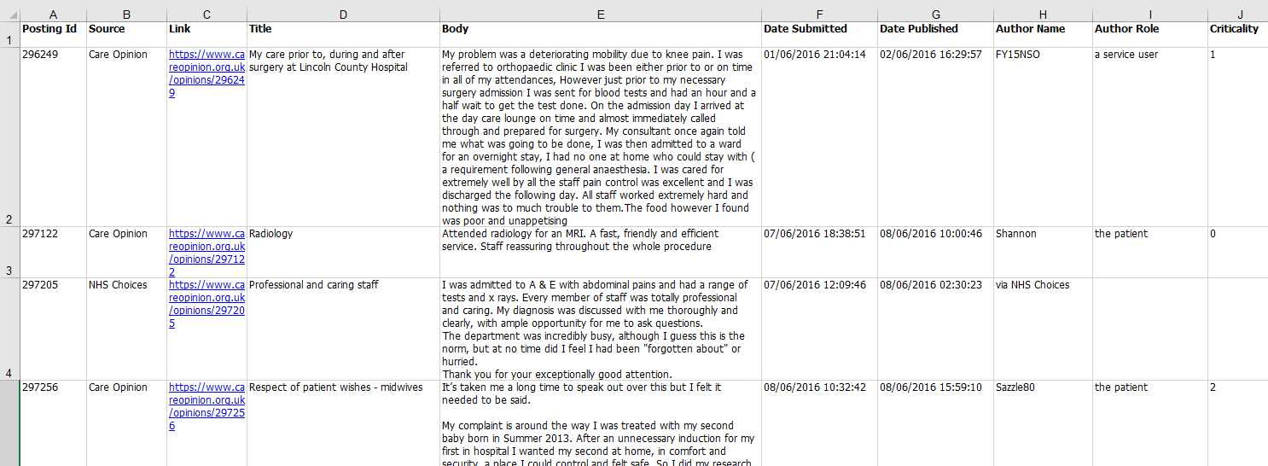
Notes:
Screenshot from story listing in a table report

Slide 10
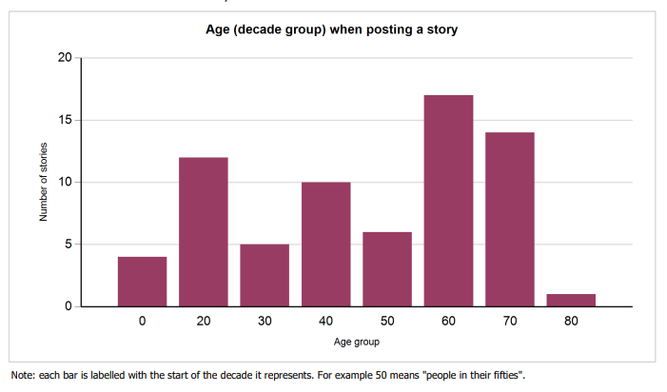
Notes:
Screenshot from opinion authors in summary report

Slide 11
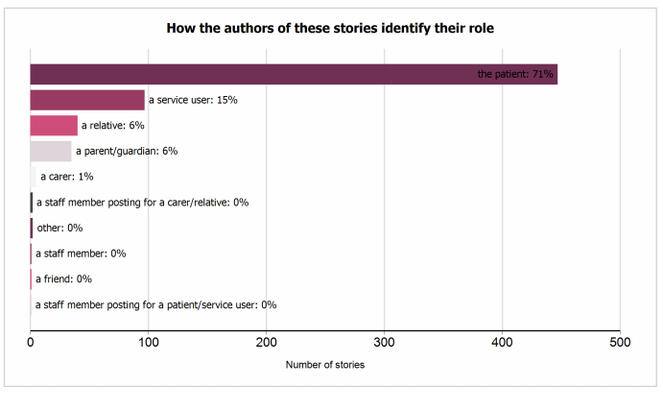
Notes:
Screenshot from opinion authors in summary report

Slide 12
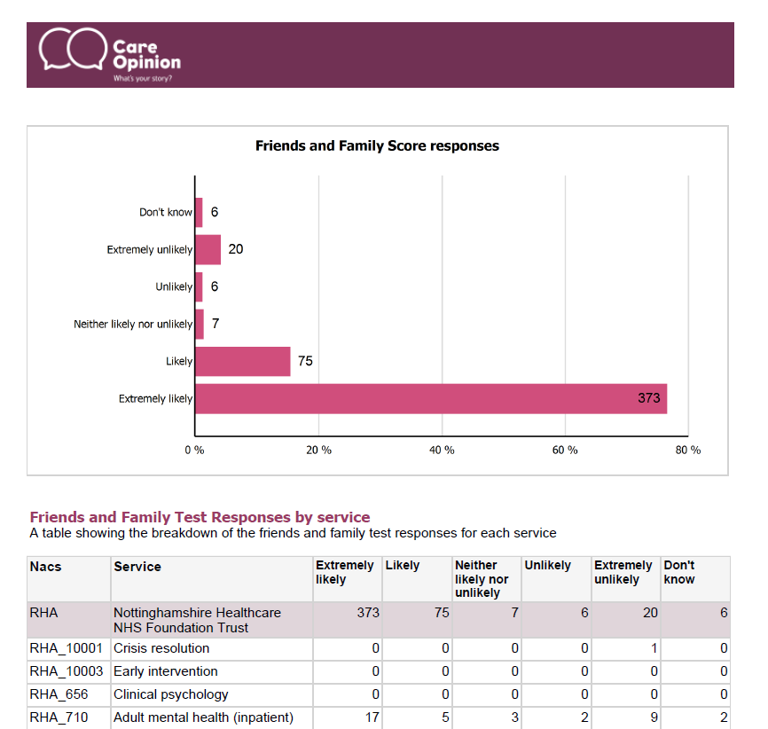
Notes:
Preview of fft report, not available yet

Slide 13
All reports…
Can be saved for later
Downloaded in different formats
Be tailored to specific services
Be set on a schedule (weekly, monthly etc)

Slide 14
Visualisations
Tag bubbles
Story swarms – criticality and progress
Lilly pad
Tag word clouds
Story word clouds
Sunburst

Slide 15
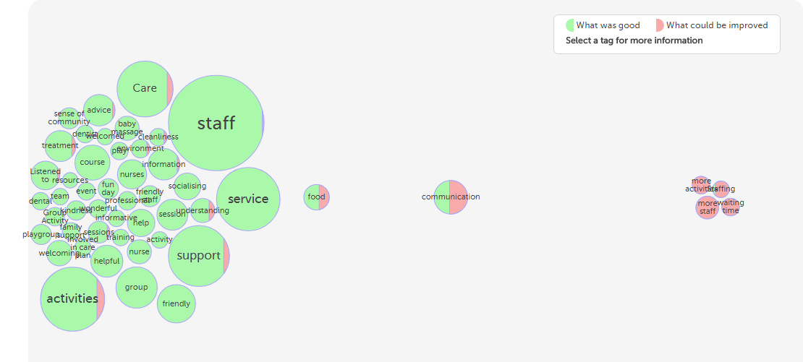
Interactive tag bubbles about All stories about Nottinghamshire Healthcare NHS Foundation Trust 2017-2018

Slide 16
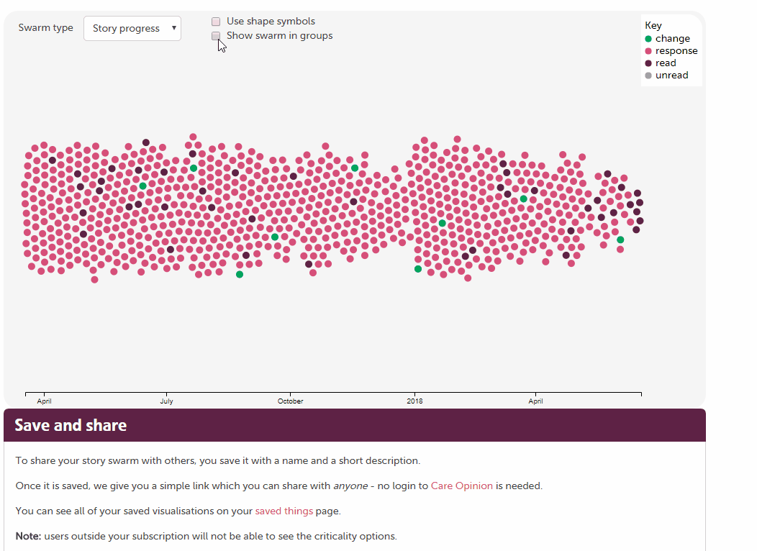

Slide 17
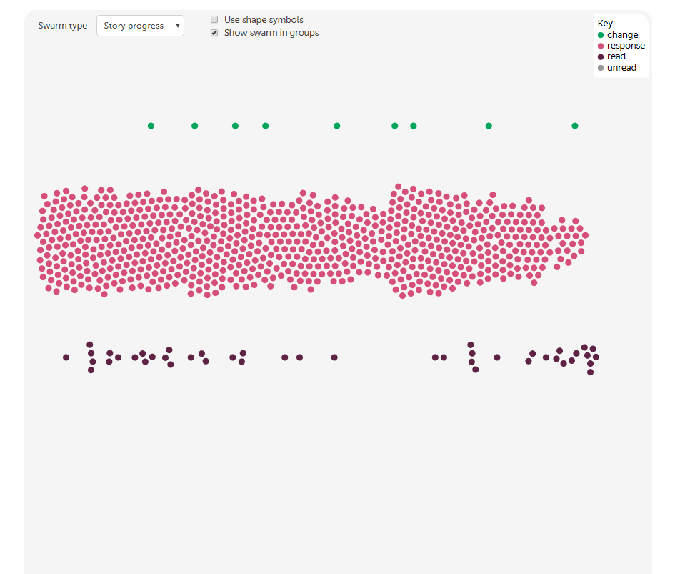

Slide 18
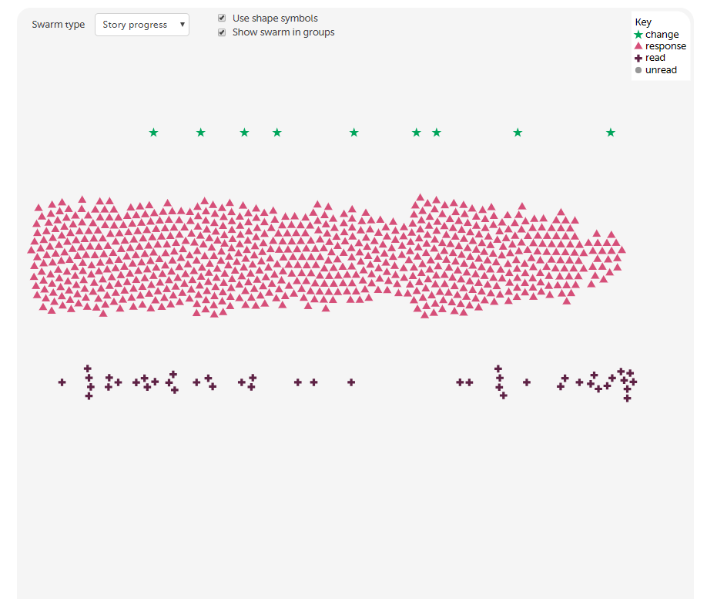

Slide 19
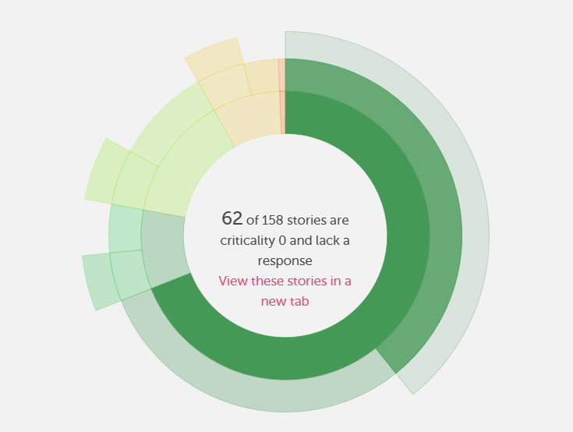

Slide 20
Subscriber tagging
Add private, subscription based or public tags to stories
Subscriber tagging allows for collaborative learning from stories.
Examples of tags that you could add: CQC domain names, stories that require a further response, names of projects or keeping track of examples you wish to use in meetings, reports, classes or case studies

Slide 21
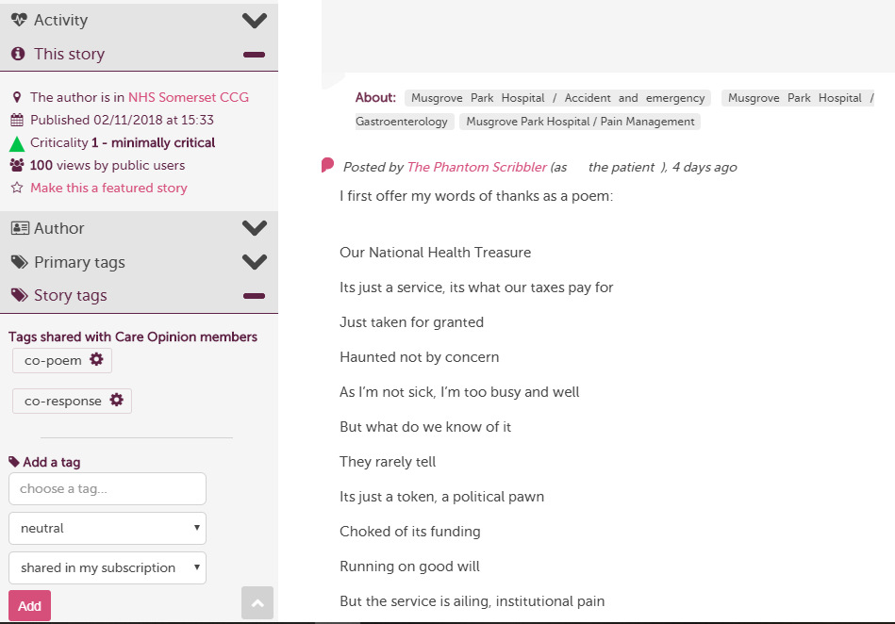

Slide 22
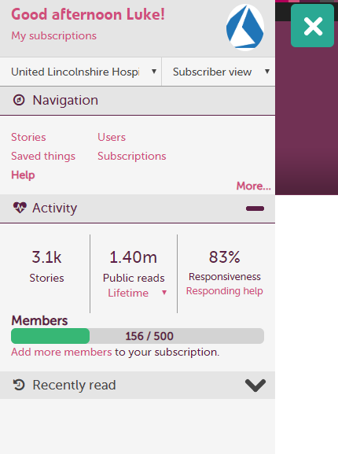
Notes:
New stats section, not available yet

Slide 23
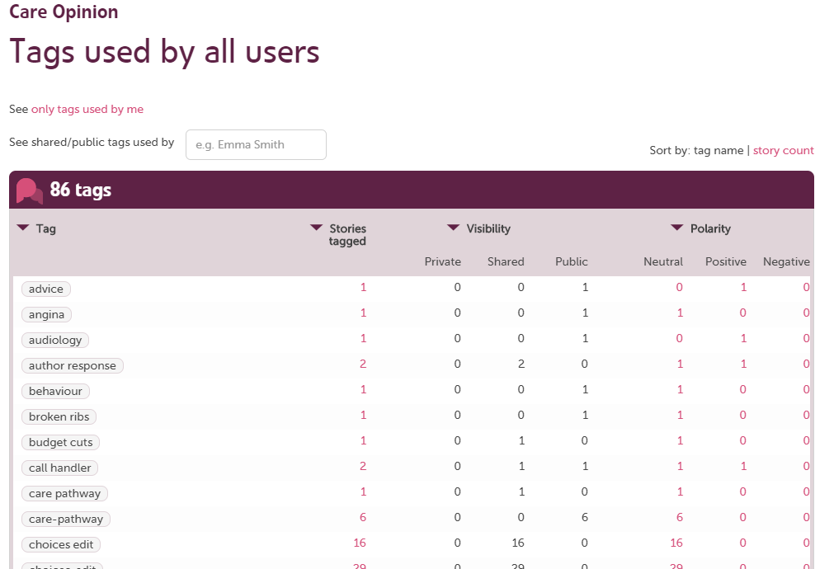
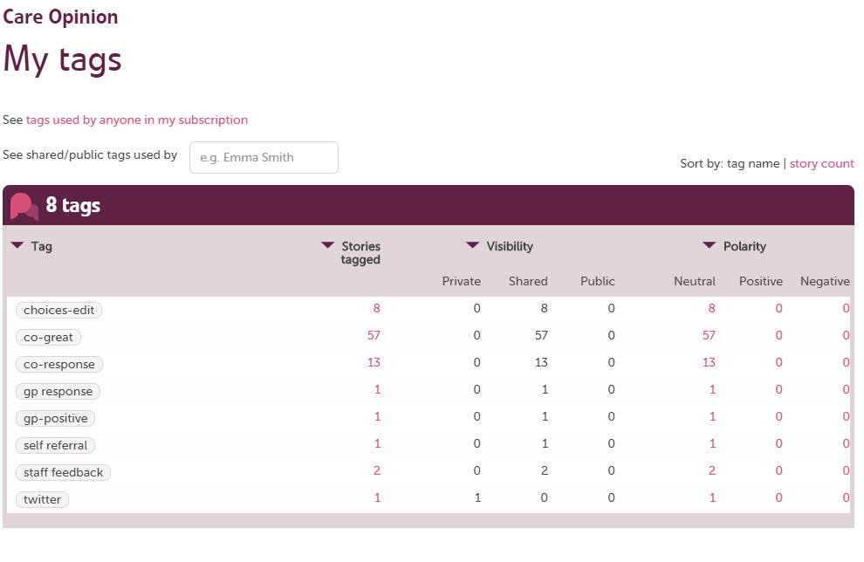
Notes:
https://www.careopinion.org.uk/secondarytags/mytags

Slide 24
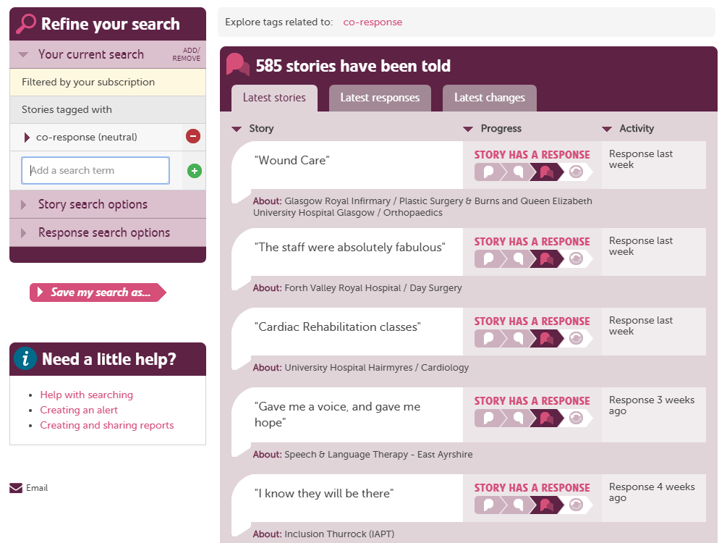
Notes:
Turn private tags into reports from the search page

Slide 25
Digests - keep key staff in the loop

Slide 26
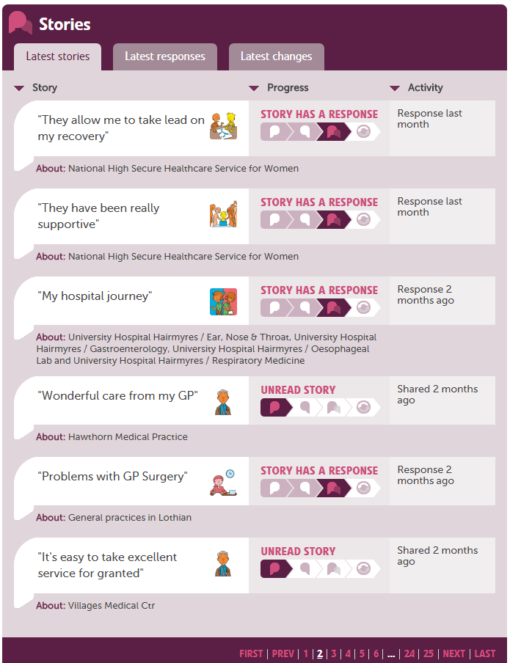

Slide 27
Any questions?
We run fortnightly training on all site features.
https://www.careopinion.org.uk/info/how-to-sessions

Slide 28
Thank
you

