Slide 1


Subscriber chat:
Embedding CO Organisation wide

Slide 2

Camera and Mic
Subscriber chat recording
Subscriber chat follow up email

Slide 3

What to expect in today’s session
Scan here for access to today’s Padlet
Welcome to everyone this afternoon
Please do share your name and trust in the chat box
Learn about the different ways that CO can be rolled out-there is no right or wrong way-it really is a case of whatever works best for you
3 presentations from trust leads:
  Kate Wood-Herefordshire and Worcestershire Health and Care NHS Trust
  Natasha Collinson-Rotherham, Doncaster and South Humber NHS Foundation Trust
  Jo Goodwin Worton-Midlands Partnership University NHS Foundation Trust
Have a chat-what are your thoughts?
Notes:
Welcome all
Combination of speakers and chat
Introduce speakers
Can everyone say hello in the chat-don’t forget to tell us where you are from
We will learn about how trusts have rolled out CO-there’s no right there’s just a way-pick out the bits that suit you and your trust/service the best

Slide 4
How do you roll out CO?
There’s no one single right way
There are 2 clearly defined ways, but these can be adapted to suit your needs
  Organisation wide roll out
  Incrementally
  service by service
    Directorate
    pilot areas
Let’s look at some guidance

Slide 5
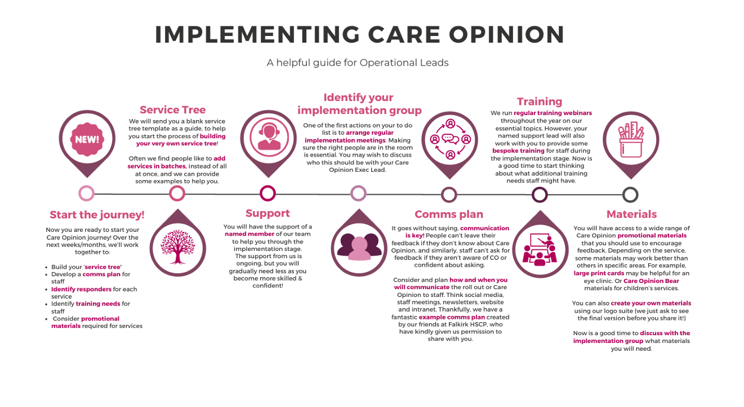

Slide 6
Guidance and implementation plans
Know your service tree-how up-to-date is your service tree? Does it need some work?
  Service tree info
  How to download a copy of your service tree
Support implementation guide.pdf
CO Implementation Action Plan
Comms plan
Check list for service managers

Slide 7
Over to:
  Kate Wood-Herefordshire and Worcestershire Health and Care NHS Trust
  Natasha Collinson-Rotherham, Doncaster and South Humber NHS Foundation Trust
  Jo Goodwin Worton-Midlands Partnership University NHS Foundation Trust

Slide 8


Time for a chat and to share your thoughts

