Slide 1

Talking Mats
Why do we keep talking about Talking Mats?

Slide 2
Tell your story
Example Story

Slide 3


Slide 4
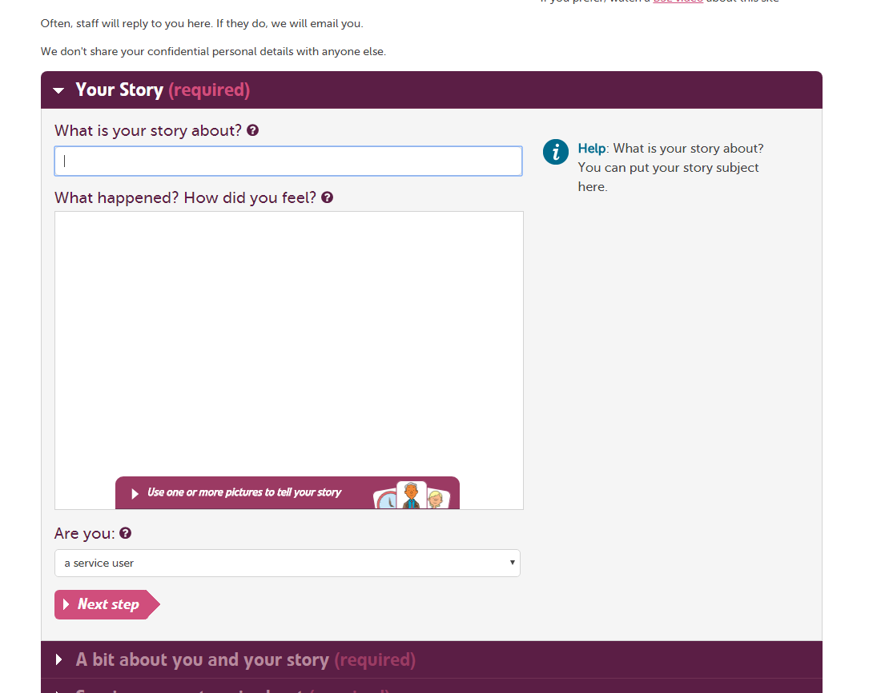

Slide 5
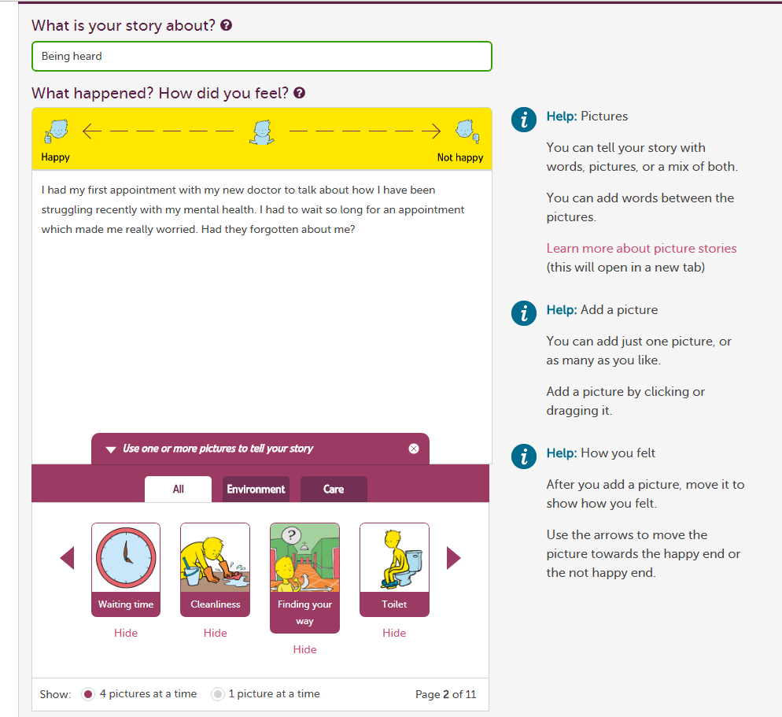

Slide 6
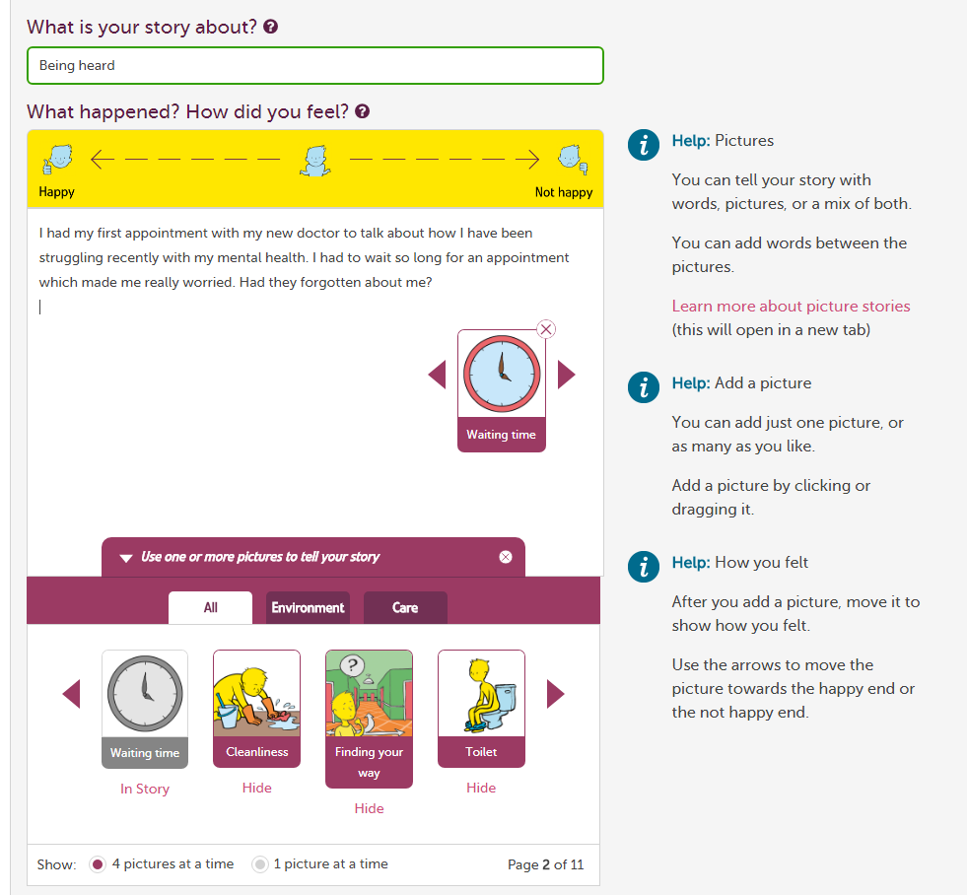

Slide 7
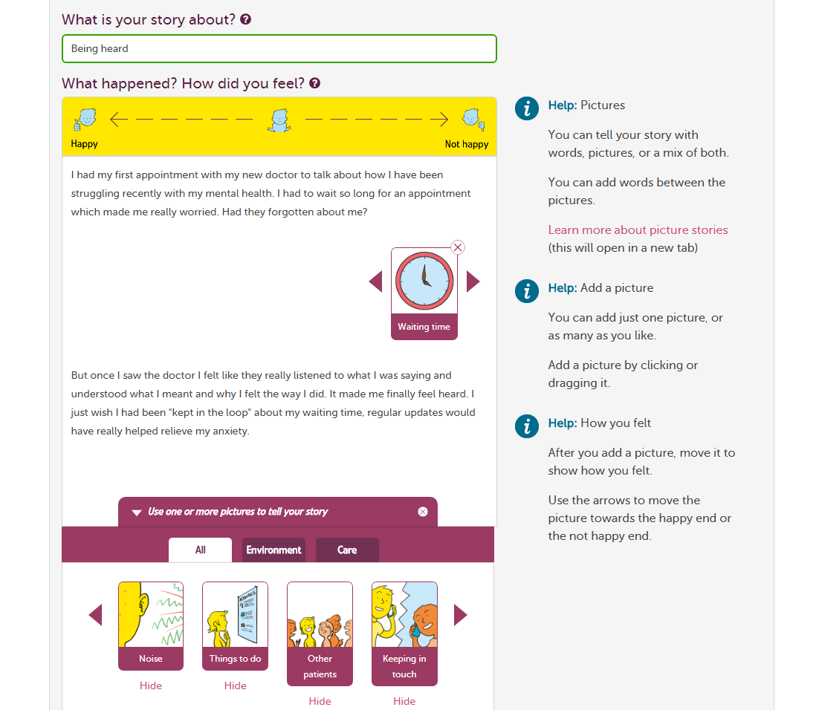

Slide 8
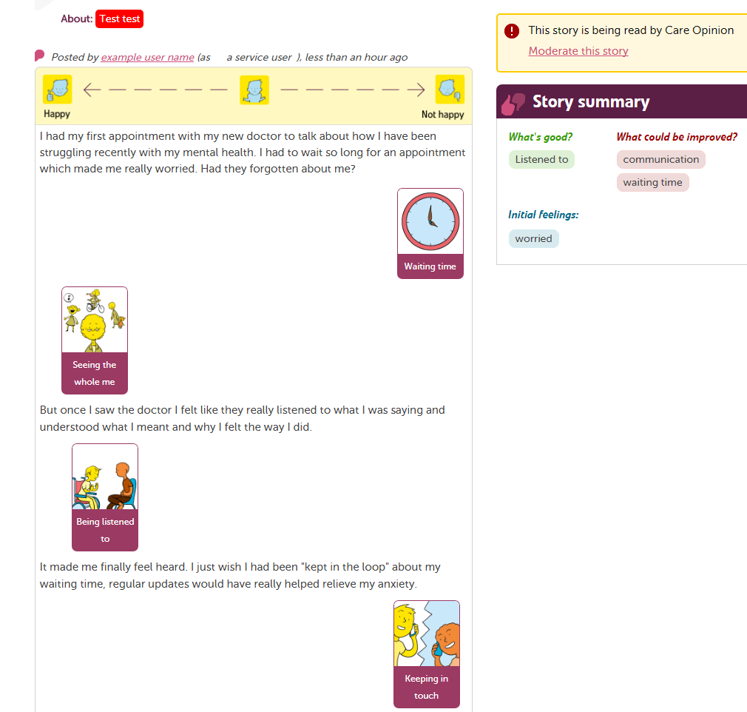

Slide 9
If you have any questions at all about using Talking Mats just get in touch.
cally.bowman@careopinion.org.uk

