Slide 1

Visualisations & Reports

Slide 2
What are Visualisations and why are they helpful?

Slide 3
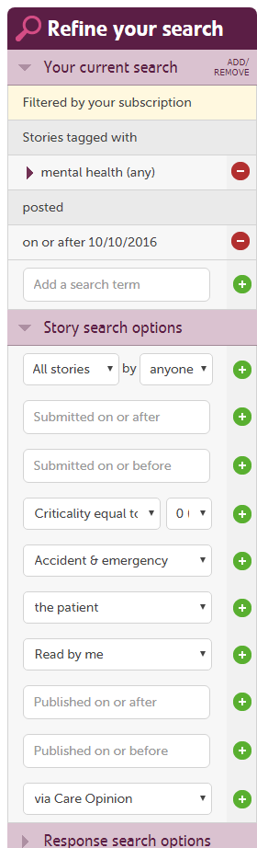

Slide 4
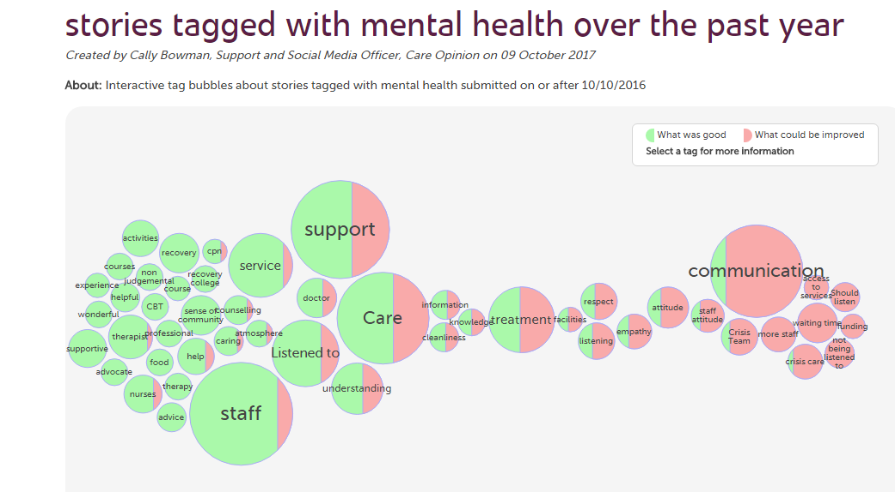
The search produces this visualisation

Slide 5
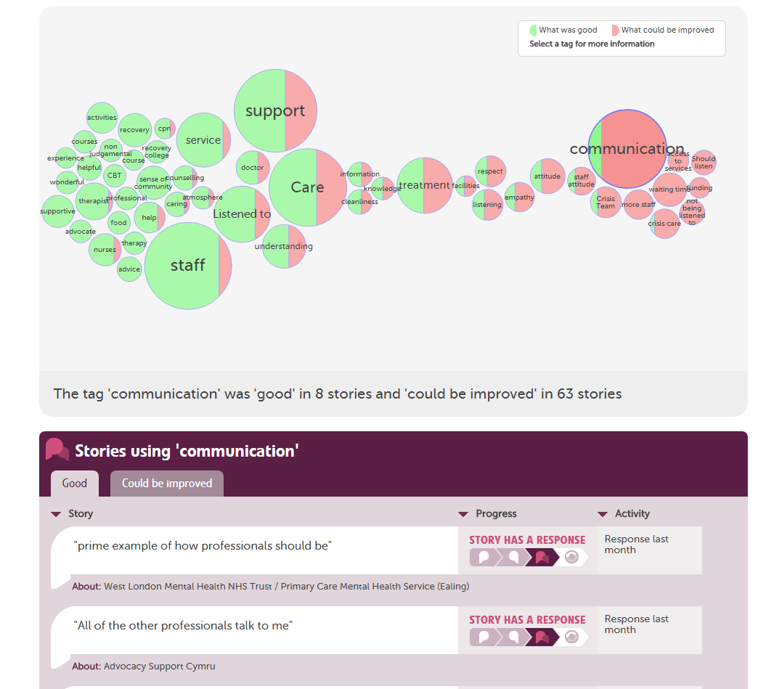

Slide 6
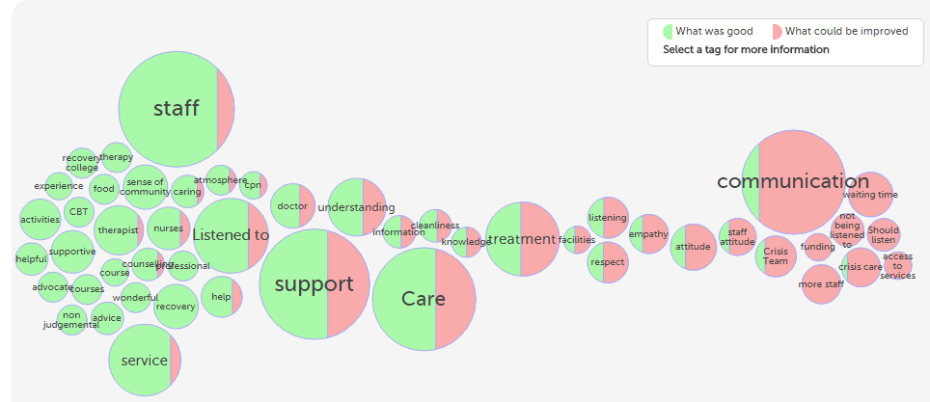
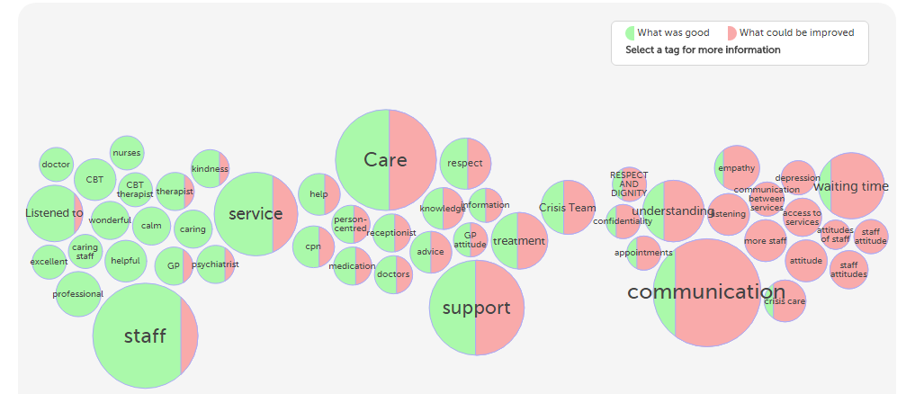
These visualisations give you a:
- fast and easy overview of what’s going well &…
- what could be improved
- great for meetings
- comparing and contrasting over time
2016-2017
2015-2016

Slide 7
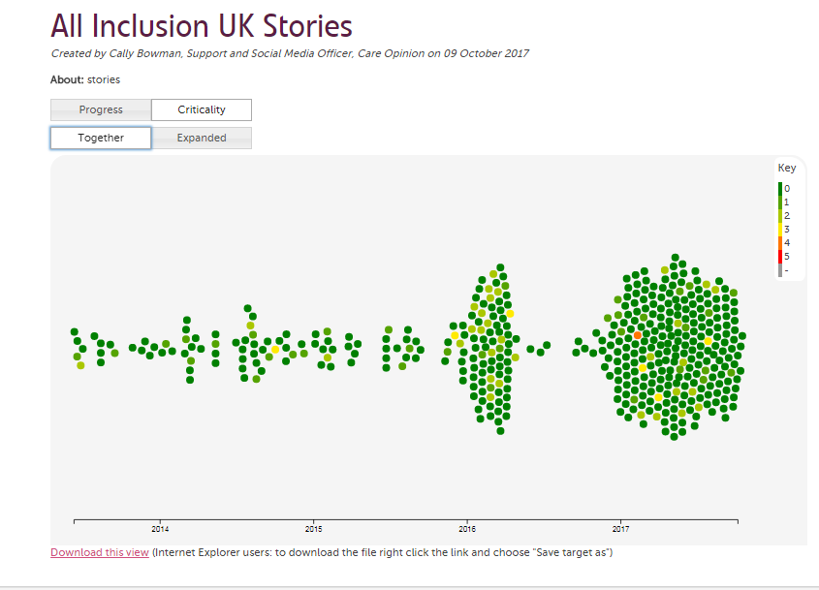
Story Swarm

Slide 8
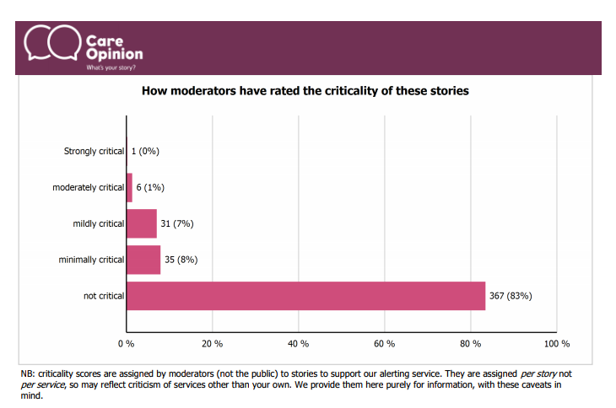

Slide 9
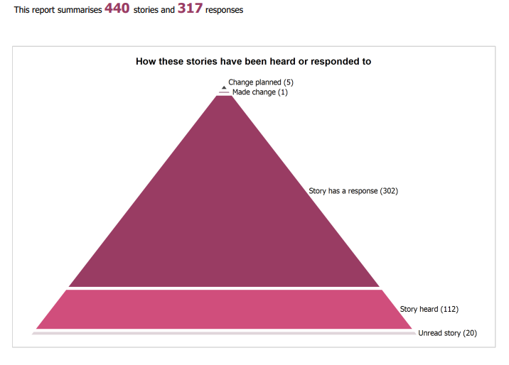

Slide 10


Slide 11

Care Opinion Platform
Reporting and Visualisations
Blogging
Digests
Talking Mats
Subscriber Tagging
Smart Alerts
APIs
Materials
Changes Made

Slide 12
Realising the Benefits of Care Opinion
Changing Staff Culture
Improving Morale
Service and Quality Improvement
Engaging with full range of service users, patients and carers
Sharing engagement with commissioners, Healthwatch and other stakeholders
Social Media
Sharing practice across Trusts and Services
Care Pathways and Integrated Care

Slide 13


